Slide 1
Memory safety, continued again
With material from Mike Hicks, Dave Levin and Michelle Mazurek
http://images.myhardhatstickers.com/img/lg/H/Everybody-Safety-Hard-Hat-Label-HH-0115.gif

Slide 2
Today
Finish up principled defenses
Avoiding exploitation
Memory violations possible but not harmful

Slide 3
Type safety
Recall
Each object is ascribed a type (int, pointer to int, pointer to function), and
Operations on the object are always compatible with the object’s type
Type safe programs do not “go wrong” at run-time
Type safety is stronger than memory safety
int (*cmp)(char*,char*);
int *p = (int*)malloc(sizeof(int));
*p = 1;
cmp = (int (*)(char*,char*))p;
cmp("hello","bye"); // crash!
Memory safe,
NOT type safe

Slide 4
Why not type safety?
C/C++ often chosen for performance reasons
Manual memory management
Tight control over object layouts
Interaction with low-level hardware
Enforcement of type safety is typically expensive
Garbage collection avoids temporal violations
Can be as fast as malloc/free, often uses much more memory
Bounds and null-pointer checks avoid spatial violations
Hiding representation may inhibit optimization
Many C-style casts, pointer arithmetic, & operator, not allowed

Slide 5
A new hope?
Many applications do not need C/C++
Or the risks that come with it
New languages aim to provide similar features to C/C++ while remaining type safe
Google’s Go, Mozilla’s Rust, Apple’s Swift

Slide 6
Avoiding exploitation
https://www.amazon.com/Avoid-Huge-Ships-John-Trimmer/dp/0870334336

Slide 7
Until we have a widespread type-safe replacement for C, what can we do?
Make bugs harder to exploit
Crash but not code execution
Avoid bugs with better programming
Secure coding practices, code review, testing
Better together: Try to avoid bugs, but also add protection if some slip through

Slide 8
Avoiding exploitation
Recall the steps of a stack smashing attack:
Putting attacker code into memory
(No zeroes or other stoppers)
Getting %eip to point to attacker code
Finding the return address
How can we make these attack steps more difficult?

Slide 9
Side note: How to implement fixes?
Goal: change libraries, compiler, or OS
Fix architectural design, not code
Avoid changing (lots of) application code
One update fixes all programs at once

Slide 10
Avoiding exploitation
Recall the steps of a stack smashing attack:
Putting attacker code into memory
(No zeroes or other stoppers)
Getting %eip to point to attacker code
Finding the return address
How can we make these attack steps more difficult?

Slide 11
Detecting overflows with canaries
19th century coal mine integrity
Is the mine safe?
Dunno; bring in a canary
If it dies, abort!
We can do the same for stack integrity!

Slide 12
Detecting overflows with canaries
%eip
Text
...
00 00 00 00
02 8d e2 10
%ebp
%eip
0xbdf
&arg1
nop nop nop …
…
\x0f \x3c \x2f ...
buffer
canary
Check canary just before every function return.
Not the expected value: abort!
What value should the canary have?

Slide 13
Canary values
Terminator canaries (CR, LF, NUL (i.e., 0), -1)
Leverages the fact that scanf etc. don’t allow these
Random canaries
Write a new random value @ each process start
Save the real value somewhere in memory
Must write-protect the stored value
Random XOR canaries
Same as random canaries
But store canary XOR some control info, instead

Slide 14
Other canary tricks
Put canaries in heap metadata
Reorganize locals to put buffers above pointers
Buffers can only overwrite themselves, canary
[ProPolice]
Global return stack [StackShield]
Copy ret address from separate stack every time

Slide 15
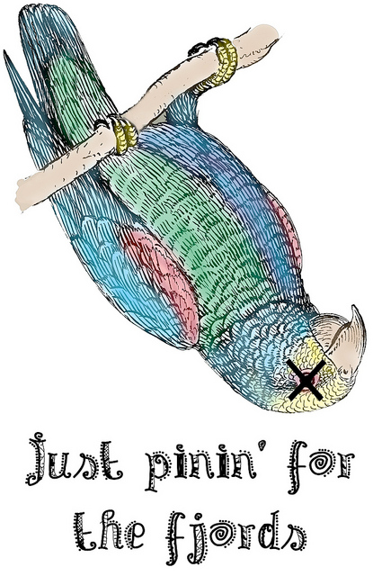
Canary weaknesses
Overwrite function pointer
Overwrite local variable pointer to indirectly reference eip
Anything not stack (heap, etc.)
Bad randomization
Memory is not necessarily secret
Buffer overreads
Read via crash
https://yy1.staticflickr.com/6127/5953402062_a2e35ff01b_z.jpg

Slide 16
Overread example
From Strackx et al.
void vulnerable(char *name_in)
{
char buf[10];
strncpy(buf, name_in, sizeof(buf));
printf("Hello, %s\n", buf);
}
name_in = “0123456789ABC”
does not
append NULL
prints until NULL
Text
...
36 37 38 39
%ebp
%eip
&arg1
…
00 00 00 00
02 8d e2 10
buf
canary
Strncpy is “safe” because it won’t overwrite
But string not properly terminated

Slide 17
Avoiding exploitation
Recall the steps of a stack smashing attack:
Putting attacker code into memory
Getting %eip to point to attacker code
Finding the return address
Defense: Stack Canaries
How can we make these attack steps more difficult?

Slide 18
Goal: Don’t run attacker code
Defense: Make stack non-executable
Try to jump to attacker shellcode in the stack, panic instead
http://www.ipadforums.net/wallpapers/data/2/DontPanic.png

Slide 19
Return-to-libc
known location
Only need to know where libc is
good guess
%eip
padding
...
0x17f
Text
00 00 00 00
%ebp
0xbdf
0x20d
%eip
&arg1
..
\x0f \x3c \x2f ...
nop nop nop ...
libc
buffer
nop sled
malicious code
...
exec()
printf()
...
“ /bin/sh “
...
libc

Slide 20
Avoiding exploitation
Recall the steps of a stack smashing attack:
Putting attacker code into memory
Getting %eip to point to attacker code
Finding the return address
Defense: Stack Canaries
]
Defense: Non-executable stack (kind of)
How can we make these attack steps more difficult?

Slide 21
Address-space layout randomization
Randomly place some elements in memory
Make it hard to find libC functions
Make it hard to guess where stack (shellcode) is

Slide 22
Return-to-libc, thwarted
unknown locations
%eip
padding
Text
...
00 00 00 00
%ebp
%eip
&arg1
..
???
???
libc
buffer
...
exec()
printf()
...
“/bin/sh “
...
libc

Slide 23
ASLR today
Available on modern operating systems
Linux in 2004, other systems slowly afterwards; most by 2011
Caveats:
Only shifts the offset of memory areas
Not locations within those areas
Possible to use a read exploit to find it
May not apply to program code, just libraries
Need sufficient randomness, or can brute force
32-bit systems: typically16 bits = 65536 possible starting positions; sometimes 20 bits. Shacham brute force attack could defeat this in 216 seconds (2004 hardware)
64-bit systems more promising, e.g., 40 bits possible

Slide 24
Cat and mouse
Defense: Make stack/heap non-executable to prevent injection of code
Attack response: Return to libc
Defense: Hide the address of desired libc code or return address using ASLR
Attack response: Brute force search or information leak
Defense: Avoid/limit use of libc code
Attack response: Construct needed functionality using return oriented programming (ROP)

Slide 25
Return oriented programming (ROP)

Slide 26
Return-oriented Programming
Introduced by Hovav Shacham, CCS 2007
Idea: rather than use a single (libc) function to run your shellcode, string together pieces of existing code, called gadgets, to do it instead
Challenges
Find the gadgets you need
String them together

Slide 27
Approach
Gadgets are instruction groups that end with ret
Stack serves as the code
%esp = program counter
Gadgets invoked via ret instruction
Gadgets get their arguments via pop, etc.
Also on the stack

Slide 28
Simple example
%eip
(ret)
0x17f: pop %edx
ret
goal: put 5 into edx
mov %edx, 5
Gadget
“program counter”
%esp
Text
…
0x17f
5
next
gadget
%edx
5
“Instructions”
0x00
0xffffffff

Slide 29
Code sequence (no ROP)
0x17f: mov %eax, [%esp]
mov %ebx, [%esp+8]
mov [%ebx], %eax
%eip
%eax
%ebx
5
0x404
%esp
Text
5
…
5
…
0x404
…
…
0x00
0x404
0xffffffff

Slide 30
Equivalent ROP sequence
0x17f: pop %eax
ret
…
0x20d: pop %ebx
ret
…
0x21a: mov [%ebx], %eax
%eip
%eax
%ebx
5
0x404
%esp
Text
5
…
5
0x20d
0x404
0x21a
…
0x00
0x404
0xffffffff

Slide 31
Image by Dino Dai Zovi

Slide 32
Whence the gadgets?
How can we find gadgets to construct an exploit?
Automated search: look for ret instructions, work backwards
Cf. https://github.com/0vercl0k/rp
Are there sufficient gadgets to do anything interesting?
For significant codebases (e.g., libc), Turing complete
Especially true on x86’s dense instruction set
Schwartz et al. (USENIX Sec’11) automated gadget shellcode creation, Turing complete not required

Slide 33
Control Flow Integrity

Slide 34
Behavior-based detection
Stack canaries, non-executable data, ASLR make standard attacks harder / more complicated, but may not stop them
Idea: observe the program’s behavior — is it doing what we expect it to?
If not, might be compromised
Challenges
Define “expected behavior”
Detect deviations from expectation efficiently
Avoid compromise of the detector

Slide 35
Control-flow Integrity (CFI)
Define “expected behavior”:
Detect deviations from expectation efficiently
Avoid compromise of the detector
Control flow graph (CFG)

Slide 36
Call Graph
sort2(int a[], int b[], int len)
{
sort(a, len, lt);
sort(b, len, gt);
}
bool lt(int x, int y) {
return x<y;
}
bool gt(int x, int y) {
return x>y;
}
sort2
lt
sort
gt
Which functions call other functions

Slide 37
Control Flow Graph
sort2(int a[], int b[], int len)
{
sort(a, len, lt);
sort(b, len, gt);
}
bool lt(int x, int y) {
return x<y;
}
bool gt(int x, int y) {
return x>y;
}
sort2
lt
sort
gt
Break into basic blocks
Distinguish calls from returns

Slide 38
CFI: Compliance with CFG
Compute the call/return CFG in advance
During compilation, or from the binary
Monitor the control flow of the program and ensure that it only follows paths allowed by the CFG
Observation: Direct calls need not be monitored
Assuming the code is immutable, the target address cannot be changed
Therefore: monitor only indirect calls
jmp, call, ret with non-constant targets

Slide 39
Control Flow Graph
sort2(int a[], int b[], int len)
{
sort(a, len, lt);
sort(b, len, gt);
}
bool lt(int x, int y) {
return x<y;
}
bool gt(int x, int y) {
return x>y;
}
sort2
lt
sort
gt
Direct calls (always the same target)

Slide 40
Control Flow Graph
sort2(int a[], int b[], int len)
{
sort(a, len, lt);
sort(b, len, gt);
}
bool lt(int x, int y) {
return x<y;
}
bool gt(int x, int y) {
return x>y;
}
sort2
lt
sort
gt
Indirect transfer (call via register, or ret)

Slide 41
Control-flow Integrity (CFI)
Define “expected behavior”:
Detect deviations from expectation efficiently
Avoid compromise of the detector
Control flow graph (CFG)
In-line reference monitor (IRM)

Slide 42
In-line Monitor
Implement the monitor in-line, as a program transformation
Insert a label just before the target address of an indirect transfer
Insert code to check the label of the target at each indirect transfer
Abort if the label does not match
The labels are determined by the CFG

Slide 43
Simplest labeling
sort2
lt
label L
sort
label L
label L
gt
label L
label L
Use the same label at all targets: label just means it’s OK to jump here.
What could go wrong?

Slide 44
Simplest labeling
sort2
lt
label L
sort
label L
label L
gt
label L
label L
ok…
system
Can’t return to functions that aren’t in the graph
Can return to the right function in the wrong order

Slide 45
Detailed labeling
sort2
lt
label M
sort
label L
label N
gt
label L
label M
ok…
All potential destinations of same source must match
Return sites from calls to sort must share a label (L)
Call targets gt and lt must share a label (M)
Remaining label unconstrained (N)
Prevents more abuse than simple labels,
but still permits call from site A to return to site B

Slide 46
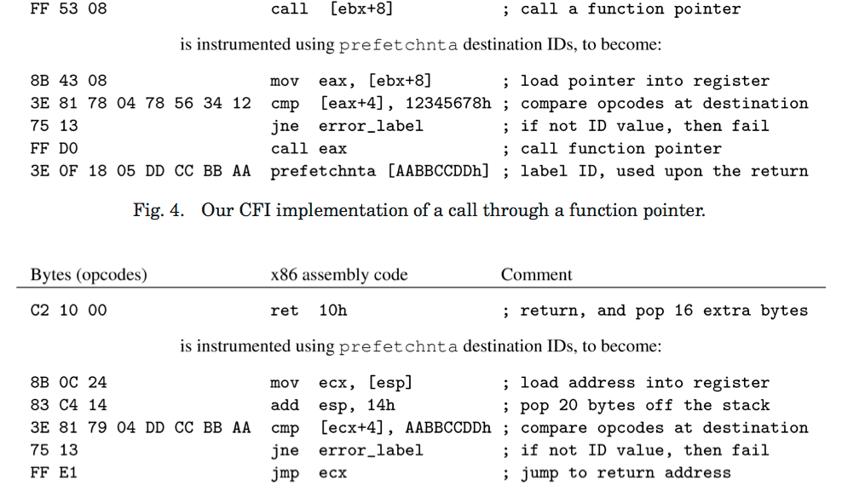
Classic CFI instrumentation
Before CFI
After CFI

Slide 47
Classic CFI instrumentation

Slide 48
Efficient?
Classic CFI (2005) imposes 16% overhead on average, 45% in the worst case
Works on arbitrary executables
Not modular (no dynamically linked libraries)
Modular CFI (2014) imposes 5% overhead on average, 12% in the worst case
C only
Modular, with separate compilation
http://www.cse.lehigh.edu/~gtan/projects/upro/

Slide 49
Control-flow Integrity (CFI)
Define “expected behavior”:
Detect deviations from expectation efficiently
Avoid compromise of the detector
Control flow graph (CFG)
In-line reference monitor (IRM)
Sufficient randomness, immutability

Slide 50
Can we defeat CFI?
Inject code that has a legal label
Won’t work because we assume non-executable data
Modify code labels to allow the desired control flow
Won’t work because the code is immutable
Modify stack during a check, to make it seem to succeed
Won’t work because adversary cannot change registers into which we load relevant data

Slide 51
CFI Assurances
CFI defeats control flow-modifying attacks
Remote code injection, ROP/return-to-libc, etc.
But not manipulation of control-flow that is allowed by the labels/graph
Called mimicry attacks
The simple, single-label CFG is susceptible to these
Nor data leaks or corruptions
Heartbleed would not be prevented
Nor the authenticated overflow
Which is allowed by the graph
void func(char *arg1)
{
int authenticated = 0;
char buffer[4];
strcpy(buffer, str);
if(authenticated) { ...
}

Slide 52
Secure?
MCFI can eliminate 95.75% of ROP gadgets on x86-64 versions of SPEC2006 benchmark suite
By ruling their use non-compliant with the CFG
Average Indirect-target Reduction (AIR) > 99%
Essentially, the percentage of possible targets of indirect jumps that CFI rules out

