Slide 1
Memory safety, continued again
With material from Mike Hicks, Dave Levin and Michelle Mazurek
http://images.myhardhatstickers.com/img/lg/H/Everybody-Safety-Hard-Hat-Label-HH-0115.gif

Slide 2
Last time
Buffer Overflows
Other memory attacks

Slide 3
Today
Principled defenses
Avoiding exploitation
Memory violations possible but not harmful

Slide 4
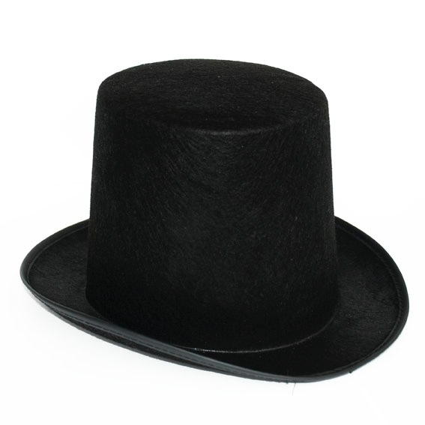
Time to switch hats
We have seen many styles of attack
How can we defend against them?

Slide 5
Defenses
Against memory and buffer attacks
http://www.full-stop.net/wp-content/uploads/2012/05/Great-wall-of-china.jpeg

Slide 6
Stepping back
What do these attacks have in common?
The attacker is able to control some data that is used by the program
The use of that data permits unintentional access to some memory area in the program
Past a buffer
To arbitrary positions on the stack / in the heap

Slide 7
Outline
Memory safety and type safety
Properties that, if satisfied, ensure an application is immune to memory attacks
Automatic defenses
Stack canaries
Address space layout randomization (ASLR)
Return-oriented programming (ROP) attack
How Control Flow Integrity (CFI) can defeat it
Secure coding

Slide 8
Memory Safety
https://diarrheapolice.files.wordpress.com/2015/08/elephant-bicycle-never-forget.png?w=590&h=334

Slide 9
What is memory safety?
A memory safe program execution:
Only creates pointers through standard means
p = malloc(...), or p = &x, or p = &buf[5], etc.
Only uses a pointer to access memory that “belongs” to that pointer
Combines two ideas:
temporal safety and spatial safety
Notes:
THINK/PAIR/SHARE: what are properties of memory safety? how would you define it? what rules are needed / what is ensured?

Slide 10
Spatial safety
View pointers as capabilities: triples (p,b,e)
p is the actual pointer (current address)
b is the base of the memory region it may access
e is the extent (bounds) of that region (count)
Access allowed iff b ≤ p ≤ (e-sizeof(typeof(p)))
Operations:
Pointer arithmetic increments p, leaves b and e alone
Using &: e determined by size of original type

Slide 11
Examples
int x; // assume sizeof(int)=4
int *y = &x; // p = &x, b = &x, e = &x+4
int *z = y+1; // p = &x+4, b = &x, e = &x+4
*y = 3; // OK: &x ≤ &x ≤ (&x+4)-4
*z = 3; // Bad: &x ≤ &x+4 ≤ (&x+4)-4
struct foo {
char buf[4];
int x;
};
struct foo f = { "cat", 5 };
char *y = &f.buf; // p = b = &f.buf, e = &f.buf+4
y[3] = ‘s’; // OK: p = &f.buf+3 ≤ (&f.buf+4)-1
y[4] = ‘y’; // Bad: p = &f.buf+4 ≤ (&f.buf+4)-1

Slide 12
Visualized example
struct foo {
int x;
int y;
char *pc;
};
struct foo *pf = malloc(...);
pf->x = 5;
pf->y = 256;
pf->pc = "before";
pf->pc += 3;
int *px = &pf->x;
p
b
e
p
b
e
pf:
px:
p
b
e
5
256
b
e
f
o
r
e
⍉

Slide 13
No buffer overflows
A buffer overflow violates spatial safety
Overrunning bounds of source and/or destination buffers implies either src or dst is illegal
void copy(char *src, char *dst, int len)
{
int i;
for (i=0;i<len;i++) {
*dst = *src;
src++;
dst++;
}
}

Slide 14
No format string attacks
The call to printf dereferences illegal pointers
View the stack as a buffer defined by the number and types of the arguments it provides
The extra format specifiers construct pointers beyond the end of this buffer and dereference them
Essentially a kind of buffer overflow
char *buf = "%d %d %d\n";
printf(buf);

Slide 15
Temporal safety
Violated when trying to access undefined memory
Spatial safety assures it was to a legal region
Temporal safety assures that region is still in play
Memory regions either defined or undefined
Defined means allocated (and active)
Undefined means unallocated, uninitialized, or deallocated
Pretend memory is infinitely large, no reuse

Slide 16
No dangling pointers
Accessing a freed pointer violates temporal safety
The memory dereferenced no longer belongs to p.
Accessing uninitialized pointers is similarly not OK:
int *p = malloc(sizeof(int));
*p = 5;
free(p);
printf("%d\n",*p); // violation
int *p;
*p = 5; // violation

Slide 17
Integer overflows?
int f() {
unsigned short x = 65535;
x++; // overflows to become 0
printf("%d\n",x); // memory safe
char *p = malloc(x); // size-0 buffer!
p[1] = ‘a’; // violation
}
Integer overflows are themselves allowed
But can’t become illegal pointers
Integer overflows often enable buffer overflows
For more on memory safety, see
http://www.pl-enthusiast.net/2014/07/21/memory-safety/

Slide 18
How to get memory safety?
The easiest way to avoid all of these vulnerabilities is to use a memory-safe language
Modern languages are memory safe
Java, Python, C#, Ruby
Haskell, Scala, Go, Objective Caml, Rust
In fact, these languages are type safe, which is even better (more on this shortly)

Slide 19
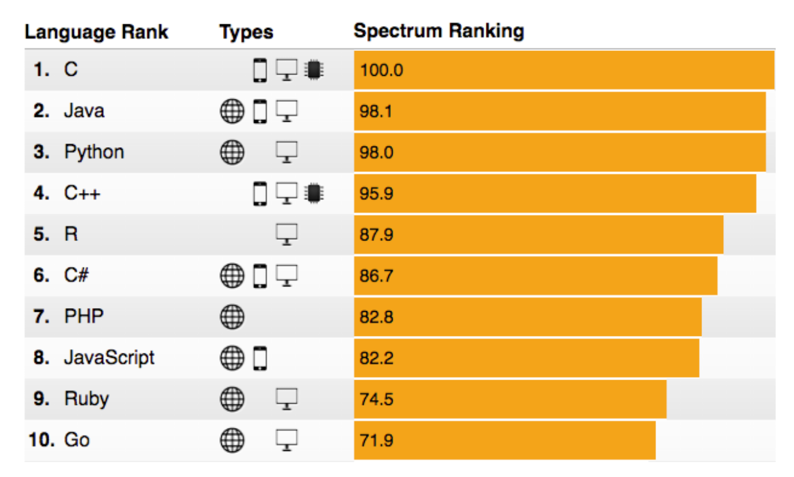
C and C++ still very popular
Recall
spectrum.ieee.org/computing/software/the-2016-top-programming-languages

Slide 20
Memory safety for C
C/C++ are here to stay.
You can write memory safe programs with them
But the language provides no guarantee
Compilers could add code to check for violations
Out-of-bounds: immediate failure (Java ArrayBoundsException)
This idea has been around for more than 20 years. Performance has been the limiting factor.
Work by Jones and Kelly in 1997 adds 12x overhead
Valgrind memcheck adds 17x overhead

Slide 21
Research progress
CCured (2004), 1.5x slowdown
But no checking in libraries
Compiler rejects many safe programs
Softbound/CETS (2010): 2.16x slowdown
Complete checking, highly flexible
Intel MPX hardware (2015 in Linux)
Hardware support to make checking faster
ccured
https://software.intel.com/en-us/blogs/2013/07/22/intel-memory-protection-extensions-intel-mpx-support-in-the-gnu-toolchain
Notes:
click on link to show MPX example!!!!

Slide 22
Type Safety
https://a.dilcdn.com/bl/wp-content/uploads/sites/8/2014/02/typewriterfont.jpg

Slide 23
Type safety
Each object is ascribed a type (int, pointer to int, pointer to function), and
Operations on the object are always compatible with the object’s type
Type safe programs do not “go wrong” at run-time
Type safety is stronger than memory safety
int (*cmp)(char*,char*);
int *p = (int*)malloc(sizeof(int));
*p = 1;
cmp = (int (*)(char*,char*))p;
cmp("hello","bye"); // crash!
Memory safe,
NOT type safe

Slide 24
Aside: Dynamic Typing
Dynamically typed languages
Don’t require type declaration
e.g., Ruby and Python (typically interpreted languages)
Can be viewed as type safe
Type-checking is done at runtime not compile time!

Slide 25
Types for Security
Use types to enforce security property invariants
Invariants about data’s privacy and integrity
Enforced by the type checker
Example: Java with Information Flow (JIF)
int{Alice, Bob} x;
int{Alice, Bob, Chuck} y;
x = y; //OK: policy on x is stronger
y = x; //BAD: policy on y is weaker
Types have security labels that govern information flow
http://www.cs.cornell.edu/jif
Notes:
Only Alice and Bob can know x
Alice, Bob and Chuck can know y
x=y: Alice and Bob can find out y, that’s OK
y=x: Chuck can find out x, that’s NOT OK
(this is somewhat counter-intuitive to many people)

Slide 26
Why not type safety?
C/C++ often chosen for performance reasons
Manual memory management
Tight control over object layouts
Interaction with low-level hardware
Enforcement of type safety is typically expensive
Garbage collection avoids temporal violations
Can be as fast as malloc/free, often uses much more memory
Bounds and null-pointer checks avoid spatial violations
Hiding representation may inhibit optimization
Many C-style casts, pointer arithmetic, & operator, not allowed

Slide 27
A new hope?
Many applications do not need C/C++
Or the risks that come with it
New languages aim to provide similar features to C/C++ while remaining type safe
Google’s Go, Mozilla’s Rust, Apple’s Swift

