Slide 1
Introduction
ENEE 457/CMSC 498E
Computer Systems Security
Fall 2017
Dana Dachman-Soled
Includes material from Prof. Michelle Mazurek and Prof. Dave Levin

Slide 2
Normally, we care about correctness
Does software achieve desired behavior?
Security is a kind of correctness
Does software prevent undesired behavior?
The key difference is the adversary!
Notes:
Adversary: active, intentional, malicious. Seeks to circumvent protections.

Slide 3
What are undesired behaviors?
Reveals info that users want to hide
Corporate secrets, private data, PII
Privacy/Confidentiality
Modifies info or functionality
Destroy records, change data mid-processing, install unwanted software
Integrity
Deny access to data or service
Crash website, DoS, fairness

Slide 4
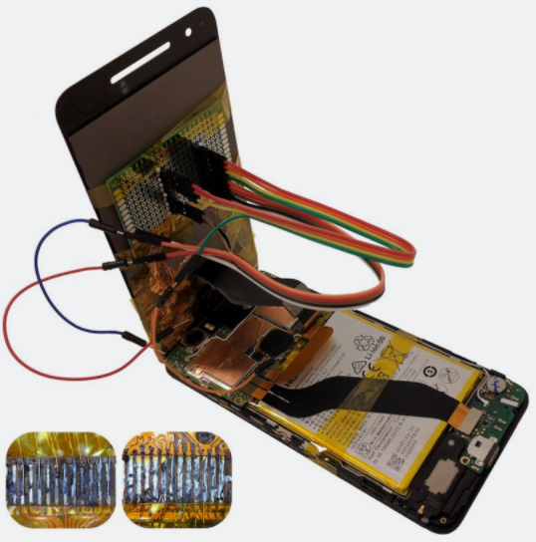
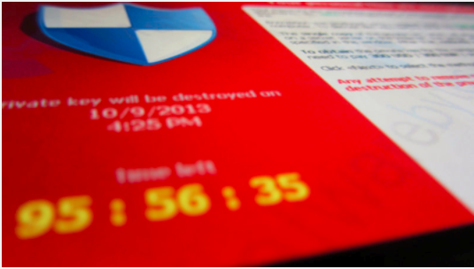
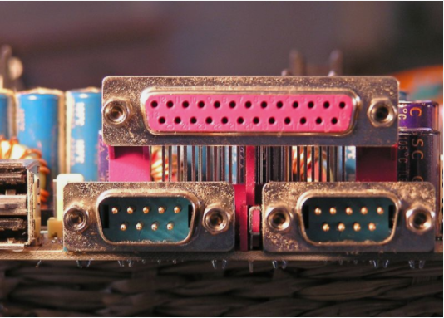
Notes:
These are all from the front page of the Ars Technica security blog.

Slide 5
Why are attacks so common?
Systems are complex, people are limited
Many attacks exploit a vulnerability
A software defect that can be manipulated to yield an undesired behavior
Software defects come from:
Flaws in design
Bugs in implementation

Slide 6
Case study: Heartbleed
SSL is the main protocol for secure (encrypted) online communication
Heartbleed was a vulnerability in the most popular SSL server

Slide 7
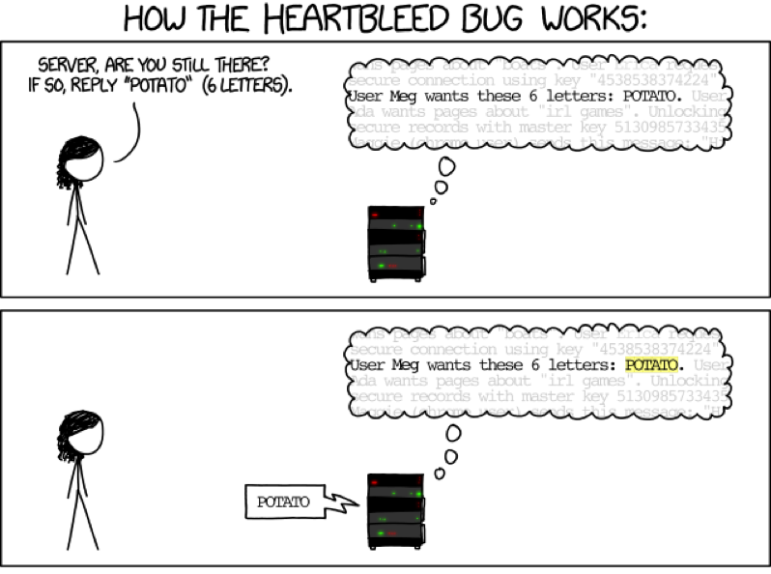
https://xkcd.com/1354/

Slide 8
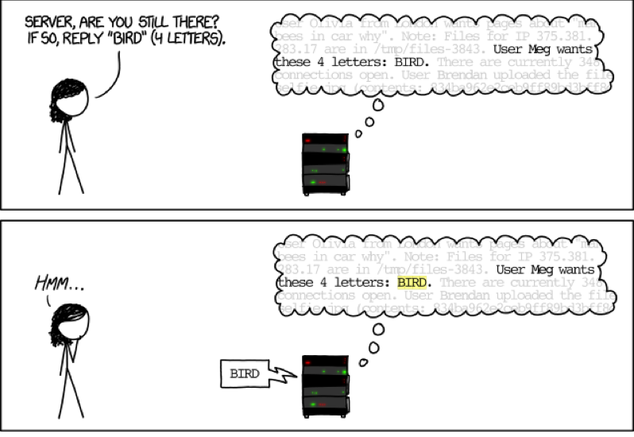

Slide 9
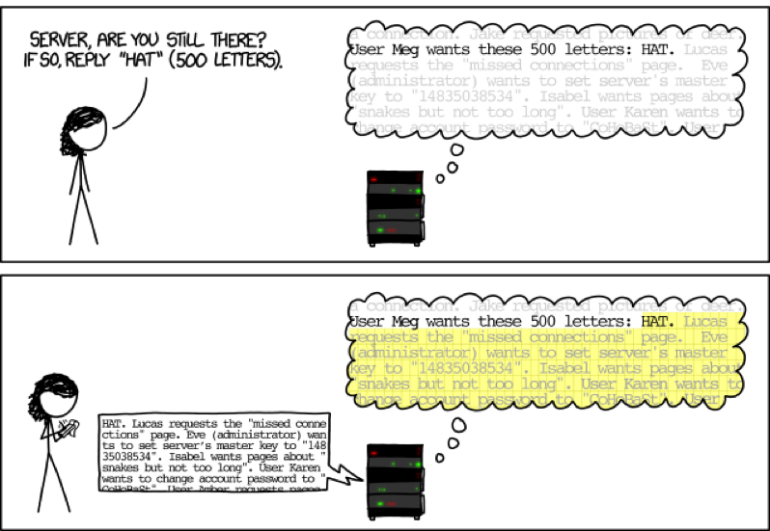

Slide 10
Case study: Heartbleed
SSL is the main protocol for secure (encrypted) online communication
Malformed packet allows you to see server memory
Passwords, keys, emails, visitor logs …..
Fix: Don’t let the user tell you how much data to send back!
This is a design flaw

Slide 11
Why are attacks so common?
Normal users avoid bugs
Adversaries look for them to exploit
Attacks are possible even with perfect software

Slide 12
Why are attacks so common?
Because it’s profitable
(Or attackers think it is)
Because complex systems are only as strong as their weakest link

Slide 13
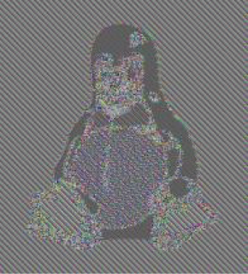
Steps toward more security….
Eliminate bugs or design flaws, or make them harder to exploit
Think like an attacker!
Deeply understand systems we build
Be mindful of user-controlled inputs

Slide 14
Today’s agenda
What is security
Administrivia
C Refresher (Pointers, Memory Allocation)
Closer Look at Heartbleed
Course Survey

Slide 15
Administrivia

Slide 16
People
Me: Dana Dachman-Soled (danadach@ece.umd.edu)
TAs: Xinyu Zhou (xyzhou@terpmail.umd.edu)
Paul Watrobski (ptw@umd.edu)
Notes:
**** NO OFFICE HOURS TODAY

Slide 17
Resources
Make sure to regularly check the class website:
http://www.ece.umd.edu/~danadach/Security_Fall_17/
Announcements, assignments, lecture notes, readings
We will be using the Canvas page for the class
Announcements, grades, HW submission, solutions
We will also use Piazza
Class discussion, questions
You should have received an email invite

Slide 18
Resources
Instructor Office hours: M, T 3:30-4:30pm
If your schedule does not allow you to attend OH, email me for an individual meeting.
TA Office hours: TBD

Slide 19
Reading
Recommended: textbooks, outside resources
Listed on website
Share your recommendations on Piazza

Slide 20
Prerequisite knowledge
Reasonably proficient in C and Unix
Refresher on C pointers/memory allocation (today)
Creative and resourceful
No prior knowledge in networking, crypto

Slide 21
Grading
Projects: 50%
9%, 9%, 9%, 9%, 14%
Last programming assignment is somewhat more involved and will be done in teams.
Midterm: 25%
Tentative date: Monday October 16
Final: 25%
Friday, December 15, 2017, 10am-12pm in our regular classroom.
Notes:
Can talk about class, or anything else – your interests, your plans, research, good TV shows, etc.
If you can’t make my office hours, email to set up a time

Slide 22
Ethics and legality
You will learn about, implement attacks
Do not use them without explicit written consent from everyone involved!
Make sure you know who is involved
If you want to try something, tell me and I will try to help set up a test environment
Don’t violate: Ethics, UMD policies, state and national laws

Slide 23
Read the syllabus
No late homework accepted
Excused absences for exams
Contesting project/exam grade
Academic integrity
Extra Credit opportunities
Notes:
Act like adults, I will treat you that way.
There are 85 of you.

Slide 24
Important: Project 1 (Heartbleed)
Assigned today (8/28)
Due right before class on 9/6
9/6 at 10:59 am
Submission will be done through Canvas

Slide 25
What’s in this course?
Software and Web security
Crypto
Network security
Special Topics (Bitcoin, Side-Channels, and more)

Slide 26
Software security
Memory safety
Malware
Web security
Static analysis
Design principles

Slide 27
What’s in this course?
Software security
Crypto
Network security
Special Topics (Bitcoin, Side-Channels, and more)

Slide 28
Applied crypto
What it is (medium-high level)
How to use it responsibly
Black-box approach
Designing protocols that use crypto
Authentication
Anonymity
Notes:
How do we build secure software?

Slide 29
What’s in this course?
Software security
Crypto
Network security
Special Topics (Bitcoin, Side-Channels, and more)

Slide 30
Network security
How to build secure networked systems
Attacks on TCP, DNS, BGP
Anonymity
Notes:
How do we build secure software?

Slide 31
What’s in this course?
Software security
Crypto
Network security
Special Topics (Bitcoin, Side-Channels, and more)

Slide 32
First Topic: Buffer Overflows

Slide 33
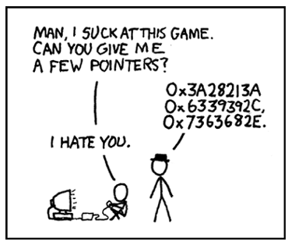
Review: Pointers and Memory Allocation in C

Slide 34
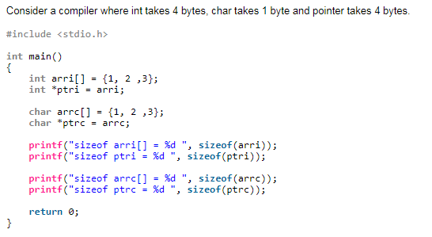
Review: Pointers and Memory Allocation in C

Slide 35
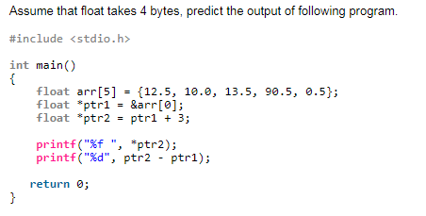
Review: Pointers and Memory Allocation in C

Slide 36
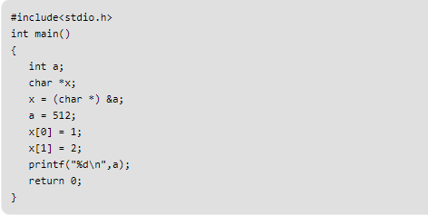
Review: Pointers and Memory Allocation in C
What is the output? Assume little-endian processor.

Slide 37
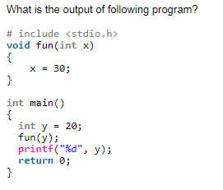
Review: Pointers and Memory Allocation in C

Slide 38
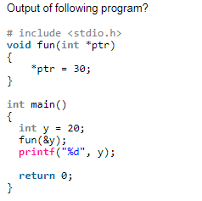
Review: Pointers and Memory Allocation in C

Slide 39
Review: Pointers and Memory Allocation in C

Slide 40
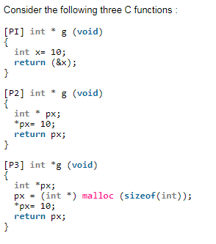
Review: Pointers and Memory Allocation in C

Slide 41
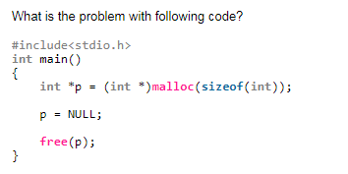
Review: Pointers and Memory Allocation in C

Slide 42
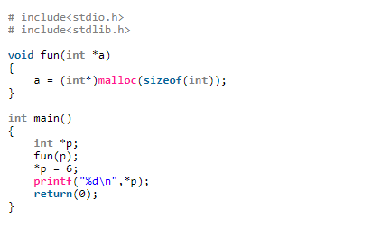
Review: Pointers and Memory Allocation in C

Slide 43
Review: Pointers and Memory Allocation in C

Slide 44
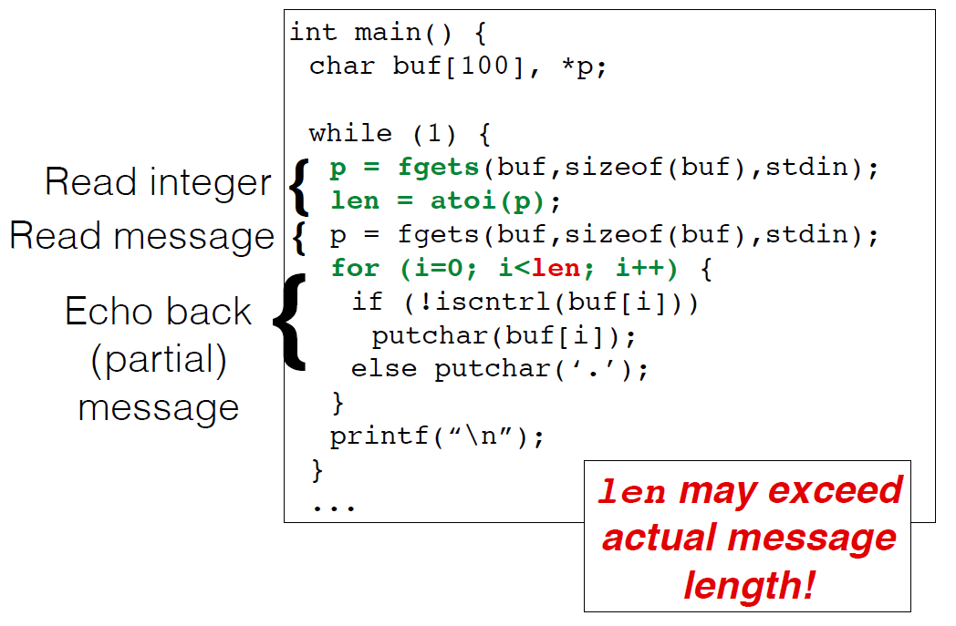
Revisiting Heartbleed: A Closer Look at Buffer Read Overflow
Read Overflow: A bug that permits reading past the end of a buffer.

Slide 45
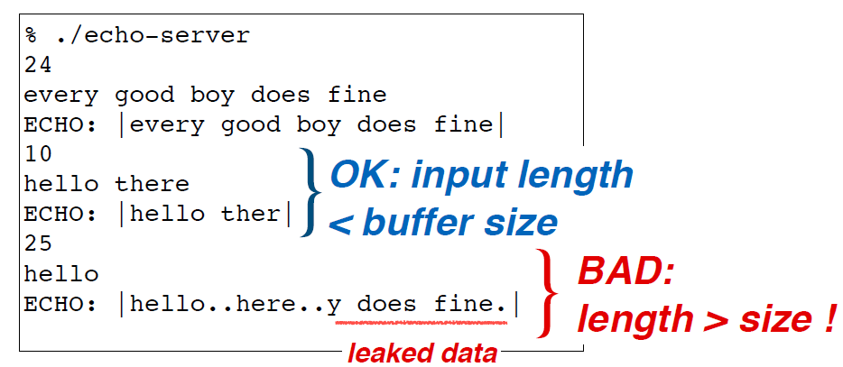
Revisiting Heartbleed: A Closer Look at Buffer Read Overflow
Sample Output:

Slide 46
Revisiting Heartbleed: A Closer Look at Buffer Read Overflow

