Slide 1
ENEE244-02xx Digital Logic Design
Lecture 6

Slide 2
Announcements
Homework 2 due today
Homework 3 up on webpage
Coming up: First midterm on Sept. 30
Will cover material form Lectures 1-7.
List of topics for exam will be posted by the end of the week on course webpage.
Lecture on Thursday, Sept. 25 will be a review session.

Slide 3
Agenda
Last time:
Manipulations of Boolean Formulas (3.6)
Gates and Combinational Networks (3.7)
Incomplete Boolean Functions and Don’t Care Conditions (3.8 )
This time:
Universal Gates (3.9.3)
NAND/NOR/XOR Gate Realizations (3.9.4-3.9.6)
Gate Properties (3.10)

Slide 4
Some Terminology
System specification: A description of the function of a system and of other characteristics required for its use.
A function (table, algebraic) on a finite set of inputs.
Double-rail logic: both variables and their complements are considered as primary inputs.
Single-rail logic: only variables are considered as primary inputs. Need inverters for their complements.

Slide 5
Universal Gates
A gate or set of gates is called universal if it can implement all Boolean functions.
Standard universal gates:
AND, OR, NOT
Proof?
Theorem:
A set of gates $\left\{G_{1}, …, G_{n}\right\}$ is universal if it can implement AND, OR, NOT.

Slide 6
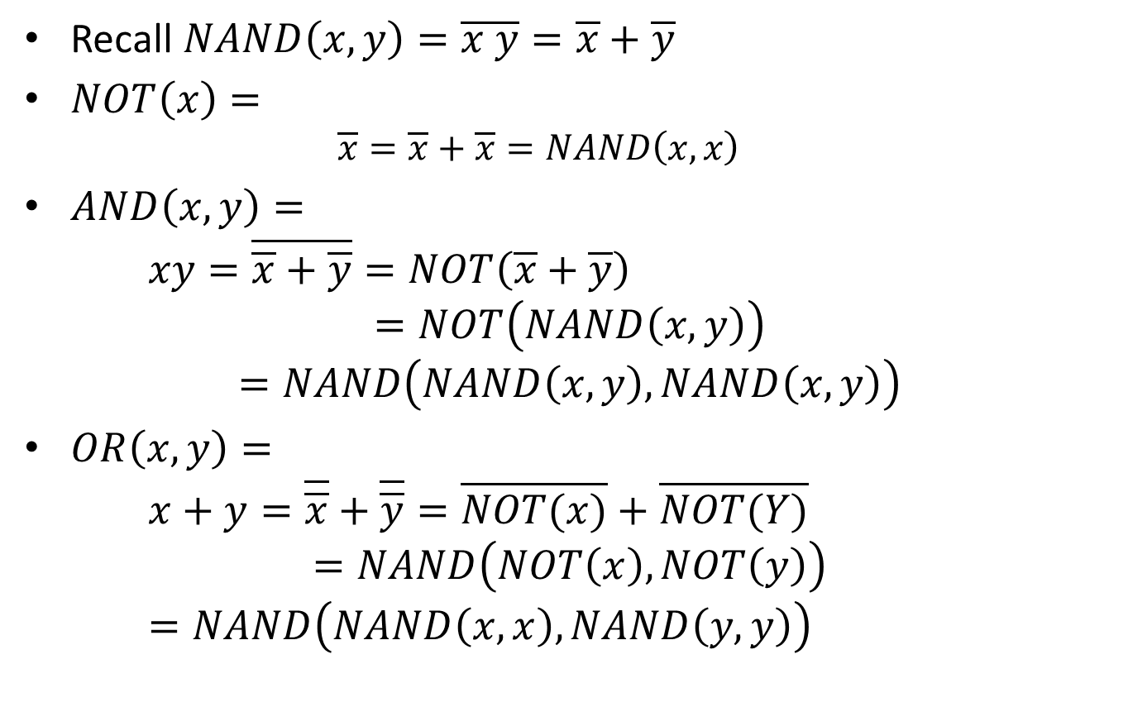
NAND is Universal
Recall $NAND\left(x,y\right)=\overline{x y}=\overline{x}+\overline{y}$
$NOT\left(x\right)=$
$$\overline{x}=\overline{x}+\overline{x}=NAND\left(x,x\right)$$
$AND\left(x,y\right)=$
$xy=\overline{\overline{x}+\overline{y}}=NOT\left(\overline{x}+\overline{y}\right)$
$$=NOT\left(NAND\left(x,y\right)\right)$$
$$=NAND\left(NAND\left(x,y\right), NAND\left(x,y\right)\right)$$
$OR\left(x,y\right)=$
$x+y=\overline{\overline{x}}+\overline{\overline{y}}=\overline{NOT(x)}+\overline{NOT(Y)}$
$$=NAND\left(NOT\left(x\right), NOT\left(y\right)\right)$$
$=NAND\left(NAND\left(x,x\right), NAND\left(y,y\right)\right)$

Slide 7
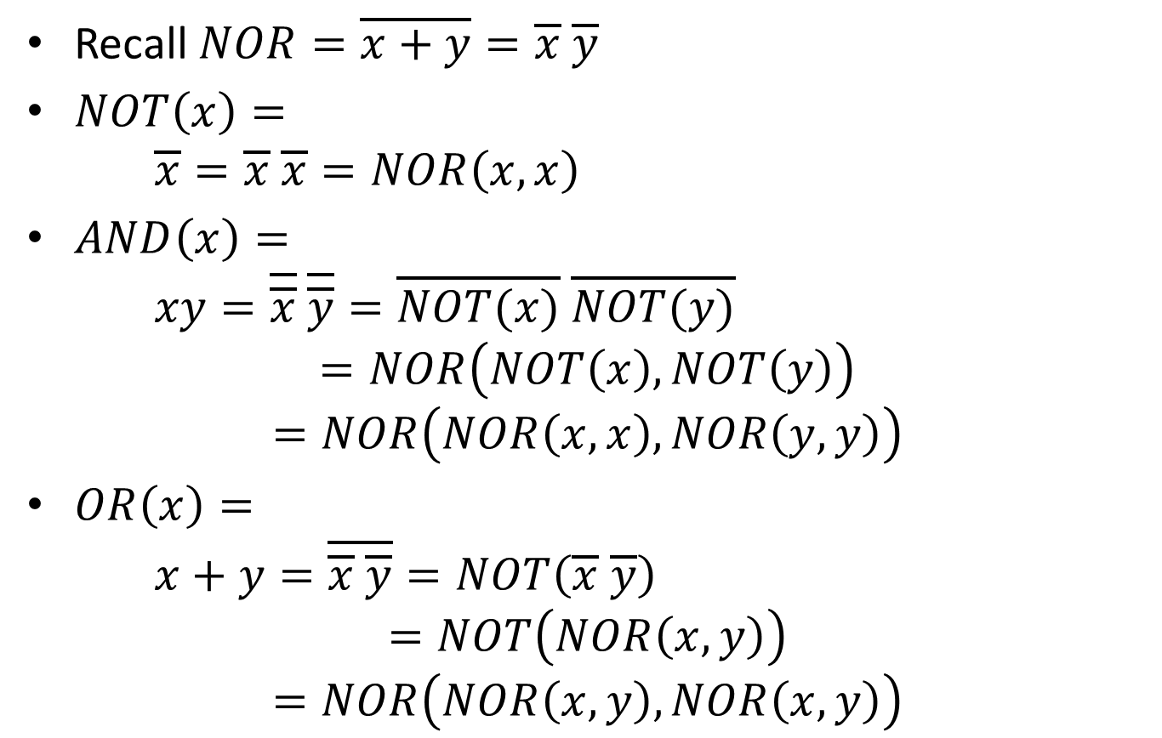
NOR is Universal
Recall $NOR=\overline{x+y}=\overline{x} \overline{y}$
$NOT\left(x\right)=$
$\overline{x}=\overline{x} \overline{x}=NOR\left(x,x\right)$
$AND\left(x\right)=$
$xy=\overline{\overline{x}} \overline{\overline{y}}=\overline{NOT(x)} \overline{NOT(y)}$
$$=NOR\left(NOT\left(x\right), NOT\left(y\right)\right)$$
$$=NOR\left(NOR\left(x,x\right), NOR\left(y,y\right)\right)$$
$OR\left(x\right)=$
$x+y=\overline{\overline{x} \overline{y}}=NOT\left(\overline{x} \overline{y}\right)$
$$=NOT\left(NOR\left(x,y\right)\right)$$
$$=NOR\left(NOR\left(x,y\right), NOR\left(x,y\right)\right)$$

Slide 8
More on Universal Gates
Define a 3-input gate $f\left(x,y,z\right)=\overline{x}yz+x\overline{y}+\overline{y}z.$ Show that $f$ is universal.
$NOT\left(x\right)=f\left(x, 1,1\right)$
$AND\left(x,y\right)=f\left(x, NOT\left(y\right), 0\right)=f\left(x, f\left(y,1,1\right),0\right)$
$OR\left(x,y\right)=f(x,0,y)$

Slide 9
NAND-Gate Realizations
Naïve approach: build network out of AND/OR/NOT gates, use the universal property above to replace each one with several NAND gates.
A better approach: manipulate Boolean expression into the form NAND(A, B, . . .,C)

Slide 10
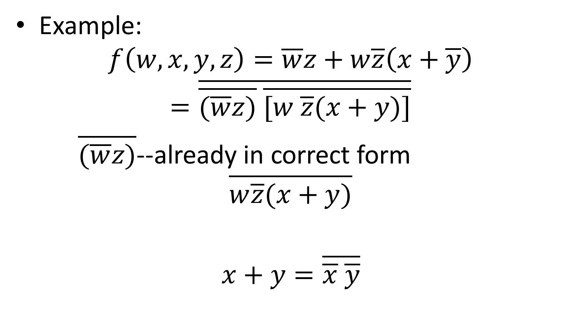
NAND-Gate Realizations
Example:
$$f\left(w,x,y,z\right)=\overline{w}z+w\overline{z}\left(x+\overline{y}\right)$$
$$=\overline{\overline{(\overline{w}z)} \overline{[w \overline{z}(x+y)]}}$$
$\overline{(\overline{w}z)}$--already in correct form
$$\overline{w\overline{z}(x+y)}$$
$$x+y=\overline{\overline{x} \overline{y}}$$

Slide 11
NAND-Gate Realizations
Only works if highest-order operation is an or-operation.
Highest-order operation is the last operation that is performed when the expression is evaluated.
What to do? Negate and repeat the procedure for $\overline{f}.$ Then note that $f\left(x_{1},…, x_{n}\right)=NAND(1, \overline{f}(x_{1},…, x_{n)})$

Slide 12
NAND-Gate Realizations
$$f\left(x_{0}, x_{1}, x_{2}, x_{3}\right)=x_{3}+{\overline{x}}_{2}+x_{1}{\overline{x}}_{0}$$

Slide 14
NOR-Gate Realizations
Essentially the same procedure. See Section 3.9.5 in the textbook.

Slide 15
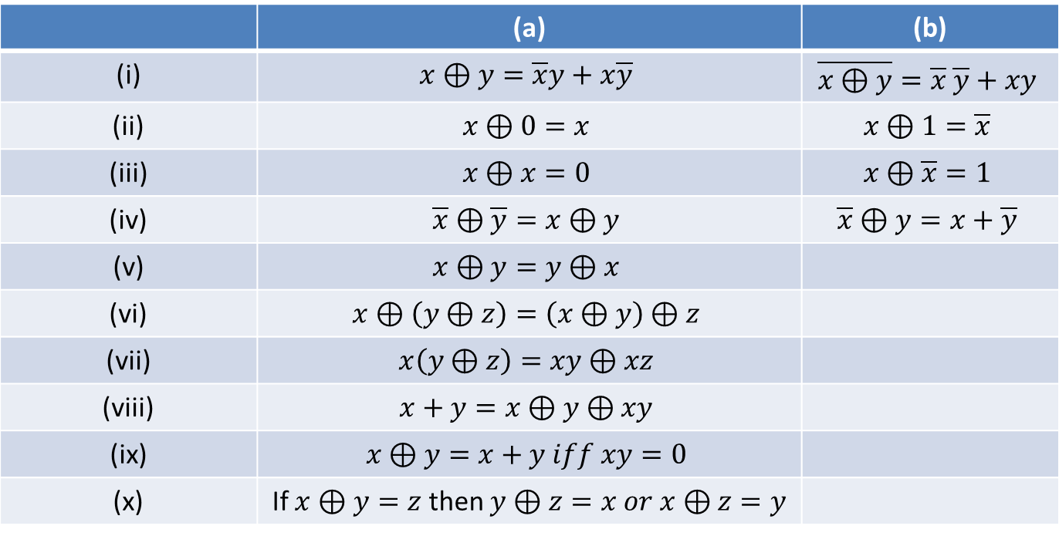
XOR-Gate Realizations
Properties of XOR
 | (a) | (b)
(i) | $$x⊕y=\overline{x}y+x\overline{y}$$ | $$\overline{x⊕y}=\overline{x} \overline{y}+xy$$
(ii) | $$x⊕0=x$$ | $$x⊕1=\overline{x}$$
(iii) | $$x⊕x=0$$ | $$x⊕\overline{x}=1$$
(iv) | $$\overline{x}⊕\overline{y}=x⊕y$$ | $$\overline{x}⊕y=x+\overline{y}$$
(v) | $$x⊕y=y⊕x$$
(vi) | $$x⊕\left(y⊕z\right)=\left(x⊕y\right)⊕z$$
(vii) | $$x\left(y⊕z\right)=xy⊕xz$$
(viii) | $$x+y=x⊕y⊕xy$$
(ix) | $$x⊕y=x+y iff xy=0$$
(x) | If $x⊕y=z$ then $y⊕z=x or x⊕z=y$

Slide 16
Gate Properties

Slide 17
Gate Properties
The two signal values associated with logic-0 and logic-1 are actually ranges of values.
If signal value is in some low-level voltage range between $V_{L\left(min\right)}$and $V_{L(max)}$ then it is assigned to logic-0. When a signal value is in some high-level voltage range between $V_{H(min)}$ and $V_{H(max)}$it is assigned to logic-1.

Slide 18
Noise Margins
The minimal signal value that is acceptable as a logic-1 at the input to a gate is different from the minimal logic-1 signal value that a gate produces at its output.
Similar situation for $V_{L(max)}$
Manufacturers normally state a $V_{IL(max)}, V_{IH(min)}, V_{OL(max)}, V_{OH(min)}$ in gate specifications.
Where $V_{OL(max)}<V_{IL(max)}< V_{IH(min)},<V_{OH(min)}$

Slide 19
Noise Margins
Consider connecting output of gate to another gate, where noise is induced between the two gates.
Worst case low-level noise margin: Any noise less than $V_{IL(max)}−V_{OL(max)}$does not affect behavior of Gate 2 on a low-level signal.
Worst case high-level noise margin: Any noise less than $V_{OH(min)}−V_{IH(min)}$does not affect behavior of Gate 2 on a high-level signal.
Gate 1
Noise
Gate 2

Slide 20
Fan-Out
The signal value at the output of a gate is dependent upon the number of gates to which the output is connected.
Limitation on number of gates output can connect to. This is known as the fan-out capability of the gate. Manufacturers specify this limitation.
Circuits known as buffers serve as amplifiers for this purpose.

Slide 21
Propagation Delays
Digital signals to not change nor do circuits respond instantaneously. Limitation to the overall speed of operation associated with a gate.
These time delays are called propagation delays.
Time required for output signal to change from low-level to high-level is $t_{pHL}$.
Time required for output signal to change from high-level to low-level is $t_{pLH}.$
$t_{pHL}$ and $t_{pLH}$are, in general, not equal. Manufacturers give maximum times in gate specifications.
General measure used is the average propagation delay time, $t_{pd}$
$t_{pd}= \frac{t_{pHL}+t_{pLH}}{2}$

Slide 22
Power Dissipation
Digital circuit consumes power as a result of the flow of currents. Called power dissipation.
Desirable to have low power dissipation and low propagation delay times.
These two performance parameters are in conflict with each other.
Common measure of gate preformance is the product of the propagation delay and the power dissipation of the gate.
This is known as the delay-power product.

