Slide 1
ENEE244-02xx Digital Logic Design
Lecture 5

Slide 2
Announcements
Homework 1 solutions are on Canvas
Homework 2 due on Thursday
Coming up: First midterm on Sept. 30

Slide 3
Agenda
Last time:
Boolean Algebra axioms and theorems (3.1,3.2)
Canonical Forms (3.5)
This time:
Finish up Canonical Forms (3.5)
Manipulations of Boolean Formulas (3.6)
Gates and Combinational Networks (3.7)
Incomplete Boolean Functions and Don’t Care Conditions (3.8 )

Slide 4

Canonical Forms (Review)
X | Y | Z | f
0 | 0 | 0 | 0
0 | 0 | 1 | 1
0 | 1 | 0 | 0
0 | 1 | 1 | 1
1 | 0 | 0 | 1
1 | 0 | 1 | 0
1 | 1 | 0 | 0
1 | 1 | 1 | 0
$f\left(x,y,z\right)=Σm(1,3,4)$
$f\left(x,y,z\right)=ΠM(0,2,5,6,7)$

Slide 5
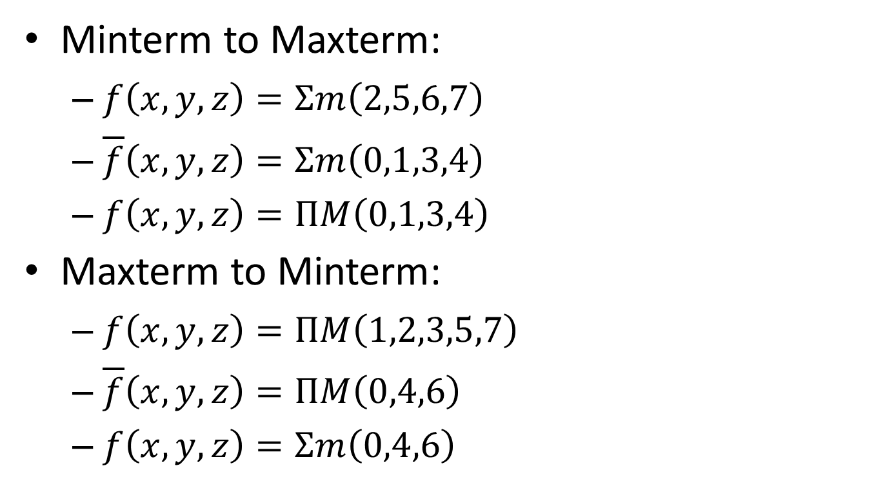
Canonical Forms Conversion
Minterm to Maxterm:
$f\left(x,y,z\right)=Σm\left(2,5,6,7\right)$
$\overline{f}\left(x,y,z\right)=Σm\left(0,1,3,4\right)$
$f\left(x,y,z\right)=ΠM\left(0,1,3,4\right)$
Maxterm to Minterm:
$f\left(x,y,z\right)=ΠM\left(1,2,3,5,7\right)$
$\overline{f}\left(x,y,z\right)=ΠM\left(0,4,6\right)$
$f\left(x,y,z\right)=Σm\left(0,4,6\right)$

Slide 6
Manipulations of Boolean Formulas

Slide 7
Equation Complementation
For every Boolean function $f$ there is an associated complementary function $\overline{f}$ in which $\overline{f}\left(x_{1}, …, x_{n}\right)=1$ iff $\overline{f}\left(x_{1}, …, x_{n}\right)=0.$
Example:
$$f=\overline{w}x\overline{z}+w\left(x+\overline{y}z\right)$$
$$\overline{f}=\overline{\overline{w}x\overline{z}+w\left(x+\overline{y}z\right)}$$

Slide 8
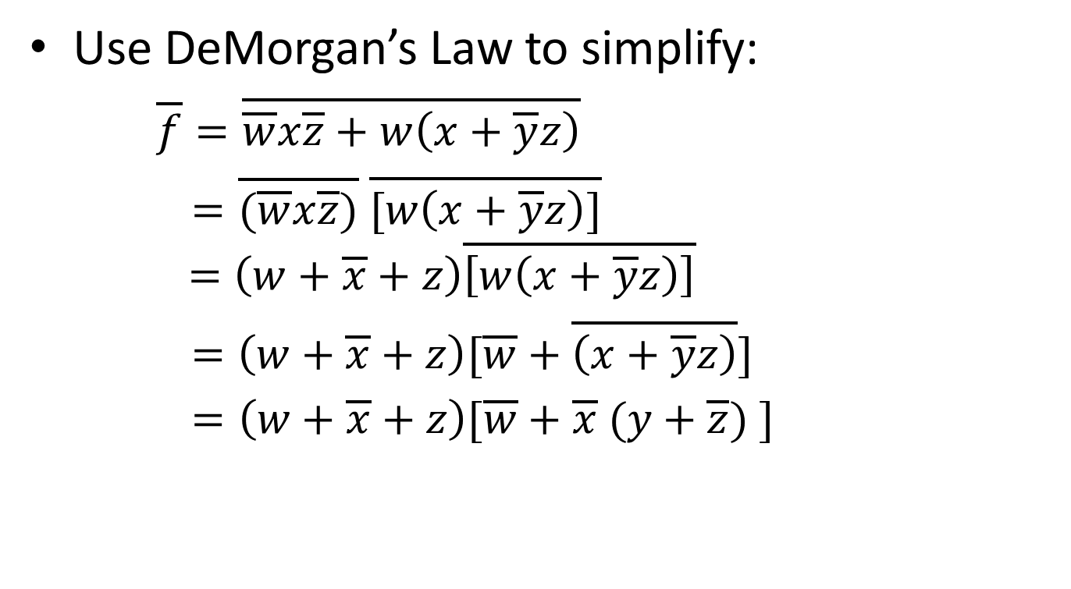
Equation Complementation
Use DeMorgan’s Law to simplify:
$\overline{f}=\overline{\overline{w}x\overline{z}+w\left(x+\overline{y}z\right)}$
$=\overline{(\overline{w}x\overline{z})} \overline{[w\left(x+\overline{y}z\right)]}$
$$=\left(w+\overline{x}+z\right)\overline{\left[w\left(x+\overline{y}z\right)\right]}$$
$=\left(w+\overline{x}+z\right)[\overline{w}+\overline{\left(x+\overline{y}z\right)}]$
$=\left(w+\overline{x}+z\right)[\overline{w}+\overline{x} (y+\overline{z}) ]$

Slide 9
Expansion about a Variable
Rewrite a Boolean formula $f(x_{1}, …, x_{n})$ so that it has the structure:
$f\left(x_{1}, …, x_{n}\right)=x_{i}g_{1}+{\overline{x}}_{i}g_{2}$ OR
$$f\left(x_{1}, …, x_{n}\right)={(x}_{i}{+h}_{1})\left({\overline{x}}_{i}{+h}_{2}\right)$$

Slide 10
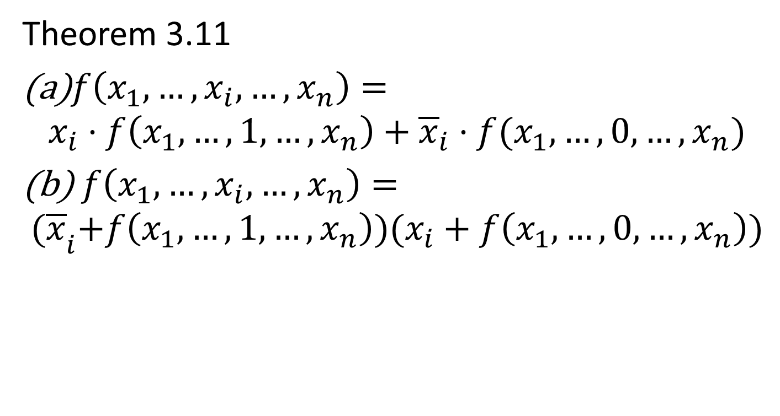
Expansion about a Variable
Theorem 3.11
$f\left(x_{1},…, x_{i}, …, x_{n}\right)=$
$$x_{i}⋅f\left(x_{1},…, 1, …, x_{n}\right)+{\overline{x}}_{i}⋅f(x_{1}, …, 0, …, x_{n})$$
(b) $f\left(x_{1},…, x_{i}, …, x_{n}\right)=$
$${(\overline{x}}_{i}+f\left(x_{1},…, 1, …, x_{n}\right))(x_{i}+f\left(x_{1}, …, 0, …, x_{n}\right))$$

Slide 11
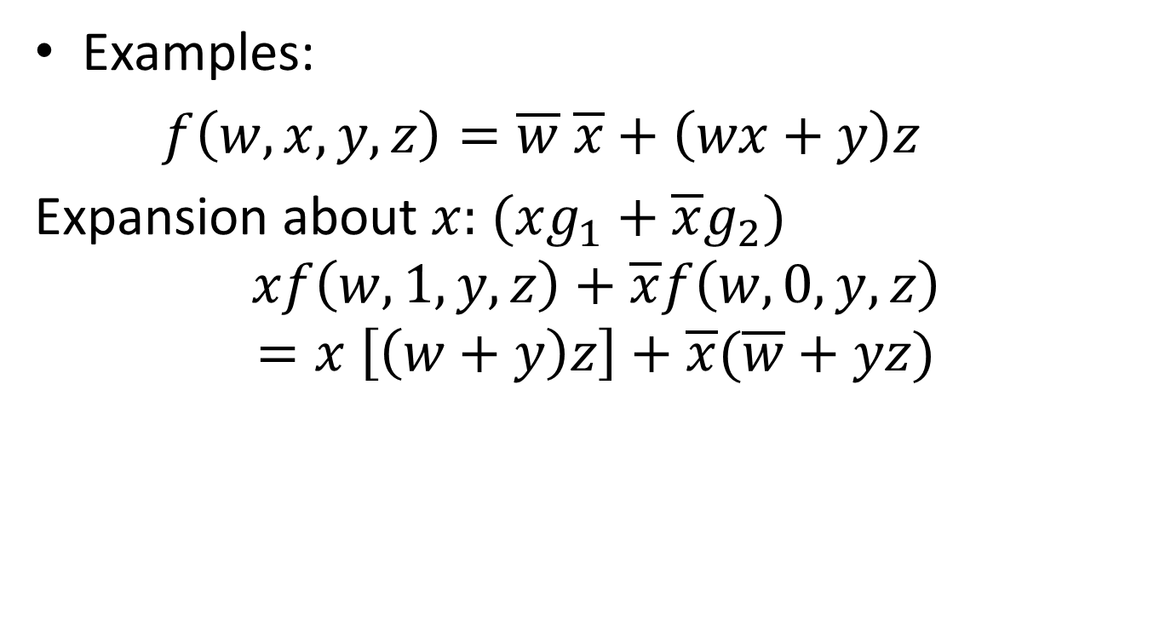
Expansion about a Variable
Examples:
$f\left(w,x,y,z\right)=\overline{w} \overline{x}+\left(wx+y\right)z$
Expansion about $x:$ $(xg_{1}+\overline{x}g_{2})$
$$xf\left(w,1, y,z\right)+\overline{x}f\left(w,0,y,z\right)$$
$$=x \left[\left(w+y\right)z\right]+\overline{x}(\overline{w}+yz)$$

Slide 12
Shannon’s Reduction Theorems
Used for obtaining simplified Boolean formula.
Theorem 3.12
(a) $x_{i}⋅f\left(x_{1},…, x_{i}, …, x_{n}\right)=x_{i}⋅f(x_{1},…, 1, …, x_{n})$
(b) $x_{i}+f\left(x_{1},…, x_{i}, …, x_{n}\right)=x_{i}+f(x_{1},…, 0, …, x_{n})$
Theorem 3.13
(a)${\overline{x}}_{i}⋅f\left(x_{1},…, x_{i}, …, x_{n}\right)={\overline{x}}_{i}⋅f(x_{1},…, 0, …, x_{n})$
(b) ${\overline{x}}_{i}+f\left(x_{1},…, x_{i}, …, x_{n}\right)={\overline{x}}_{i}+f(x_{1},…, 1, …, x_{n})$

Slide 13
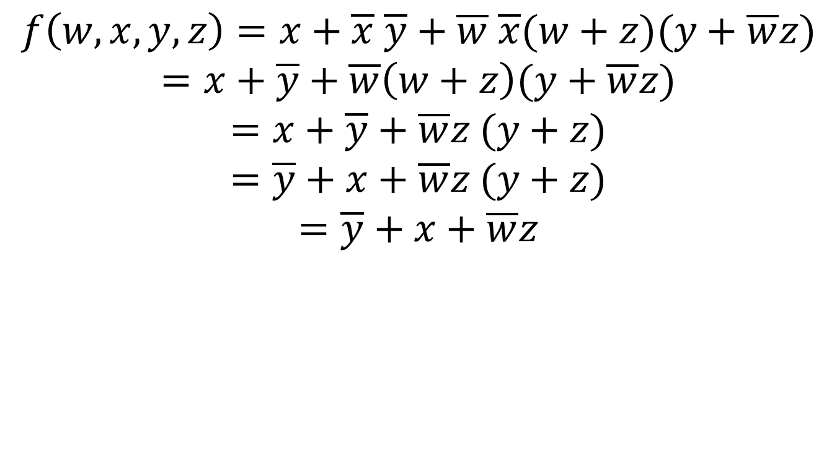
Example of Equation Simplification
$$f\left(w,x,y,z\right)=x+\overline{x} \overline{y}+\overline{w} \overline{x}(w+z)(y+\overline{w}z)$$
$$=x+\overline{y}+\overline{w}\left(w+z\right)(y+\overline{w}z)$$
$$=x+\overline{y}+\overline{w}z (y+z)$$
$$=\overline{y}+x+\overline{w}z (y+z)$$
$$=\overline{y}+x+\overline{w}z$$

Slide 14
Gates and Combinational Networks

Slide 15
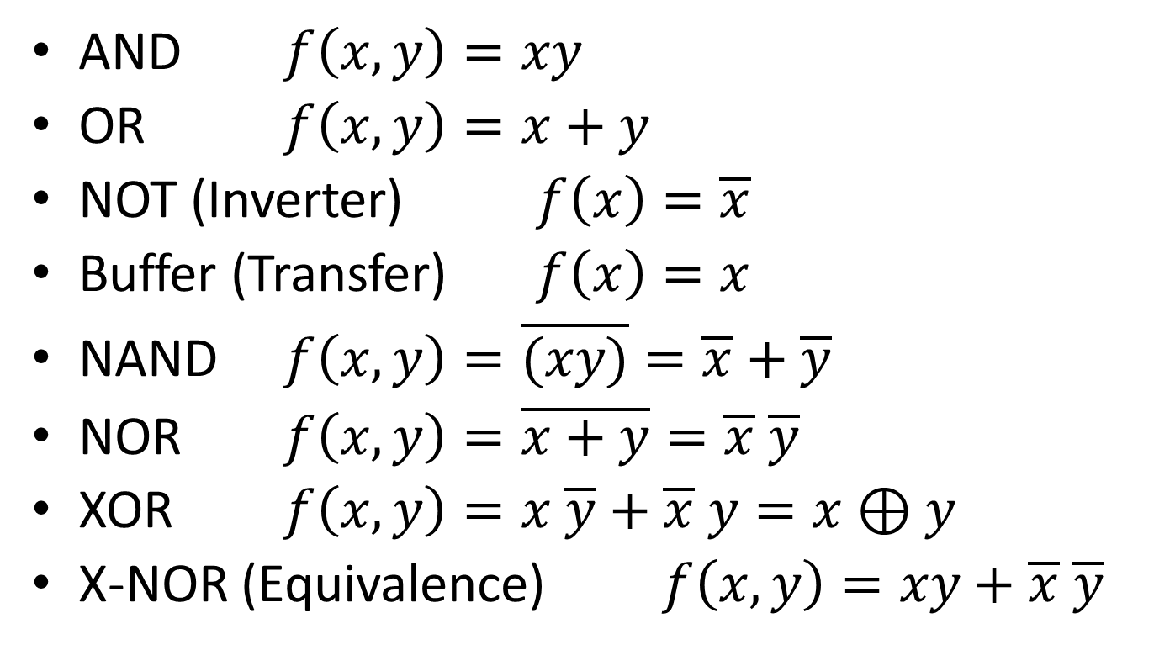
Digital Logic Gates
AND $f\left(x, y\right)=xy$
OR $f\left(x,y\right)=x+y$
NOT (Inverter) $f\left(x\right)=\overline{x}$
Buffer (Transfer) $f\left(x\right)=x$
NAND $f\left(x,y\right)=\overline{(xy)}=\overline{x}+\overline{y}$
NOR $f\left(x,y\right)=\overline{x+y}=\overline{x} \overline{y}$
XOR $f\left(x,y\right)=x \overline{y}+\overline{x} y=x⊕y$
X-NOR (Equivalence) $f\left(x,y\right)=xy+\overline{x} \overline{y}$

Slide 17
Gates and Combinational Networks
Synthesis Procedure
Example: Truth table for parity function on three variables
X | Y | Z | f
0 | 0 | 0 | 0
0 | 0 | 1 | 1
0 | 1 | 0 | 1
0 | 1 | 1 | 0
1 | 0 | 0 | 1
1 | 0 | 1 | 0
1 | 1 | 0 | 0
1 | 1 | 1 | 1

Slide 18
Synthesis Procedure
X | Y | Z | f
0 | 0 | 0 | 0
0 | 0 | 1 | 1
0 | 1 | 0 | 1
0 | 1 | 1 | 0
1 | 0 | 0 | 1
1 | 0 | 1 | 0
1 | 1 | 0 | 0
1 | 1 | 1 | 1
Minterm Canonical Form:
$f\left(x,y,z\right)=\overline{x} \overline{y}z+\overline{x}y \overline{z}+x\overline{y} \overline{z}+$xyz

Slide 19
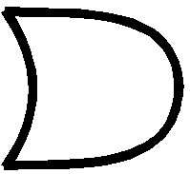
Two-level Gate Network
Minterm Canonical Form:
$$f\left(x,y,z\right)=\overline{x} \overline{y}z+\overline{x}y \overline{z}+x\overline{y} \overline{z}+ xyz$$
$$\overline{x}$$
$$\overline{y}$$
$$z$$
$$\overline{x}$$
$$y$$
$$\overline{z}$$
$$x$$
$$\overline{y}$$
$$\overline{z}$$
$$x$$
$$y$$
$$z$$

Slide 20
Incomplete Boolean Functions and Don’t Care Conditions

Slide 21
Incomplete Boolean Functions and Don’t Care Conditions
n-variable incomplete Boolean function is represented by a truth table with n+1 columns and $2^{n}$ rows.
For those combinations of values in which a functional value is not to be specified, a symbol, --, is entered.
The complement of an incomplete Boolean function is also an incomplete Boolean function having the same unspecified rows of the truth table.

Slide 22
Describing Incomplete Boolean Functions
X | Y | Z | F
0 | 0 | 0 | 1
0 | 0 | 1 | 1
0 | 1 | 0 | 0
0 | 1 | 1 | --
1 | 0 | 0 | 0
1 | 0 | 1 | --
1 | 1 | 0 | 0
1 | 1 | 1 | 1
Minterm canonical formula:
$$f\left(x,y,z\right)=∑m\left(0,1,7\right)+dc(3,5)$$

Slide 23
Describing Incomplete Boolean Functions
X | Y | Z | F
0 | 0 | 0 | 1
0 | 0 | 1 | 1
0 | 1 | 0 | 0
0 | 1 | 1 | --
1 | 0 | 0 | 0
1 | 0 | 1 | --
1 | 1 | 0 | 0
1 | 1 | 1 | 1
Maxterm canonical formula:
$$f\left(x,y,z\right)=ΠM\left(2,4,6\right)+dc(3,5)$$

Slide 24
Describing Incomplete Boolean Functions
Manipulating Boolean equations derived from incomplete Boolean functions is a very difficult task.
In the next chapter, there are procedures for obtaining minimal expressions that can handle the don’t care conditions.
Can leverage don’t care conditions to get simplified expressions for functions (smaller gate networks).

Slide 25
$$\{xy,\overline{x}y\}$$
$$\{x\overline{y},\overline{x} \overline{y}\}$$

