Slide 1
ENEE244-02xx Digital Logic Design
Lecture 3

Slide 2
Announcements
Homework 1 due next class (Thursday, September 11)
First recitation quiz will be next Monday, September 15, on the material from lectures 1,2.
Lecture notes are on course webpage.

Slide 3
Agenda
Last time:
Signed numbers and Complements (2.7)
Addition and Subtraction with Complements (2.8-2.9)
This time:
Error detecting/correcting codes (2.11, 2.12)
Boolean Algebra
Definition of Boolean algebra (3.1)
Boolean algebra theorems (3.2)

Slide 4
Codes for Error Detection and Correction

Slide 5
Codes
Encode algorithm Enc(m) = M. m is the message, M is the codeword. Enc is one-to-one.
Decode algorithm Dec(M) = m
Usually use to detect and correct errors introduced during transmission.
Assume M is in binary
Would like to detect and/or correct the flipping of one or multiple bits.

Slide 6
Error Detection/Correction
Basic properties:
Distance of a code: minimum distance between any two codewords (number of bits that need to be flipped to get from one codeword to another)
Rate of a code: |m|/|M|
Distance determines the number of errors that can be detected/corrected.
Would like to find codes with optimal tradeoff between distance and rate.

Slide 7
Error Detection/Correction
Error detection: can detect at most $dist$-1 errors, where $dist$ is the minimum distance of the code.
Error correction: can correct at most $(dist−1)/2$ errors
Error correction and detection:
$$Corr+Det=dist−1, Corr≤Det$$

Slide 8
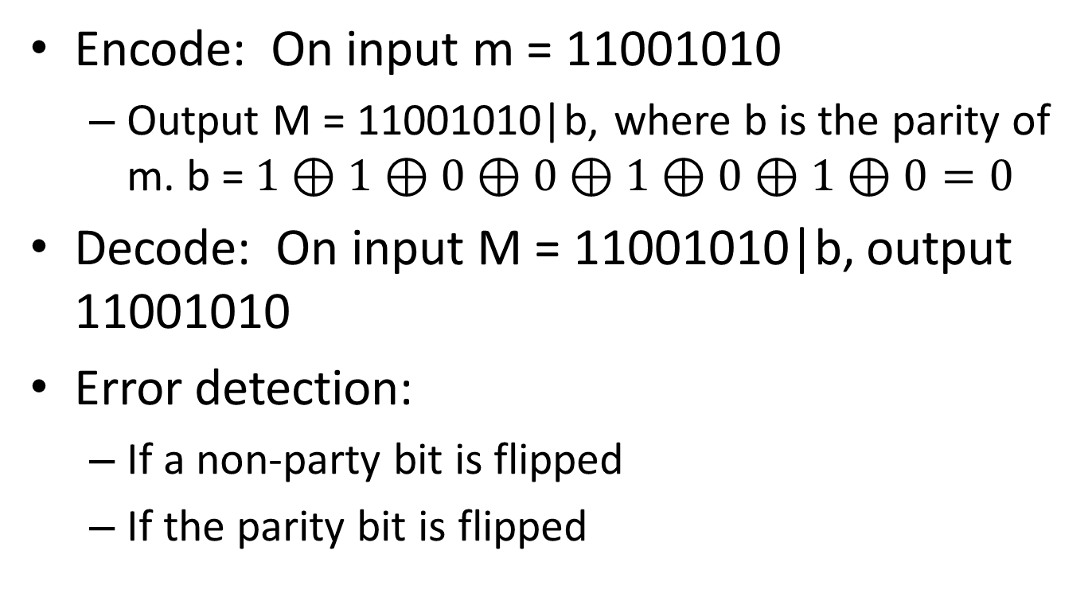
Error Detection: Parity Check
Encode: On input m = 11001010
Output M = 11001010|b, where b is the parity of m. b = $1⊕1⊕0⊕0⊕1⊕0⊕1⊕0=0$
Decode: On input M = 11001010|b, output 11001010
Error detection:
If a non-party bit is flipped
If the parity bit is flipped

Slide 9
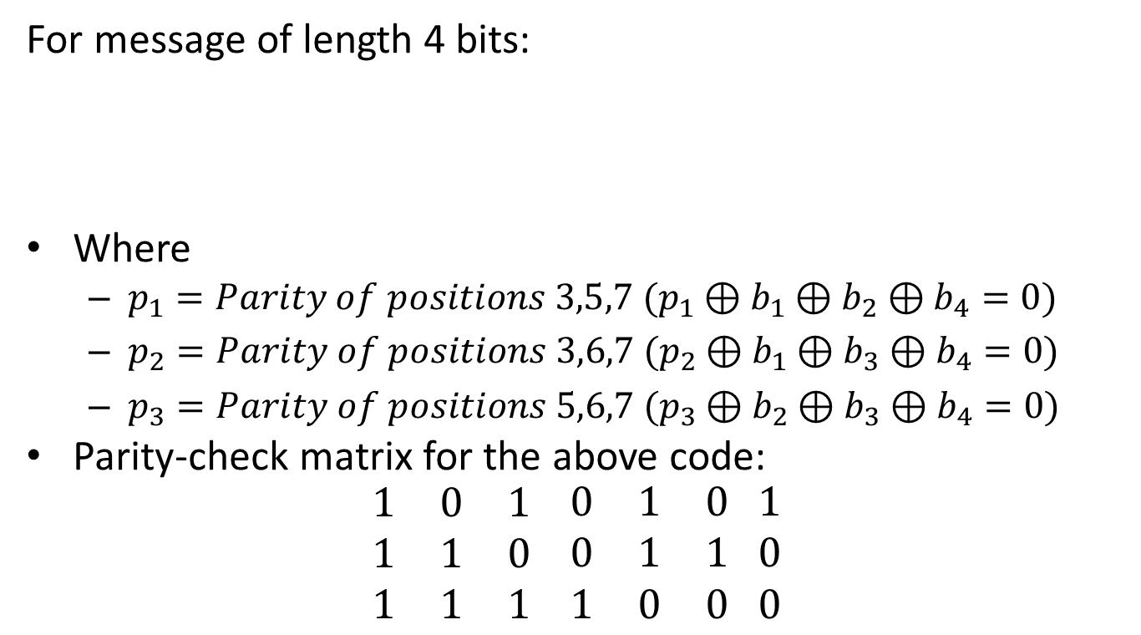
Error Correction: Hamming Code
For message of length 4 bits:
Where
$p_{1}=Parity of positions 3,5,7 (p_{1}⊕b_{1}⊕b_{2}⊕b_{4}=0)$
$p_{2}=Parity of positions 3,6,7 (p_{2}⊕b_{1}⊕b_{3}⊕b_{4}=0)$
$p_{3}=Parity of positions 5,6,7 (p_{3}⊕b_{2}⊕b_{3}⊕b_{4}=0)$
Parity-check matrix for the above code:
$$\begin{matrix}1 & 0 & 1 \\ 1 & 1 & 0 \\ 1 & 1 & 1\end{matrix} \begin{matrix}0 & 1 & 0 \\ 0 & 1 & 1 \\ 1 & 0 & 0\end{matrix} \begin{matrix}1 \\ 0 \\ 0\end{matrix}$$
7 | 6 | 5 | 4 | 3 | 2 | 1 | Position
$$b_{4}$$ | $$b_{3}$$ | $$b_{2}$$ | $$p_{3}$$ | $$b_{1}$$ | $$p_{2}$$ | $$p_{1}$$ | Code group format
First parity check
Second parity check
Third parity check
$b_{4} b_{3} b_{2} p_{3} b_{1} p_{2} p_{1}$

Slide 10
Example of Hamming Code for message length 4
7 | 6 | 5 | 4 | 3 | 2 | 1 | Position
$$b_{4}$$ | $$b_{3}$$ | $$b_{2}$$ | $$p_{3}$$ | $$b_{1}$$ | $$p_{2}$$ | $$p_{1}$$ | Code group format
7 | 6 | 5 | 4 | 3 | 2 | 1 | Position
$$1$$ | $$0$$ | $$0$$ | $$p_{3}$$ | $$1$$ | $$p_{2}$$ | $$p_{1}$$ | Code group format
7 | 6 | 5 | 4 | 3 | 2 | 1 | Position
$$1$$ | $$0$$ | $$0$$ | $$p_{3}$$ | $$1$$ | $$p_{2}$$ | $$0$$ | Code group format
7 | 6 | 5 | 4 | 3 | 2 | 1 | Position
$$1$$ | $$0$$ | $$0$$ | $$p_{3}$$ | $$1$$ | $$0$$ | $$0$$ | Code group format
7 | 6 | 5 | 4 | 3 | 2 | 1 | Position
$$1$$ | $$0$$ | $$0$$ | $$1$$ | $$1$$ | $$0$$ | $$0$$ | Code group format

Slide 11
Which bit is flipped?
For message of length 4 bits:
Where
$p_{1}=Parity of positions 3,5,7 (p_{1}⊕b_{1}⊕b_{2}⊕b_{4}=0)$
$p_{2}=Parity of positions 3,6,7 (p_{2}⊕b_{1}⊕b_{3}⊕b_{4}=0)$
$p_{3}=Parity of positions 5,6,7 (p_{3}⊕b_{2}⊕b_{3}⊕b_{4}=0)$
Parity-check matrix for the above code:
$$\begin{matrix}1 & 0 & 1 \\ 1 & 1 & 0 \\ 1 & 1 & 1\end{matrix} \begin{matrix}0 & 1 & 0 \\ 0 & 1 & 1 \\ 1 & 0 & 0\end{matrix} \begin{matrix}1 \\ 0 \\ 0\end{matrix}$$
7 | 6 | 5 | 4 | 3 | 2 | 1 | Position
$$b_{4}$$ | $$b_{3}$$ | $$b_{2}$$ | $$p_{3}$$ | $$b_{1}$$ | $$p_{2}$$ | $$p_{1}$$ | Code group format

Slide 12
Hamming Code for arbitrary length messages
Parity-check matrix:
$$\begin{matrix}1 & 0 & 1 \\ 1 & 1 & 0 \\ 1 & 1 & 1\end{matrix} \begin{matrix}0 & 1 & 0 \\ 0 & 1 & 1 \\ 1 & 0 & 0\end{matrix} \begin{matrix}1 \\ 0 \\ 0\end{matrix}$$
Message length = $2^{k} −k −1$
Hamming code has optimal rate of:
$\frac{2^{k} −k −1}{2^{k}−1}=1− \frac{k}{2^{k}−1}$
$k$ parity bits
$2^{k}−1$ codeword length

Slide 13
Single Error Correction, Double Error Detection
Can achieve this by adding an overall parity bit.
If parity checks are correct and overall parity bit are correct, then no single or double errors occurred.
If overall parity bit is incorrect, then single error has occurred, can use previous to correct.
If one or more of parity checks incorrect but overall parity bit is correct, then two errors are detected.

Slide 14
Boolean Algebra

Slide 15
Boolean Algebra
Provides a way of describing combinational networks and sequential networks.
Can express the terminal properties of networks that appear in digital systems.
Correspondence between algebraic expressions and their network realizations.
To find optimal networks can manipulate and simplify corresponding Boolean algebraic expressions.

Slide 16
Definition of a Boolean Algebra
A mathematical system consisting of:
A set of elements $B$ [0/1 or T/F]
Two binary operators (+) and ($⋅$) [OR/AND]
= for equivalence, () indicating order of operations
Where the following axioms/postulates hold:
P1. Closure
For all $x,y∈B, x+y∈B, x⋅y∈B$
P2. Identity
There exist identity elements in $B$, denoted 0,1 relative to (+) and ($⋅$), respectively.
For all $x∈B, 0+x=x+0=x, 1⋅x=x⋅1=x.$

Slide 17
Definition of Boolean Algebra
P3. Commutativity
The operations (+), ($⋅$) are commutative
For all $x, y∈B x+y=y+x, x⋅y=y⋅x$
P4. Distributivity
***Each operation (+), ($⋅$) is distributive over the other.
For all $x,y,z∈B$:
$x+\left(y⋅z\right)=\left(x+y\right)⋅\left(x+z\right)$ [$x OR (y AND z)$]
$x⋅\left(y+z\right)=\left(x⋅y\right)+(x⋅z)$ [$x AND (y OR z)$]

Slide 18
Definition of Boolean Algebra
P5. Complement
For every element $x∈B$there exists an element $\overline{x}∈B$called the complement of $x$ such that:
$x+\overline{x}=1$
$x⋅\overline{x}=0$
P6. Non-triviality
There exist at least two elements $x, y∈B$ such that $x≠y.$

