Slide 1
Digital Logic Design
Lecture 22

Slide 2
Announcements
Homework 7 due today
Homework 8 on course webpage, due 11/20.
Recitation quiz on Monday on material from Lectures 21,22

Slide 3
Agenda
Last time:
Programmable Logic Devices (5.7-5.10)
This time:
New topic: Flip-flops
The Basic Bistable Element (6.1)
Latches (6.2)
Timing Considerations (6.3)
Master-Slave Flip-Flops (6.4)
Edge-Triggered Flip-Flops (6.5)

Slide 4
Sequential Networks
The logic networks studied so far are combinational networks:
The outputs at any instant depend only upon the inputs present at that instant.
Sequential Network:
The outputs at any instant are dependent not only upon the inputs present at that instant but also upon the past history of inputs.
Sequential networks have memory.
The information preserved is referred to as the internal state, secondary state, or state of the network.

Slide 5
Sequential Networks
Synchronous sequential network
Behavior is determined by the values of the signals at only discrete instants of time.
Master-clock generator which produces a sequence of clock pulses that sample the input.
Asynchronous sequential network
Behavior of the network is immediately affected by the input signal changes.

Slide 6
Flip-Flop
The basic logic element that provides memory in many sequential networks.
Flip-flop itself is a simple sequential network.
All sequential networks require the existence of feedback.
Feedback is present in flip-flop circuits.
Flip-flop has two stable conditions.
Each of this is associated with a state or storage of a binary symbol.

Slide 7
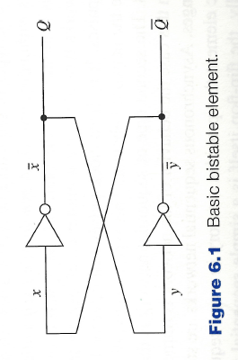
The Basic Bistable Element
Central to all flip-flop circuits.
Has two outputs $Q, \overline{Q}$
Two stable states:
$x=0;\overline{x}=1;Q=1;y=1;\overline{y}=0;\overline{Q}=0;x=0;$
$\overline{Q}=x=\overline{y}=0;Q=\overline{x}=y=1$
$x=1;\overline{x}=0;Q=0;y=0;\overline{y}=1;\overline{Q}=1;x=1;$
$\overline{Q}=x=\overline{y}=1;Q=\overline{x}=y=0$

Slide 8
The Basic Bistable Element
When output line $Q=1$ the element is storing a 1; when output line $Q=0$ the element is storing a 0.
There is one more equilibrium condition that can exist. Occurs when the two output signals are halfway between logic-0 and logic-1.
Known as metastable state.
Any small change causes the element to enter one of its two stable states.
Amount of time a device can stay in its metastable state is unpredictable.
Metastable state must be avoided.

Slide 9
The Basic Bistable Element
Has no inputs.
When power is applied, it becomes stable in one of its two stable states and remains in this state until power is removed.
To be useful, must be able to force the device into a particular state.
A flip-flop is a bistable device, with inputs, that remains in a given state as long as power is applied and until input signals are applied to cause its output to change.
Inputs to flip-flops:
Asynchronous or direct input: a signal change produces an immediate change in the state of the flip-flop.
Synchronous input: A signal change does not immediately affect the state of the flip-flop. Affects it only when some control signal (clock) occurs.

Slide 10
Latches
Latches are one class of flip-flops
The timing of the output changes is not controlled
The output responds immediately to changes on the input lines.
Input lines are continuously being interrogated.
Sections 6.4,6.5: flip-flops in which the timing of the output changes is controlled.

Slide 11
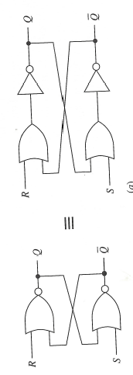
The SR (set-reset) Latch
Cross-coupling of two NOR gates.
Two inputs: S, R referred to as the set and reset inputs
Two outputs: $Q, \overline{Q}$
S = R = 0 logic diagram simplifies to basic bistable element
R = 1; S = 0—latch is “reset”
If R is returned to 0 then latch retains its present state
S = 1; R = 0—latch is “set”
S,R are asynchronous inputs

Slide 12
The SR (set-reset) Latch
Cross-coupling of two NOR gates.
Two inputs: S, R referred to as the set and reset inputs
Two outputs: $Q, \overline{Q}$
Consider the case where S = R = 1
Output of both NOR gates becomes 0, not complementary
When inputs return to 0:
If one input returns to 0 before the other, the last input to stay at 1 determines the final state.
If both inputs return to 0 simultaneously, the device may enter its metastable state. Final state is unpredictable.
S = R = 1 regarded as “forbidden state”

Slide 13
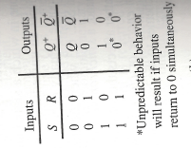
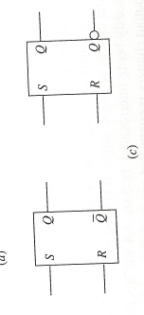
The SR Latch
Next state is the same as the previous state.
$Q^{+}, {\overline{Q}}^{+}$ indicates the response of the latch at the $Q, \overline{Q}$ output terminals as a consequence of applying the various inputs.
$Q^{+}$is called the next state of the latch.

Slide 14
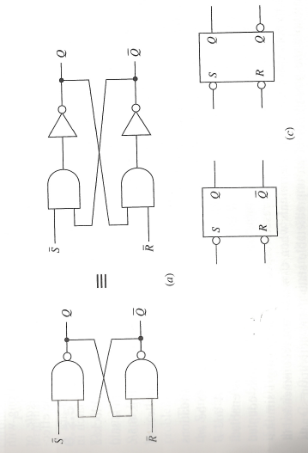
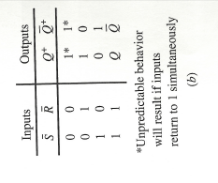
The $\overline{S} \overline{R}$ Latch
Cross-coupling of two nand-gates
When $\overline{S}=\overline{R}=1$ logic diagram reverts to the basic bistable element.
Device has 2 stable states.

Slide 15
The Gated SR Latch
Inputs for SR Latch and $\overline{S} \overline{R}$ Latch are asynchronous.
A change in the value of the inputs causes an immediate change of the outputs.
Frequently desirable to prevent input activation signals from affecting the state of the latch immediately.
“gated SR latch” or “SR latch with enable” is used.

Slide 16
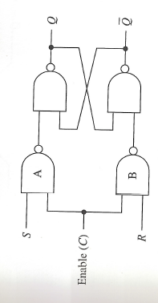
The Gated SR Latch
$\overline{S} \overline{R}$ Latch along with 2 additional NAND gates and a control input C.
C is referred to as enable, gate or clock input.
C determines when the S and R inputs become effective.
As long as C input is 0, outputs of NAND gates are 1, keeps the $\overline{S} \overline{R}$ Latch in its current stable state.
Any changes to S,R are blocked.
Output is “latched” in its present state.
When C is 1, the latch behaves as an SR Latch.
If S = R = C = 1 then $Q=\overline{Q}=1.$
If C then goes to 0, can enter metastable state.

Slide 17
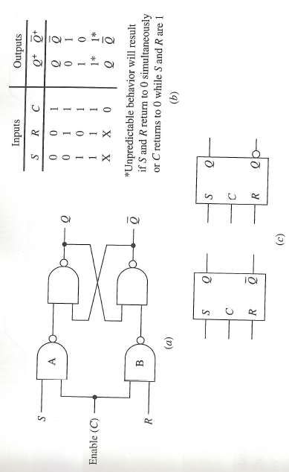
The Gated SR Latch

Slide 18
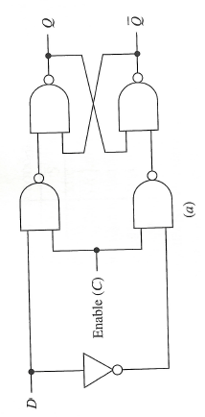
The Gated D Latch
The latches discussed thus far each has an input combination that is not recommended.
The gated D (data) latch does not have this problem.
Gated SR-latch in which a not-gate is connected between the S and R terminals.
Why does this help?

Slide 19
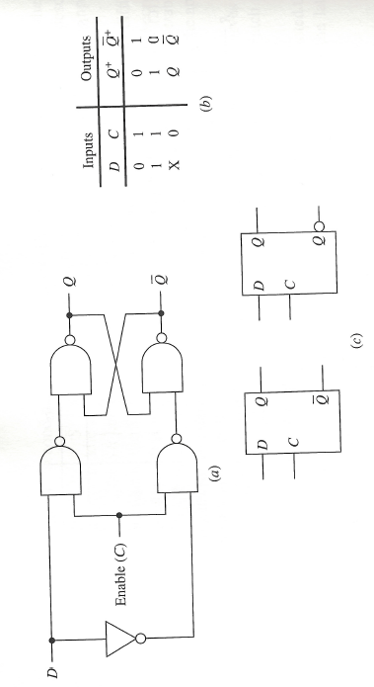
The Gated D Latch

Slide 20
Timing Considerations
Responses to inputs are not really immediate, but occur after some appropriate time delay.
To achieve desired responses, certain timing constraints must be satisfied.

Slide 21
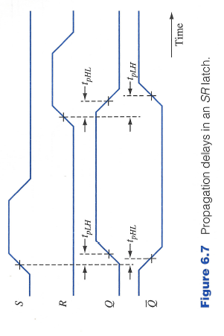
Propagation Delays
The propagation delay is the time it takes a change in an input signal to produce a change in an output signal.
Propagation delay from low to high: $t_{pLH}$
Propagation delay from high to low: $t_{pHL}$
In general, these may be different.

Slide 22
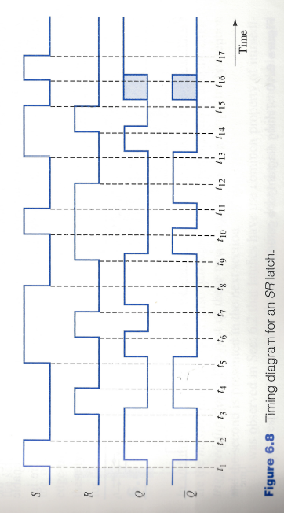
Timing Diagram
Propagation delays from high-low, low-high assumed equal.
When S = R = 1, both $Q, \overline{Q}$ become 0.
$t_{15}$, signals on S, R are simultaneously changed from 1 to 0.
Response of latch is unpredictable. Can be in 0-state, 1-state or metastable state.
Application of 1 on the set input terminal returns the latch to predictable.

Slide 23
Minimum Pulse Width
Another specification stated by the manufacturers of latches is that of a minimum pulse width $t_{w(min)}$.
Minimum amount of time a signal must be applied in order to produce a desired result.
Failure to satisfy the constraint may cause unintended change or have the latch enter its metastable state.

Slide 24
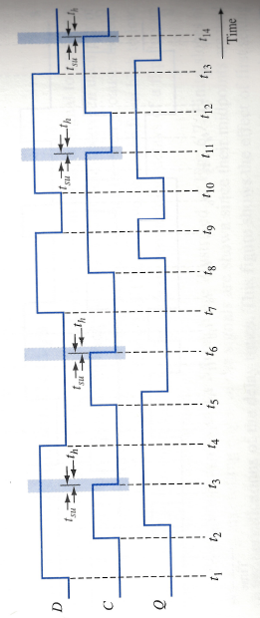
Setup and Hold Times
Consider timing diagram for a gated D latch
Q-output follows the input signal at D whenever the enable signal C = 1.
When C = 0, changes are ignored.
Consider times $t_{3}, t_{6}, t_{11}, t_{14}$.
C is returned to 0. Output latches onto its current state.
To guarantee latching action: constraint is placed on D signal. Must not change right before and after C goes from 1 to 0.
Setup time: minimum time $t_{su}$ that D signal must be held fixed before the latching action.
Hold time: minimum time $t_{h}$ that D signal must be held fixed after the latching action.

Slide 25
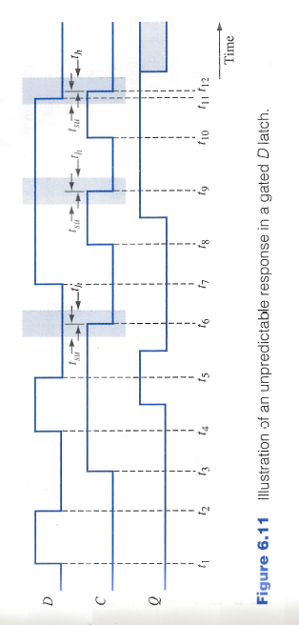
Unpredictable Response in a gated D latch

