Slide 1
ENEE244-02xx Digital Logic Design
Lecture 2

Slide 2
Announcements
Change in TA:
Shang Li
Email: shawn.li.xjtu@gmail.com
Office hours: 11am-12pm, 1143 AV Williams
First homework assigned (see course webpage). Due date: Sept. 11
First recitation is on Monday!

Slide 3
Agenda
Last time:
Positional Number Systems (2.1)
Basic Arithmetic Operations (2.3)
Polynomial Method of Number Conversion (2.4)
Iterative Method of Number Conversion (2.5)
Special Conversion Procedures (2.6)
This time:
Signed numbers and Complements (2.7)
Addition and Subtraction with Complements (2.8-2.9)
Codes for Error Detection (2.11)
Codes for Error Correction (2.12)

Slide 4
Signed Numbers and Complements

Slide 5
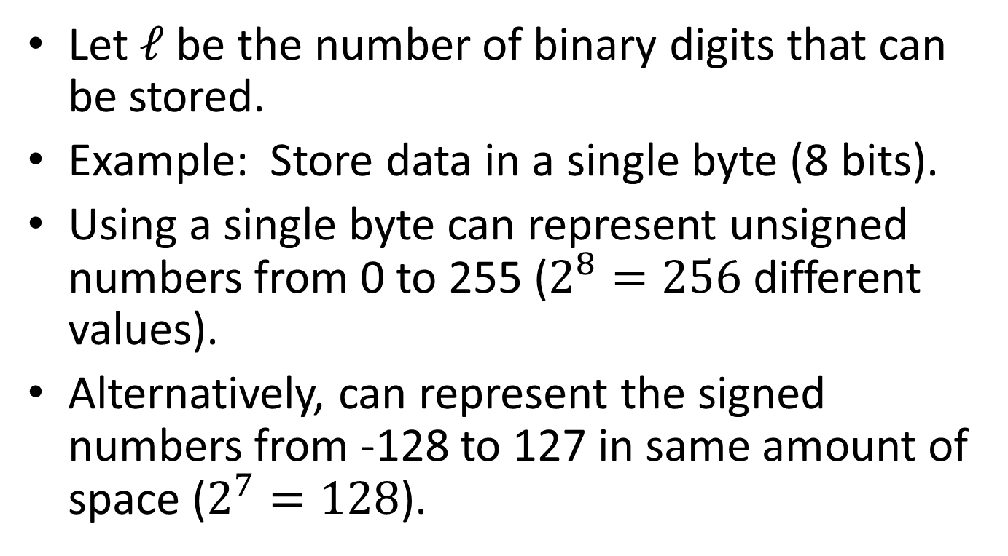
Range of represented numbers
Let $ℓ$ be the number of binary digits that can be stored.
Example: Store data in a single byte (8 bits).
Using a single byte can represent unsigned numbers from 0 to 255 ($2^{8}=256$ different values).
Alternatively, can represent the signed numbers from -128 to 127 in same amount of space ($2^{7}=128$).

Slide 6
Signed Numbers and Complements
How to denote if a number is positive or negative?
Use a sign bit: $0_{s}1001$ denotes positive 9, $1_{s}1001$ denotes negative 9. This representation is called the sign-magnitude representation.
This works, but it will be convenient to use a different representation of negative numbers.
Two methods: $r$’s complement and $(r−1)$’s complement.

Slide 7
$r$’s Complement
$r$’s complement of $N=r^{ℓ}−N={10}^{ℓ}−N$
In our example (one byte of memory, to represent -9, (where 9 = 1001 in binary), compute ${\left(10\right)}^{8}−1001=100000000 −1001=$11110111
Notice for negative numbers, most significant bit is always 1. For positive numbers, most significant bit is always 0.
This bit is therefore called the sign bit.
Aside: This is equivalent to doing arithmetic modulo $r^{ℓ}$.

Slide 8
Subtraction using $r$’s complement
Just do addition as usual
Ignore highest order carry
This is always correct unless there is overflow.

Slide 9

Example of subtraction using $r$’s complement
Assume $ℓ=6:$
Compute:
11010 - 00111
Compute:
00111 - 11010

Slide 10
Overflow in $r$’s complement
Overflow occurs in the following cases:
These conditions are the same as:
Carry-In to sign position $≠$ Carry-Out from sign position
Operation | Operand A | Operand B | Result
A + B | $$≥0$$ | $$≥0$$ | $$<0$$
A+B | $$<0$$ | $$<0$$ | $$≥0$$
A-B | $$≥0$$ | $$<0$$ | $$<0$$
A-B | $$<0$$ | $$≥0$$ | $$≥0$$

Slide 11

Example of Overflow in $r$’s complement
Assume $ℓ=6$
Compute:
11100 + 10111

Slide 12
$(r−1)$’s Complement
$(r−1)$’s complement of $N=r^{ℓ}−r^{−m} − N={10}^{ℓ}−{10}^{−m}−N$
For integers, $m=0,$ so subtract from ${10}^{n}−1$
In our example, to represent -9, (where 9 = 1001 in binary), compute ${\left(10\right)}^{8}−1−1001=11111111 −1001=$11110110
This corresponds to flipping the bits of 00001001.
Again, for negative numbers, $nth$ digit is always 1. For positive numbers, nth digit is always 0.
There are now two ways to represent 0: 00000000 or 11111111

Slide 13
Subtraction using $(r−1)$’s complement
Do addition as usual
If there is an end carry, add it to the least significant bit.
Most significant bit tells you the sign (unless overflow occurs).

Slide 14

Example of subtraction using $(r−1)$’s complement
Assume $ℓ=6$
Compute:
11010 - 00111
Compute:
00111 - 11010

Slide 15
Fast(er) way to compute 2’s complement
To form the 2’s complement of 0110 1010:
Take the 1s complement: 1001 0101
Then add 1: 1001 0110

Slide 16
Advantages/Disadvantages of 1’s vs. 2’s complement
1s complement | 2s complement
Easy to compute (just flip bits) | Harder to compute (flip bits and add one)
Harder to manipulate (e.g., for subtraction, need to add in extra carry.) | Easy to manipulate (e.g., subtraction is the same as addition—no extra hardware needed)

