Slide 1
Digital Logic Design
Lecture 19

Slide 2
Announcements
Homework 6 due Thursday 11/6
Recitation quiz on Monday, 11/10
Will cover material from lectures 18,19,20
Change in Instructor Office Hours:
Tuesday 10am-11am
Thursday 11am-12pm

Slide 3
Agenda
Last time:
Binary Adders and Subtracters (5.1, 5.1.1)
Carry Lookahead Adders (5.1.2, 5.1.3)
This time:
Decimal Adders (5.2)
Comparators (5.3)
Decoders (5.4)
Encoders (5.5)
Multiplexers (5.6)

Slide 4
Decimal Adders
8421 weighted coding scheme or BCD Code
Decimal Digit | BCD
0 | 0000
1 | 0001
2 | 0010
3 | 0011
4 | 0100
5 | 0101
6 | 0110
7 | 0111
8 | 1000
9 | 1001
Forbidden codes: 1010, 1011, 1100, 1101, 1110, 1111

Slide 5
Decimal Adder
Inputs: $A_{3}A_{2}A_{1}A_{0}, B_{3}B_{2}B_{1}B_{0}, C_{in}$ from previous decade.
Output: $C_{out}$ (carry to next decade), $Z_{3}Z_{2}Z_{1}Z_{0}.$
Idea: Perform regular binary addition and then apply a corrective procedure.

Slide 6
Comparing Binary and BCD Sums
$C_{out}$ is set to 0
Decimal Sum | K | $$P_{3}$$ | $$P_{2}$$ | $$P_{1}$$ | $$P_{0}$$ | $$C_{out}$$ | $$Z_{3}$$ | $$Z_{2}$$ | $$Z_{1}$$ | $$Z_{0}$$
0-9
10 | 0 | 1 | 0 | 1 | 0 | 1 | 0 | 0 | 0 | 0
11 | 0 | 1 | 0 | 1 | 1 | 1 | 0 | 0 | 0 | 1
12 | 0 | 1 | 1 | 0 | 0 | 1 | 0 | 0 | 1 | 0
13 | 0 | 1 | 1 | 0 | 1 | 1 | 0 | 0 | 1 | 1
14 | 0 | 1 | 1 | 1 | 0 | 1 | 0 | 1 | 0 | 0
15 | 0 | 1 | 1 | 1 | 1 | 1 | 0 | 1 | 0 | 1
16 | 1 | 0 | 0 | 0 | 0 | 1 | 0 | 1 | 1 | 0
17 | 1 | 0 | 0 | 0 | 1 | 1 | 0 | 1 | 1 | 1
18 | 1 | 0 | 0 | 1 | 0 | 1 | 1 | 0 | 0 | 0
19 | 1 | 0 | 0 | 1 | 1 | 1 | 1 | 0 | 0 | 1
---------Same-----------

Slide 7
Decimal Adder
No correction needed when the decimal sum is between 0-9.
Must apply a correction when the sum is between 10-19.
Case 1:
16-19: K is set to 1. Add binary quantity 0110 to $P_{3}P_{2}P_{1}P_{0}$.
10-15: $KP_{3}P_{2}P_{1}P_{0}$ are set to 01010, 01011, . . , 01111. Need to add 6$.$ Use a K-map to obtain a Boolean expression to detect these six binary combinations.

Slide 8
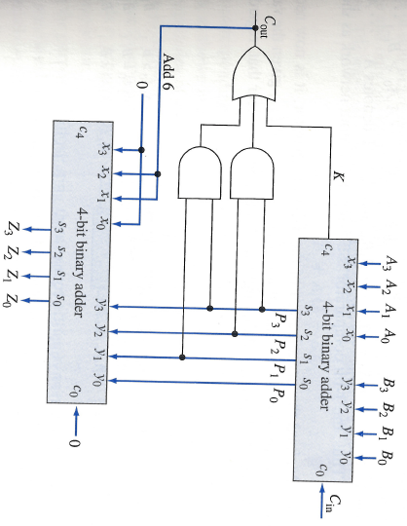
A single-decade BCD Adder

Slide 9
Comparators
Compare the magnitude of two binary numbers for the purpose of establishing whether one is greater than, equal to, or less than the other.
A comparator makes use of a cascade connection of identical subnetworks similar to the case of the parallel adder.

Slide 10
Comparators
Consider two n-bit binary numbers:
$$A=A_{n−1}⋯A_{i}A_{i−1}⋯A_{1}A_{0}$$
$$B=B_{n−1}⋯B_{i}B_{i−1}⋯B_{1}B_{0}$$
Assume $A_{i}, B_{i}$ are entering the subnetwork and that the binary numbers are analyzed from right to left.
Subnetwork is called a 1-bit comparator.

Slide 11
Comparators
3 conditions describing the relative magnitudes of $A_{i−1}⋯A_{1}A_{0}$, $B_{i−1}⋯B_{1}B_{0}$
$G_{i}=1$ denotes $A_{i−1}⋯A_{1}A_{0}>B_{i−1}⋯B_{1}B_{0}$
$E_{i}=1$ denotes $A_{i−1}⋯A_{1}A_{0}=B_{i−1}⋯B_{1}B_{0}$
$L_{i}=1$ denotes $A_{i−1}⋯A_{1}A_{0}<B_{i−1}⋯B_{1}B_{0}$
1-bit comparator is a 5-input 3-output network

Slide 12
Comparators
Rules:
If $A_{i}=0, B_{i}=1$ then $L_{i}=1$
If $A_{i}=1, B_{i}=0$ then $G_{i}=1$
If $A_{i}=B_{i}$ and $L_{i−1}=1$ then $L_{i}=1$
If $A_{i}=B_{i}$ and $G_{i−1}=1$ then $G_{i}=1$
If $A_{i}=B_{i}$ and $E_{i−1}=1$ then $E_{i}=1$
Can use this to construct a truth table.

Slide 13
Comparators
Minimal Sum Boolean Expressions:
$G_{i+1}=A_{i}{\overline{B}}_{i}+A_{i}G_{i}+{\overline{B}}_{i}G_{i}$
$$E_{i+1}={\overline{A}}_{i}{\overline{B}}_{i}E_{i}+A_{i}B_{i}E_{i}$$
$$L_{i+1}={\overline{A}}_{i}B_{i}+B_{i}L_{i}+{\overline{A}}_{i}L_{i}$$

Slide 14
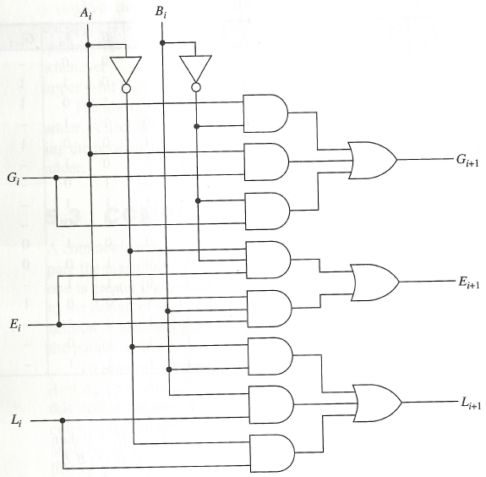
Comparators

Slide 15
Comparators

Slide 16
Decoder
Digital information represented in some binary form must be converted into some alternate binary form.
$n$ to $2^{n}$-line decoder.
Only one of the $2^{n}$ output lines responds, with a logic-1, to a given input combination of values on its $n$-input lines.

Slide 17
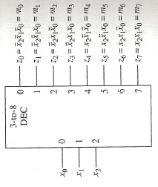
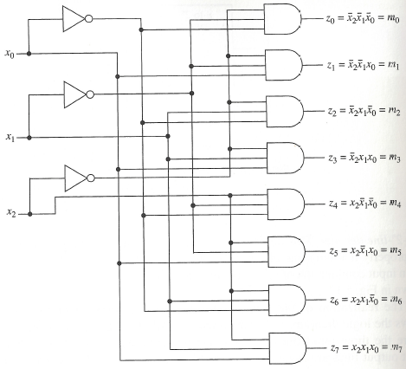
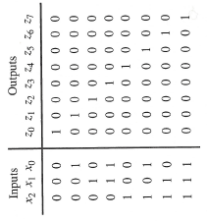
Realization
Symbol
Logic Diagram
Truth Table

Slide 18
Decoder
Input combinations can be regarded as binary numbers with the consequences that the j-th output line is at logic-1 for j = 0, 1, . . , 7 only when input combination j is applied.

Slide 19
Other types of Decoders
Function-specific decoders with less than $2^{n}$ outputs exist.
Example: Decoder with 4 inputs and 10 outputs in which a single responding output line corresponds to a combination of the 8421 code.
Example: Four input, seven output decoder that accepts the 4 bits of the 8421 code and is used to drive a seven-segment display.

Slide 20
Logic Design Using Decoders
An $n$-to-$2^{n}$ line decoder is a minterm generator.
By using or-gates in conjunction with an $n$-to-$2^{n}$ line decoder, realizations of Boolean functions are possible.
Do not correspond to minimal sum-of-products.
Are simple to produce. Particularly convenient when several functions of the same variable have to be realized.

Slide 21
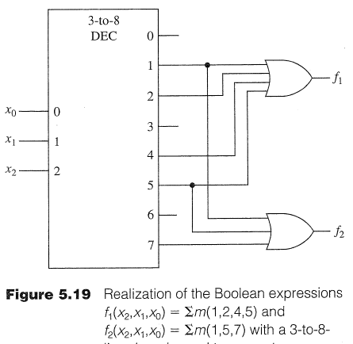
Minterms using OR Gates

Slide 22
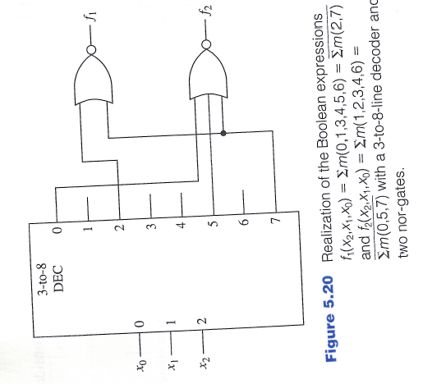
Minterms using NOR Gates

Slide 23
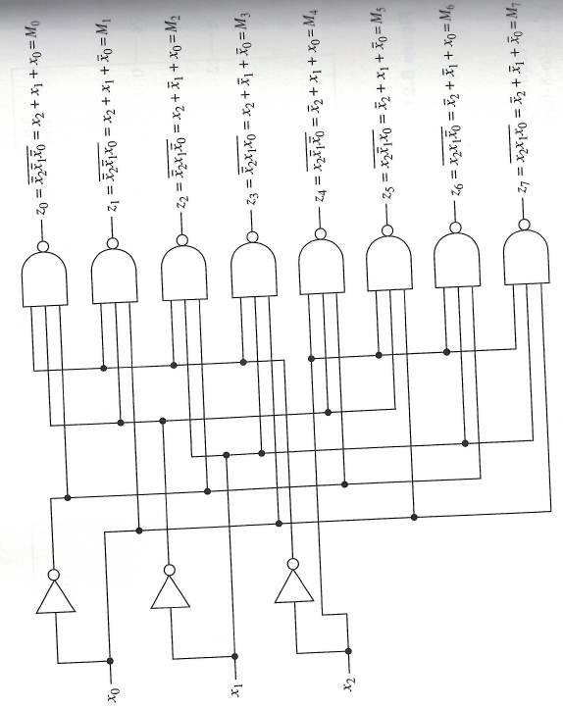
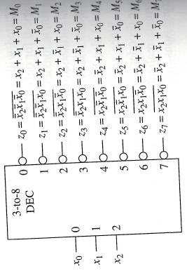
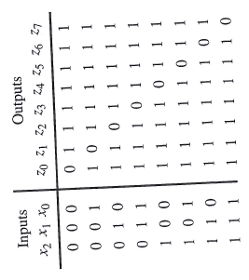
Implementing a Decoder using NAND
Symbol
Logic Diagram
Truth Table

Slide 24
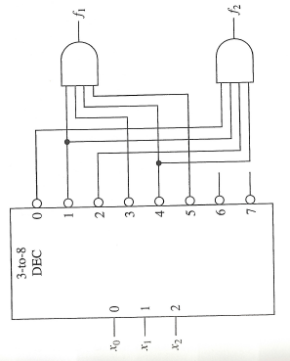
Minterms using AND gates
$$f_{1}=∑m\left(0,2,6,7\right), f_{2}=∑m(3,5,6,7)$$

Slide 25
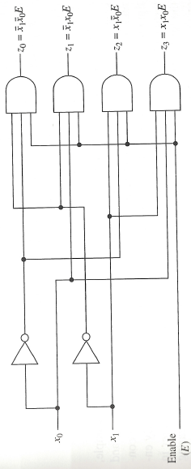
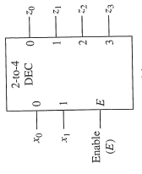
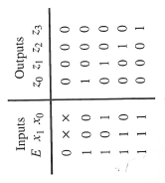
Decoders with an Enable Input
Symbol
Logic Diagram
Truth Table

Slide 26
Decoders with enable inputs
When disabled, all outputs of the decoder can either be at logic-0 or logic-1.
Enable input provides the decoder with additional flexibility. Idea: data is applied to the enable input.
Process is known as demultiplexing.
Enable inputs are useful when constructing larger decoders from smaller decoders.
$${\overline{x}}_{0}{\overline{x}}_{1}E$$
If $x_{0}=0, x_{1}=0$ then data appears on line $z_{0}$.
Data

Slide 27
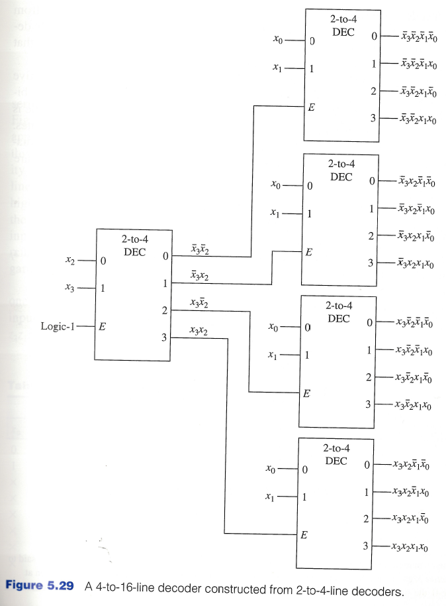
Constructing Larger Decoders

Slide 28
Encoders
Encoders provide for the conversion of binary information from one form to another.
Encoders are essentially the inverse of decoders.
$2^{n}$-to-$n$-line encoder in which an assertive logic value on one of its $2^{n}$-input lines causes the corresponding binary code to appear at the output lines.

Slide 29
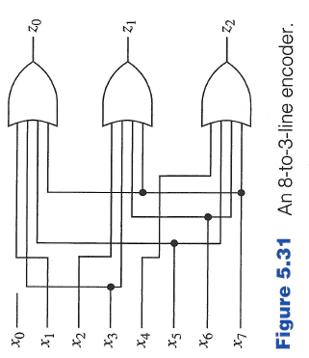
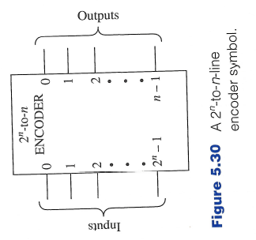
Encoders
Equations for 8-to-3-line encoder:
$$z_{0}=x_{1}+x_{3}+x_{5}+x_{7}$$
$$z_{1}=x_{2}+x_{3}+x_{6}+x_{7}$$
$$z_{2}=x_{4}+x_{5}+x_{6}+x_{7}$$
In general, the Boolean expression for the output $z_{i}$ is the sum of each input $x_{j}$ in which the binary representation of $j$ has a 1 in the $2^{i}$-bit position.

Slide 30
Priority Encoder
The assumption that at most a single input to the encoder is asserted at any time is significant in its operation.
Example: Both $x_{3} (11)$ and $x_{5} (101)$ are asserted. What is the output?
$111 \left(x_{7}\right)$
Priority Encoder:
A priority scheme is assigned to the input lines so that whenever more than one input line is asserted at any time, the output is determined by the input line having the highest priority.

Slide 31
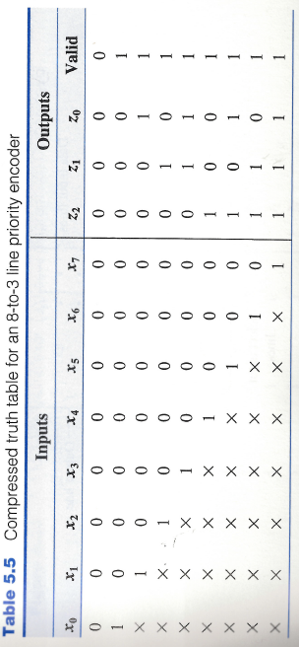
Priority Encoder
The output is determined by the asserted input having the highest index.
$x_{i}$ has higher priority than $x_{j}$ if $i>j.$
“Valid” indicates that at least one input line is asserted.
This distinguishes the situation that no input line is asserted from when the $x_{0}$ input line is asserted, since in both cases $z_{2}z_{1}z_{0}=000.$

