Slide 1
Digital Logic Design
Lecture 13

Slide 2
Announcements
HW5 up on course webpage. Due on Tuesday, 10/21 in class.
Upcoming: Exam on October 28. Will cover material from Chapter 4. Details to follow soon.

Slide 3
Agenda
Last time
Using 3,4 variable K-Maps to find minimal expressions (4.5)
This time
Minimal expressions for incomplete Boolean functions (4.6)
5 and 6 variable K-Maps (4.7)
Petrick’s method of determining irredundant expressions (4.9)

Slide 4
Minimal Expressions of Incomplete Boolean Functions
Recall an incomplete Boolean function has a truth table which contains dashed functional entries indicating don’t-care conditions.
Idea: Can replace don’t-care entries with either 0s or 1s in order to form the largest possible subcubes.

Slide 5
Example
$$f\left(w,x,y,z\right)=∑m\left(0,1,2,5,8,15\right)+dc(6,7,10)$$
$$yz$$
00
01
11
10
00
0 | 1 | 3 | 2
4 | 5 | 7 | 6
12 | 13 | 15 | 14
8 | 9 | 11 | 10
01
$$wx$$
11
10

Slide 6
Example
$$f\left(w,x,y,z\right)=∑m\left(0,1,2,5,8,15\right)+dc(6,7,10)$$
$$yz$$
00
01
11
10
00
1 | 1 | 0 | 1
0 | 1 | -- | --
0 | 0 | 1 | 0
1 | 0 | 0 | --
01
$$wx$$
11
10

Slide 7
Example
Step 1: Find prime implicants (pretend don’t care cells set to 1)
$$yz$$
00
01
11
10
00
1 | 1 | 0 | 1
0 | 1 | -- | --
0 | 0 | 1 | 0
1 | 0 | 0 | --
01
$$wx$$
11
10

Slide 8
Example
Step 2: Find essential prime implicants (discount don’t care cells)
$$yz$$
00
01
11
10
00
1 | 1 | 0 | 1
0 | 1 | -- | --
0 | 0 | 1 | 0
1 | 0 | 0 | --
01
$$wx$$
11
10
Essential prime implicants: $\overline{x} \overline{z}, xyz$

Slide 9
Example
Step 3: Add prime implicants to cover all 1-cells (discount don’t care cells)
$$yz$$
00
01
11
10
00
1 | 1 | 0 | 1
0 | 1 | -- | --
0 | 0 | 1 | 0
1 | 0 | 0 | --
01
$$wx$$
11
10
Essential prime implicants: $\overline{x} \overline{z}, xyz$
Add: $\overline{w} \overline{y} z$

Slide 10
Example
Step 3: Add prime implicants to cover all 1-cells (discount don’t care cells)
$$yz$$
00
01
11
10
00
1 | 1 | 0 | 1
0 | 1 | -- | --
0 | 0 | 1 | 0
1 | 0 | 0 | --
01
$$wx$$
11
10
Final minimal DNF: $\overline{x} \overline{z}+ xyz+\overline{w}\overline{y} z$

Slide 11
Five and Six Variable K-Maps

Slide 12
Five Variable K-Maps
We can visualize five-variable map in two different ways:

Slide 13
Five Variable K-Maps
$$xyz$$
000
001
011
010
110
111
101
100
00
0 | 1 | 3 | 2
8 | 9 | 11 | 10
24 | 25 | 27 | 26
16 | 17 | 19 | 18
6 | 7 | 5 | 4
14 | 15 | 13 | 12
30 | 31 | 29 | 28
22 | 23 | 21 | 20
01
$$vw$$
11
10
Subcubes: Two subcubes are possible about the mirror-image line. If there are two rectangular groupings of the same $2^{a}×2^{b}$ dimensions on both halves and the two groupings are the mirror image of each other.

Slide 14
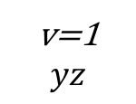
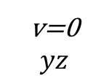
Five Variable K-Maps
v=0
$$yz$$
0 | 1 | 3 | 2
4 | 5 | 7 | 6
12 | 13 | 15 | 14
8 | 9 | 11 | 10
$$wx$$
v=1
$$yz$$
16 | 17 | 19 | 18
20 | 21 | 23 | 22
28 | 29 | 31 | 30
24 | 25 | 27 | 26
$$wx$$
Subcubes: If each layer contains a $2^{a}×2^{b}$ subcube such that they can be viewed as being directly above and below each other, then the two subcubes collectively form a single subcube consisting of $2^{a+b+1}$ cells.

Slide 15
Example
$$f\left(v,w,x,y,z\right)=∑m(1,5,9,11,13,20,21,26,27,28,29,30,31)$$
v=0
$$yz$$
0 | 1 | 0 | 0
0 | 1 | 0 | 0
0 | 1 | 0 | 0
0 | 1 | 1 | 0
$$wx$$
v=1
$$yz$$
0 | 0 | 0 | 0
1 | 1 | 0 | 0
1 | 1 | 1 | 1
0 | 0 | 1 | 1
$$wx$$

Slide 16
Example
Step 1: Find all Prime Implicants.
v=0
$$yz$$
0 | 1 | 0 | 0
0 | 1 | 0 | 0
0 | 1 | 0 | 0
0 | 1 | 1 | 0
$$wx$$
v=1
$$yz$$
0 | 0 | 0 | 0
1 | 1 | 0 | 0
1 | 1 | 1 | 1
0 | 0 | 1 | 1
$$wx$$

Slide 17
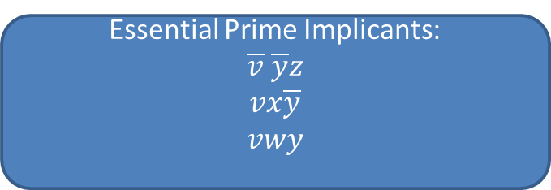
Example
Step 2: Find all Essential Prime Implicants.
v=0
$$yz$$
00
0 | 1 | 0 | 0
0 | 1 | 0 | 0
0 | 1 | 0 | 0
0 | 1 | 1 | 0
01
v=1
$$yz$$
$$wx$$
11
0 | 0 | 0 | 0
1 | 1 | 0 | 0
1 | 1 | 1 | 1
0 | 0 | 1 | 1
10
$$wx$$
Essential Prime Implicants:
$$\overline{v} \overline{y}z$$
$$vx\overline{y}$$
$$vwy$$

Slide 18
Example
Step 2: Find all Essential Prime Implicants.
v=0
$$yz$$
0 | 1 | 0 | 0
0 | 1 | 0 | 0
0 | 1 | 0 | 0
0 | 1 | 1 | 0
$$wx$$
v=1
$$yz$$
0 | 0 | 0 | 0
1 | 1 | 0 | 0
1 | 1 | 1 | 1
0 | 0 | 1 | 1
$$wx$$
Essential Prime Implicants:
$$\overline{v} \overline{y}z$$
$$vx\overline{y}$$
$$vwy$$

Slide 19
Example
Step 2: Find all Essential Prime Implicants.
v=0
$$yz$$
0 | 1 | 0 | 0
0 | 1 | 0 | 0
0 | 1 | 0 | 0
0 | 1 | 1 | 0
$$wx$$
v=1
$$yz$$
0 | 0 | 0 | 0
1 | 1 | 0 | 0
1 | 1 | 1 | 1
0 | 0 | 1 | 1
$$wx$$
Final minimal DNF:
$$\overline{v} \overline{y}z+vx\overline{y}+vwy+w\overline{x}yz$$

Slide 20
Six Variable K-Maps
We can visualize a six-variable map in two different ways:

Slide 21
Six Variable K-Maps
$$xyz$$
000
001
011
010
110
111
101
100
000
0 | 1 | 3 | 2
8 | 9 | 11 | 10
24 | 25 | 27 | 26
16 | 17 | 19 | 18
6 | 7 | 5 | 4
14 | 15 | 13 | 12
30 | 31 | 29 | 28
22 | 23 | 21 | 20
001
011
$$uvw$$
010
110
48 | 49 | 51 | 50
56 | 57 | 59 | 58
40 | 41 | 43 | 42
32 | 33 | 35 | 34
54 | 55 | 53 | 52
62 | 63 | 61 | 60
46 | 47 | 45 | 44
38 | 39 | 37 | 36
111
101
100
Subcubes: If each quadrant has a rectangular grouping of dimensions $2^{a}×2^{b}$ and each grouping is a mirror image of the other about both the horizontal and vertical mirror-image lines.

Slide 22
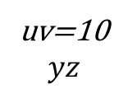
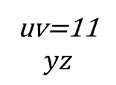
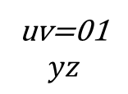
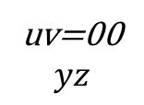
Six Variable K-Maps
uv=00
$$yz$$
0 | 1 | 3 | 2
4 | 5 | 7 | 6
12 | 13 | 15 | 14
8 | 9 | 11 | 10
uv=01
$$yz$$
16 | 17 | 19 | 18
20 | 21 | 23 | 22
28 | 29 | 31 | 30
24 | 25 | 27 | 26
uv=11
$$yz$$
$$wx$$
48 | 49 | 51 | 50
52 | 53 | 55 | 54
60 | 61 | 63 | 62
56 | 57 | 59 | 58
uv=10
$$yz$$
$$wx$$
32 | 33 | 35 | 34
36 | 37 | 39 | 38
44 | 45 | 47 | 46
40 | 41 | 43 | 42
$$wx$$
$$wx$$
Subcubes: Subcubes occurring in corresponding positions on all four layers collectively form a single subcube.

Slide 23
An Algorithm for the Final Step in Expression Minimization

Slide 24
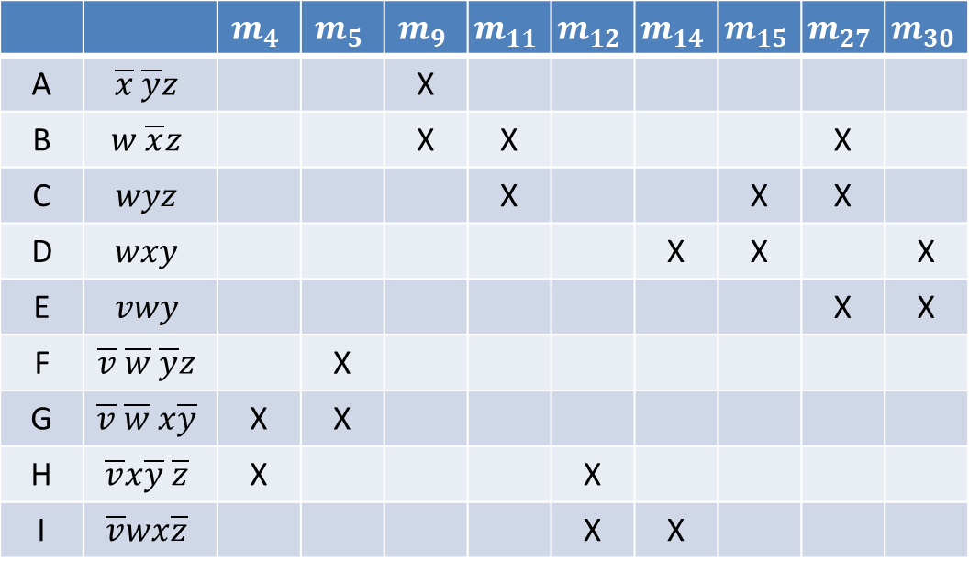
Petrick’s Method of Determining Irredundant Expressions
 |  | $$m_{4}$$ | $$m_{5}$$ | $$m_{9}$$ | $$m_{11}$$ | $$m_{12}$$ | $$m_{14}$$ | $$m_{15}$$ | $$m_{27}$$ | $$m_{30}$$
A | $$\overline{x} \overline{y}z$$ |  |  | X
B | $$w \overline{x}z$$ |  |  | X | X |  |  |  | X
C | $$wyz$$ |  |  |  | X |  |  | X | X
D | $$wxy$$ |  |  |  |  |  | X | X |  | X
E | $$vwy$$ |  |  |  |  |  |  |  | X | X
F | $$\overline{v} \overline{w} \overline{y}z$$ |  | X
G | $$\overline{v} \overline{w} x\overline{y}$$ | X | X
H | $$\overline{v}x\overline{y} \overline{z}$$ | X |  |  |  | X
I | $$\overline{v}wx\overline{z}$$ |  |  |  |  | X | X
The covering problem: Determine a subset of prime implicants that covers the table.
A minimal cover is an irredundant cover that corresponds to a minimal sum of the function.

Slide 25
Petrick’s Method of Determining Irredundant Expressions
 |  | $$m_{4}$$ | $$m_{5}$$ | $$m_{9}$$ | $$m_{11}$$ | $$m_{12}$$ | $$m_{14}$$ | $$m_{15}$$ | $$m_{27}$$ | $$m_{30}$$
A | $$\overline{x} \overline{y}z$$ |  |  | X
B | $$w \overline{x}z$$ |  |  | X | X |  |  |  | X
C | $$wyz$$ |  |  |  | X |  |  | X | X
D | $$wxy$$ |  |  |  |  |  | X | X |  | X
E | $$vwy$$ |  |  |  |  |  |  |  | X | X
F | $$\overline{v} \overline{w} \overline{y}z$$ |  | X
G | $$\overline{v} \overline{w} x\overline{y}$$ | X | X
H | $$\overline{v}x\overline{y} \overline{z}$$ | X |  |  |  | X
I | $$\overline{v}wx\overline{z}$$ |  |  |  |  | X | X
p-expression: (G+H)(F+G)(A+B)(B+C)(H+I)(D+I)(C+D)(B+C+E)(D+E)
The p-expression equals 1 iff a sufficient subset of prime implicants is selected.

Slide 26
P-expressions
If a p-expression is manipulated into its sum-of-products form using the distributive law, duplicate literals deleted in each resulting product term and subsuming product temrms deleted, then each remaining product term represents an irredundant cover of the prime implicant table.
Since all subsuming product terms have been deleted, the resulting product terms must each describe an irredundant cover.
The irredundant DNF is obtained by summing the prime implicants indicated by the variables in a product term.

Slide 27
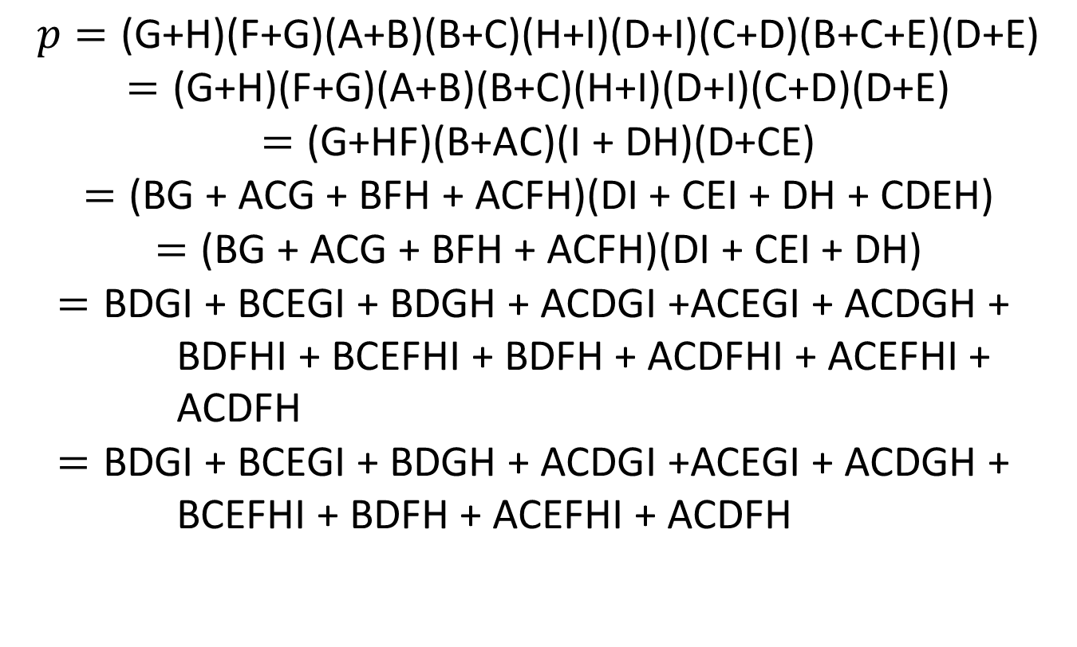
Simplifying p-expressions
$$p=\text{(}\text{G}\text{+}\text{H}\text{)(}\text{F}\text{+}\text{G}\text{)(}\text{A}\text{+}\text{B}\text{)(}\text{B}\text{+}\text{C}\text{)(}\text{H}\text{+}\text{I}\text{)(}\text{D}\text{+}\text{I}\text{)(}\text{C}\text{+}\text{D}\text{)(}\text{B}\text{+}\text{C}\text{+}\text{E}\text{)(}\text{D}\text{+}\text{E}\text{)}$$
$$=\text{(}\text{G}\text{+}\text{H}\text{)(}\text{F}\text{+}\text{G}\text{)(}\text{A}\text{+}\text{B}\text{)(}\text{B}\text{+}\text{C}\text{)(}\text{H}\text{+}\text{I}\text{)(}\text{D}\text{+}\text{I}\text{)(}\text{C}\text{+}\text{D}\text{)(}\text{D}\text{+}\text{E}\text{)}$$
$$=\text{(}\text{G}\text{+}\text{HF}\text{)(}\text{B}\text{+}\text{AC}\text{)(}\text{I}\text{ + }\text{DH}\text{)(}\text{D}\text{+}\text{CE}\text{)}$$
$$=\text{(}\text{BG}\text{ + }\text{ACG}\text{ + }\text{BFH}\text{ + }\text{ACFH}\text{)(}\text{DI}\text{ + }\text{CEI}\text{ + }\text{DH}\text{ + }\text{CDEH}\text{)}$$
$$=\text{(}\text{BG}\text{ + }\text{ACG}\text{ + }\text{BFH}\text{ + }\text{ACFH}\text{)(}\text{DI}\text{ + }\text{CEI}\text{ + }\text{DH}\text{)}$$
$$=\text{BDGI}\text{ + }\text{BCEGI}\text{ + }\text{BDGH}\text{ + }\text{ACDGI}\text{ +}\text{ACEGI}\text{ + }\text{ACDGH}\text{ + }\text{BDFHI}\text{ + }\text{BCEFHI}\text{ + }\text{BDFH}\text{ + }\text{ACDFHI}\text{ + }\text{ACEFHI}\text{ + }\text{ACDFH}$$
$$=\text{BDGI}\text{ + }\text{BCEGI}\text{ + }\text{BDGH}\text{ + }\text{ACDGI}\text{ +}\text{ACEGI}\text{ + }\text{ACDGH}\text{ + }\text{BCEFHI}\text{ + }\text{BDFH}\text{ + }\text{ACEFHI}\text{ + }\text{ACDFH}$$

Slide 28
Finding Minimal Sums
$$\text{BDGI}\text{ + }\text{BCEGI}\text{ + }\text{BDGH}\text{ + }\text{ACDGI}\text{ +}\text{ACEGI}\text{ + }\text{ACDGH}\text{ + }\text{BCEFHI}\text{ + }\text{BDFH}\text{ + }\text{ACEFHI}\text{ + }\text{ACDFH}$$
There are 10 irredundant expressions
Evaluate each one by the cost criteria to find the minimal sum.
Minimal DNFs correspond to the first, third and eighth terms.

