Slide 1
Compressive Sampling:
A Brief Overview
Ravi Garg
With slides contributed by
W.H.Chuang and Dr. Avinash L. Varna

Slide 2
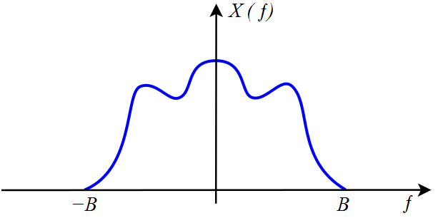
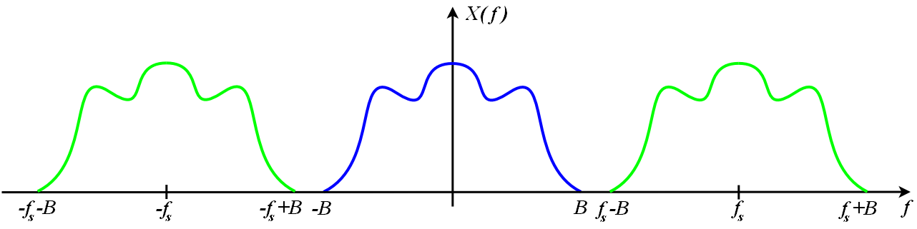
Sampling Theorem
Sampling: record a signal in the form of samples
Nyquist Sampling Theorem:
Signal can be perfectly reconstructed from samples (i.e.,
free from aliasing) if sampling rate ≥ 2 × signal bandwidth B
Samples are “measurements” of the signal
➔ serve as constraints that guide the reconstruction of
remaining signal

Slide 3
Sample-then-Compress Paradigm
Signal of interest is often compressible / sparse in a proper basis
  only small portion has large / non-zero values
If non-zero values spread wide, sampling rate has to be high, per Sampling Theorem
  In Fourier basis
Conventional data acquisition –
  sample at or above Nyquist rate
  compress to meet desired data rate
  May lose information

Slide 4
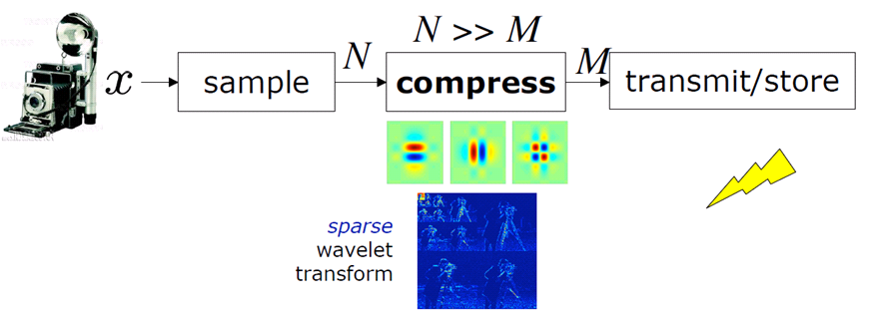

Sample-then-Compress Paradigm
often costly and wasteful!
Why even capture unnecessary data?
Romberg, “Compressed Sensing: A Tutorial”, IEEE Statistical Signal Processing Workshop, August 2007

Slide 5
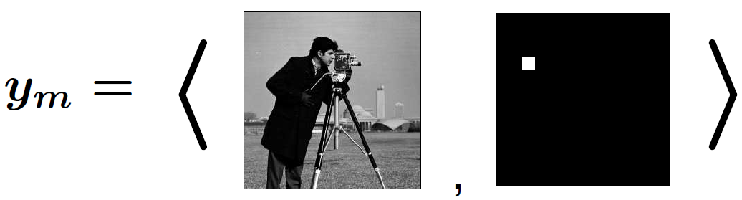
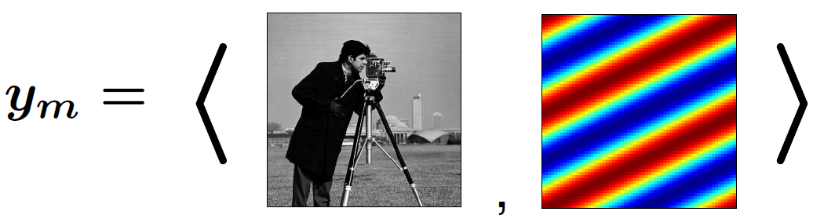
Signal Sampling by Linear Measurement
Linear measurements: inner product between signal and sampling basis functions
E.g..:
Pixels
Sinusoids
Romberg, “Compressed Sensing: A Tutorial”, IEEE Statistical Signal Processing Workshop, August 2007

Slide 6
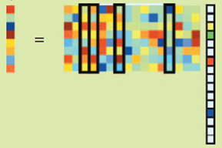
Signal Sampling by Linear Measurement
Assume: f is sparse under proper basis (sparsity basis)
Overall linear measurements: linear combinations of columns in Φ corresponding to non-zero entries in f
  Φ is known as measurement basis
Signal recovery requires special properties of Φ

Slide 7
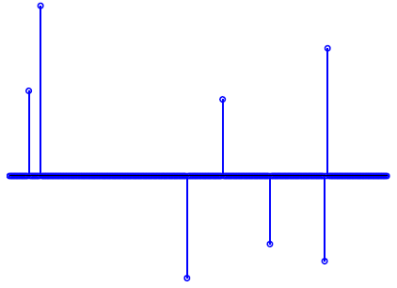
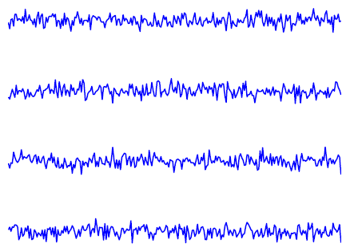
What Makes a Good Sampling Basis – Incoherence
Signal is local, measurements are global
Each measurement picks up a little info. about each component
“Triangulate” signal components from measurements
Sparse signal
Incoherent measurements
Romberg, “Compressed Sensing: A Tutorial”, IEEE Statistical Signal Processing Workshop, August 2007

Slide 8
Signal Reconstruction by L-0 / L-1 Minimization
Given the sparsity of signal and the incoherence between signal and sampling basis…
Perfect signal reconstruction by L-0 minimization:
  Believed to be NP hard: requires exhaustive enumeration of possible locations of the nonzero entries
Alternative: Signal reconstruction by L-1 minimization:
  Surprisingly, this can lead to perfect reconstruction under certain conditions!

Slide 9
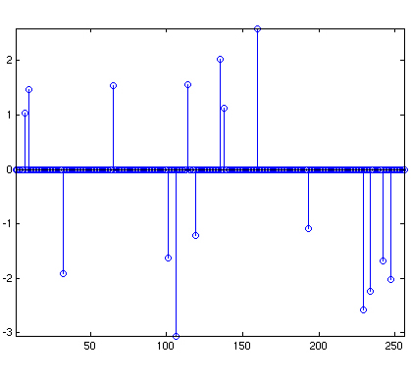
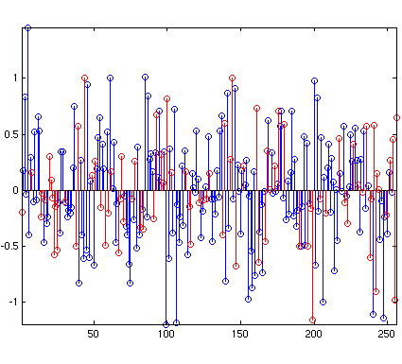
Example
Sparse signal in Fourier domain
Dense in time domain
Length 256 signal with 16 non-zero Fourier coefficients
Given only 80 samples
From: http://www.l1-magic.com

Slide 10
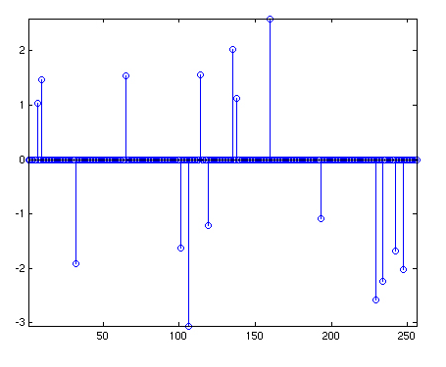
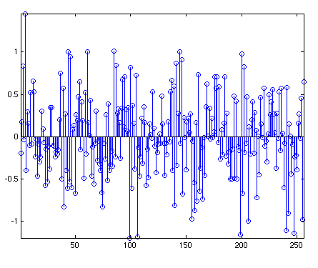
Reconstruction
Recovered signal in Fourier domain
Recovered signal in time domain
Perfect signal reconstruction

Slide 11
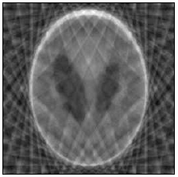
Image Reconstruction
Original Phantom Image
Fourier Sampling Mask
Min Energy Solution
L-1 norm minimization of gradient
From Notes with the l-1magic source package

Slide 12
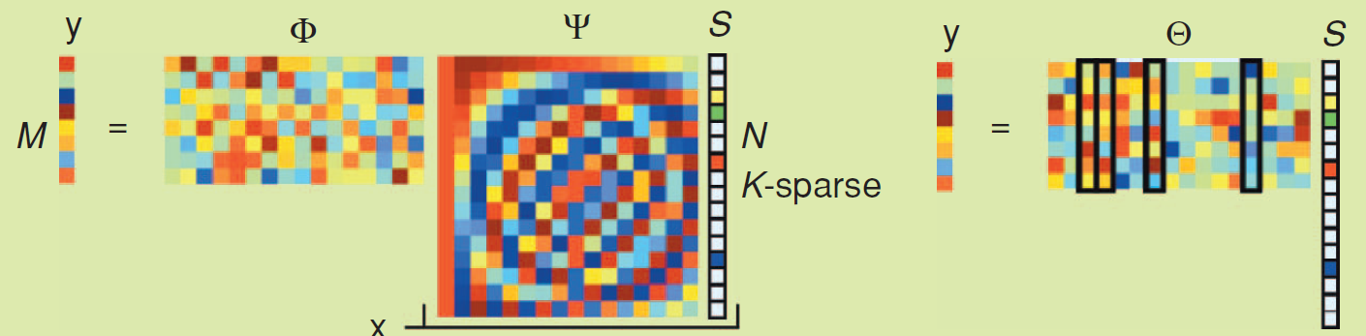
General Problem Statement
Suppose we are given M linear measurements of x
Is it possible to recover x ? How large should M be?
Image from: Richard Baraniuk, Compressive Sensing

Slide 13
Restricted Isometry Property
If the K locations of non-zero entries are known, then M ≥ K is sufficient, if the following property holds:
  Restricted Isometry Property (RIP):
  for any vector v sharing the same K locations and some s
  sufficiently small δ_{K}
  Θ= Φ Ψ “preserves” the lengths of these sparse vectors
RIP ensures that measurements and sparse vectors have good correspondence

Slide 14
Restricted Isometry Property
In general, locations of non-zero entries are unknown
A sufficient condition for signal recovery:
for arbitrary 3K–sparse vectors
RIP also ensures “stable” signal recovery:
good recovery accuracy in presence of
  Non-zero small entries
  Measurement errors

Slide 15
Random Measurement Matrices
In general, sparsifying basis Ψ may not be known
  Φ is non-adaptive, i.e., deterministic
  Construction of deterministic sampling matrix is difficult
Suppose Φ is an M x N matrix with i.i.d. Gaussian entries with M > C K log(N/K) << N
  Φ I = Φ satisfies RIP with high probability
  Φ is incoherent with the delta basis
  Further, Θ = Φ Ψ is also i.i.d. Gaussian for any orthonormal Ψ
  ➔ Φ is incoherent with every Ψ with high probability
Random matrices with i.i.d. ±1 entries also have RIP

Slide 16
Signal Reconstruction: L-2 vs L-0 vs L-1
Minimum L-2 norm solution
  Closed form solution exists; Almost always never finds sparsest solution
  Solution usually has lot of ringing
Minimum L-0 norm solution
  Requires exhaustive enumeration of possible locations of the nonzero entries
  NP hard
Minimum L-1 norm solution
  Can be reformulated as a linear program
  “L-1 trick”

Slide 17
Signal Reconstruction Methods
Convex optimization with efficient algorithms
  Basis pursuit by linear programming
  LASSO
  Danzig selector
  etc
Non-global optimization solutions are also available
  e.g.: Orthogonal Matching Pursuit

Slide 18
Summary
Given an N-dimensional vector x which is S-sparse in some basis
We obtain K random measurements of x of the form
with φ_{i} a vector with i.i.d Gaussian / ±1 entries
If we have sufficient measurements (<< N), then x can be almost always perfectly reconstructed by solving

Slide 19
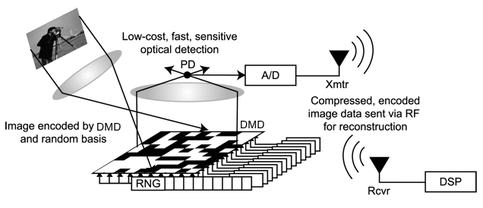
Single Pixel Camera
Capture Random Projections by setting the Digital Micromirror Device (DMD)
  Implements a ±1 random matrix generated using a seed
  Some sort of inherent “security” provided by seed
Image reconstruction after obtaining sufficient number of measurements
Michael Wakin, Jason Laska, Marco Duarte, Dror Baron, Shriram Sarvotham, Dharmpal Takhar, Kevin Kelly, and Richard Baraniuk, “An architecture for compressive imaging”. ICIP 2006

Slide 20
Advantages of CS camera
Single Low cost photodetector
Can be used in wavelength ranges where difficult / expensive to build CCD / CMOS arrays
Scalable progressive reconstruction
  Image quality can be progressively refined with more measurements
Suited to distributed sensing applications (such as sensor networks) where resources are severely restricted at sensor
Has been extended to the case of video

Slide 21
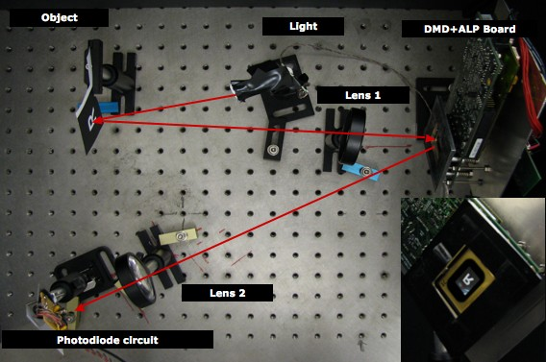
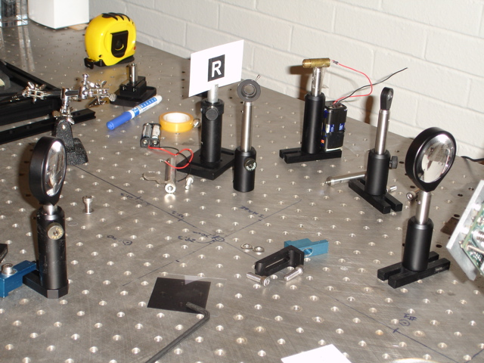
Experimental Setup
Images from http://www.dsp.rice.edu/cs/cscamera

Slide 22
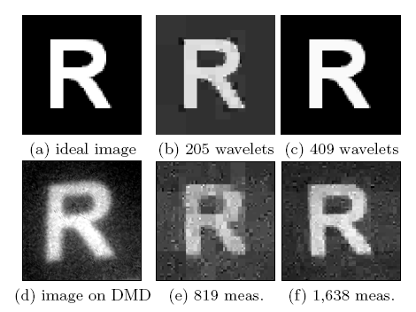
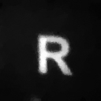
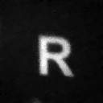
Experimental Results
1600 meas. (10%)
3300 meas. (20%)

Slide 23
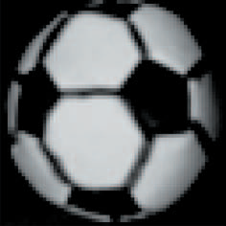




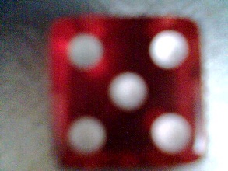
Experimental Results
Original Object
(4096 pixels)
4096 Pixels
800 Measurements
(20%)
4096 Pixels
1600 Measurements
(40%)
Original Object
4096 Pixels
800 Measurements
(20%)
4096 Pixels
1600 Measurements
(40%)

Slide 24
Error Correction
Let x denote a message to be transmitted (N – vector)
Choose A as an M x N (M > N) matrix with i.i.d. Gaussian entries
Transmit c = A x over the channel
Suppose y is the received vector which has errors in some unknown locations
y = c + e where e is an unknown sparse vector
Let F be such that FA = 0
➔ y’ = F y = FA x + Fe = Fe
e can be recovered by

Slide 25
Image Recovery
Main signal recovery problems can be approached by harnessing inherent signal sparsity
Assumption: image x can be sparsely represented by a “over-complete dictionary” D
  Fourier
  Wavelet
  Data-generated basis?
Signal recovery can be cast as

Slide 26
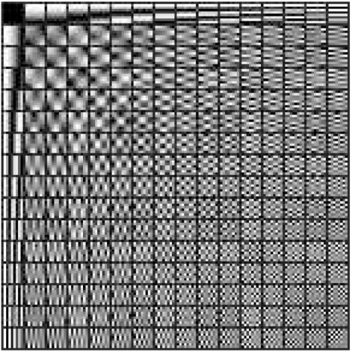
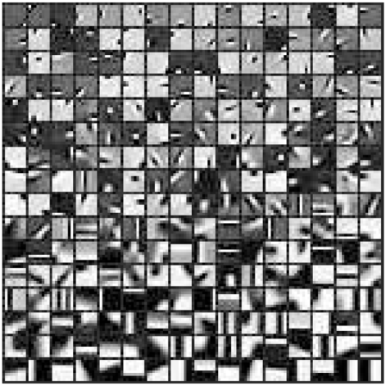

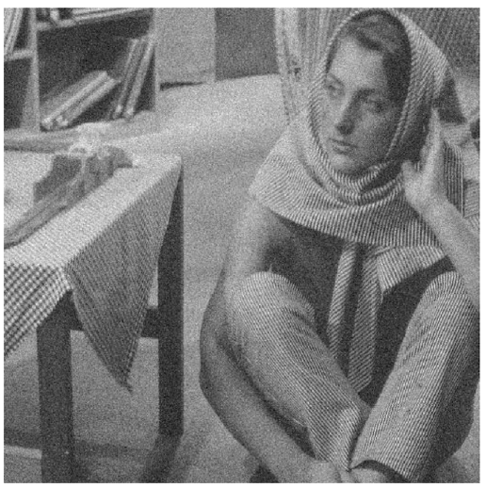
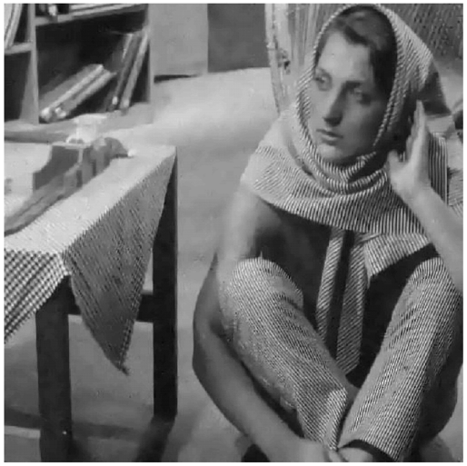
Image Denoising using Learned Dictionary
Two different types of dictionaries
Recovery results (origin – noisy – recovered)
Over-complete DCT dictionary
Trained Patch Dictionary

Slide 27
Compressive Sampling…
Has significant implications on data acquisition process
Allows us to exploit the underlying structure of the signal
  Mainly sparsity in some basis
High potential for cases where resources are scarce
  Medical imaging
  Distributed sensing in sensor networks
  Ultra wideband communications
  ….
Also has applications in
  Error-free communication
  Image processing
  …

Slide 28
References
Websites:
  http://www.dsp.rice.edu/cs/
  http://www.l1-magic.org/
Tutorials:
  Candes, “Compressive Sampling” , Proc. Intl. Congress of Mathematics, 2006
  Baraniuk, “Compressive Sensing”, IEEE Signal Processing Magazine, July 2007
  Candès and Wakin, “An Introduction to Compressive Sampling”. IEEE Signal Processing Magazine, March 2008.
  Romberg, “Compressed Sensing: A Tutorial”, IEEE Statistical Signal Processing Workshop, August 2007
Research Papers
  Candès, Romberg and Tao, “Robust uncertainty principles: exact signal reconstruction from highly incomplete frequency information”, IEEE Trans. Inform. Theory, vol. 52 (2006), 489–509
  Wakin, et al., “An architecture for compressive imaging”. ICIP 2006
  Candès and Tao, “Decoding by linear programming”, IEEE Trans. on Information Theory, 51(12), pp. 4203 - 4215, Dec. 2005
  Elad and Aharon, "Image Denoising Via Sparse and Redundant Representations Over Learned Dictionaries," IEEE Trans. On Image Processing, Dec. 2006

