Slide 1
INST201: Introduction to Information Science
Dr. Joel Chan
Office: 2118E Hornbake Building, South Wing
Email: joelchan@umd.edu
Week 11: Information Privacy

Slide 2
Learning goals
Define privacy (from different major perspectives), and distinguish from related concepts
Explain why privacy is hard in digital spaces
Explain some key privacy management mechanisms/strategies (along with strengths/weaknesses) available to individuals and society

Slide 3
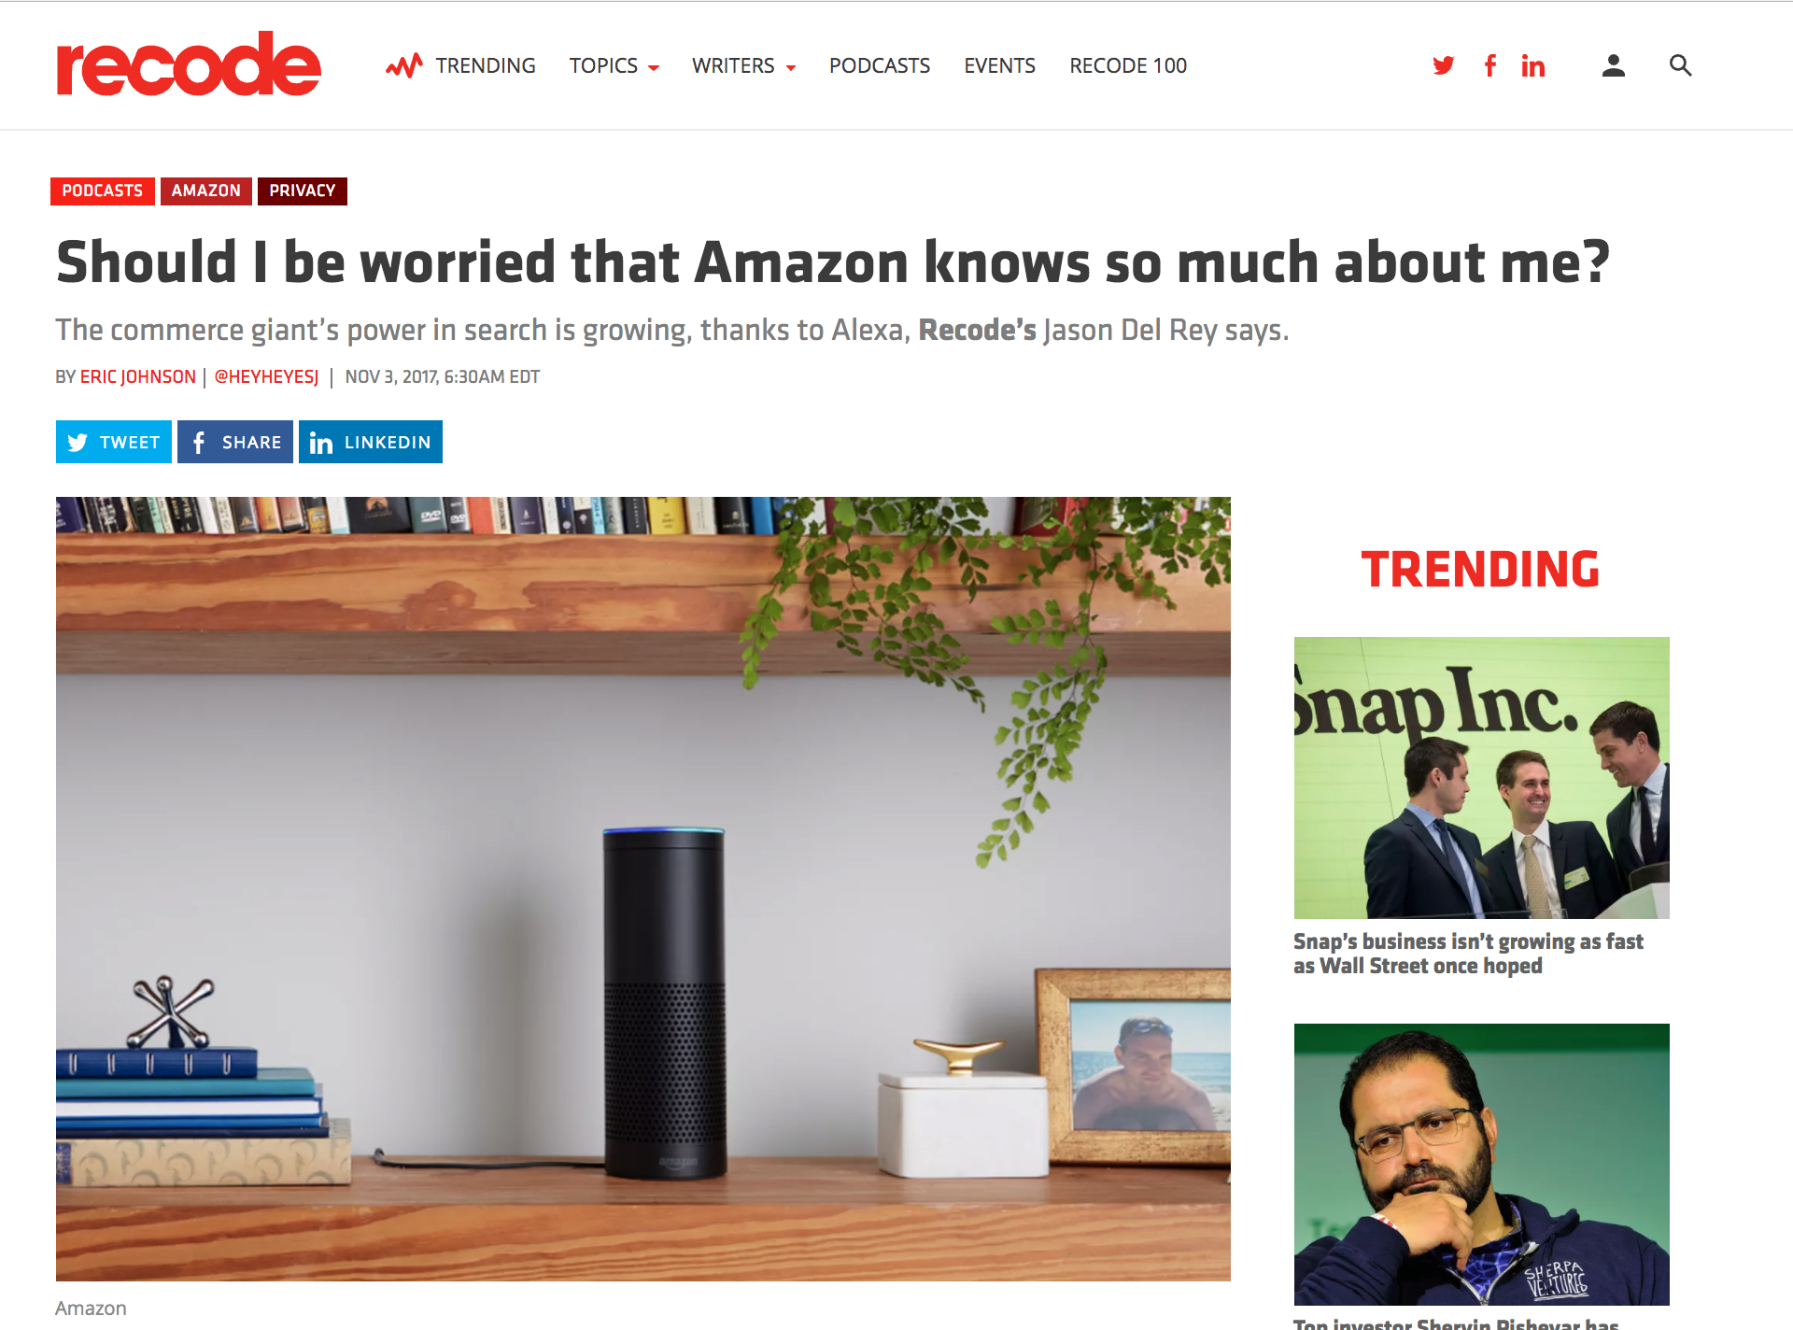

Slide 4
What words and images come to mind when you think of privacy?

Slide 5
We often treat privacy like it’s a
BLACK OR WHITE
issue
Upon closer examination, we realize most privacy issues are shades of gray.

Slide 6
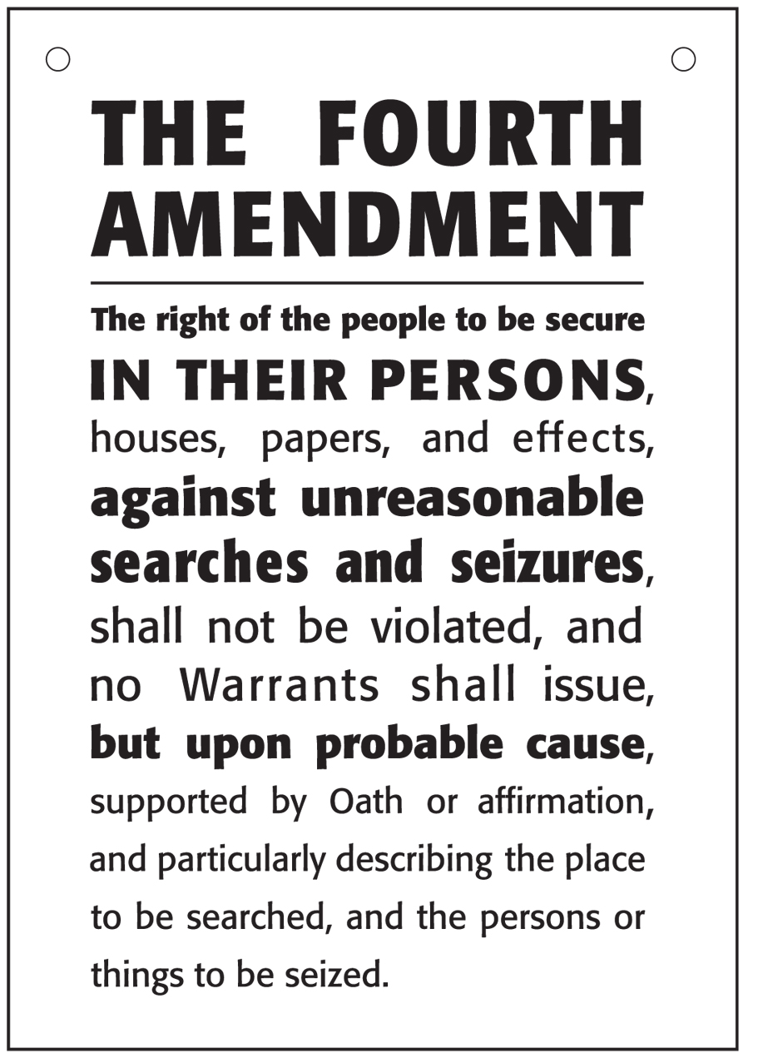
Historically speaking…
Privacy is a relatively new concept.
Google’s Cerf Says “Privacy May Be An Anomaly.” Historically, He’s Right. [TechCrunch]
Fourth Amendment to US Constitution is closest we get to founding fathers protecting individual privacy (1789).
The Right to Privacy (Harvard Law Review) –> first published legal document regarding privacy as a human right (1890).
Notes:
From Wikipedia: The Fourth Amendment (Amendment IV) to the United States Constitution is the part of the Bill of Rights that prohibits unreasonable searches and seizures and requires any warrant to be judicially sanctioned and supported by probable cause.
Case: Charles Katz used a public pay phone booth to transmit illegal gambling wagers from Los Angeles to Miami and Boston. Unbeknownst to Katz, the FBI was recording his conversations via an electronic eavesdropping device attached to the exterior of the phone booth. Katz was convicted based on these recordings. He challenged his conviction, arguing that the recordings were obtained in violation of his Fourth Amendment rights. The Court of Appeals sided with the FBI because there was no physical intrusion into the phone booth itself.
Constitutional issues of the case
Does the right to privacy extend to telephone booths and other public places?
Is a physical intrusion necessary to constitute a search?
Ruling
"The Government's activities in electronically listening to and recording the petitioner's words violated the privacy upon which he justifiably relied while using the telephone booth and thus constituted a 'search and seizure' within the meaning of the Fourth Amendment." – Justice Stewart
Regardless of the location, a conversation is protected from unreasonable search and seizure under the Fourth Amendment if it is made with a “reasonable expectation of privacy”.
Wiretapping counts as a search (physical intrusion is not necessary).

Slide 7
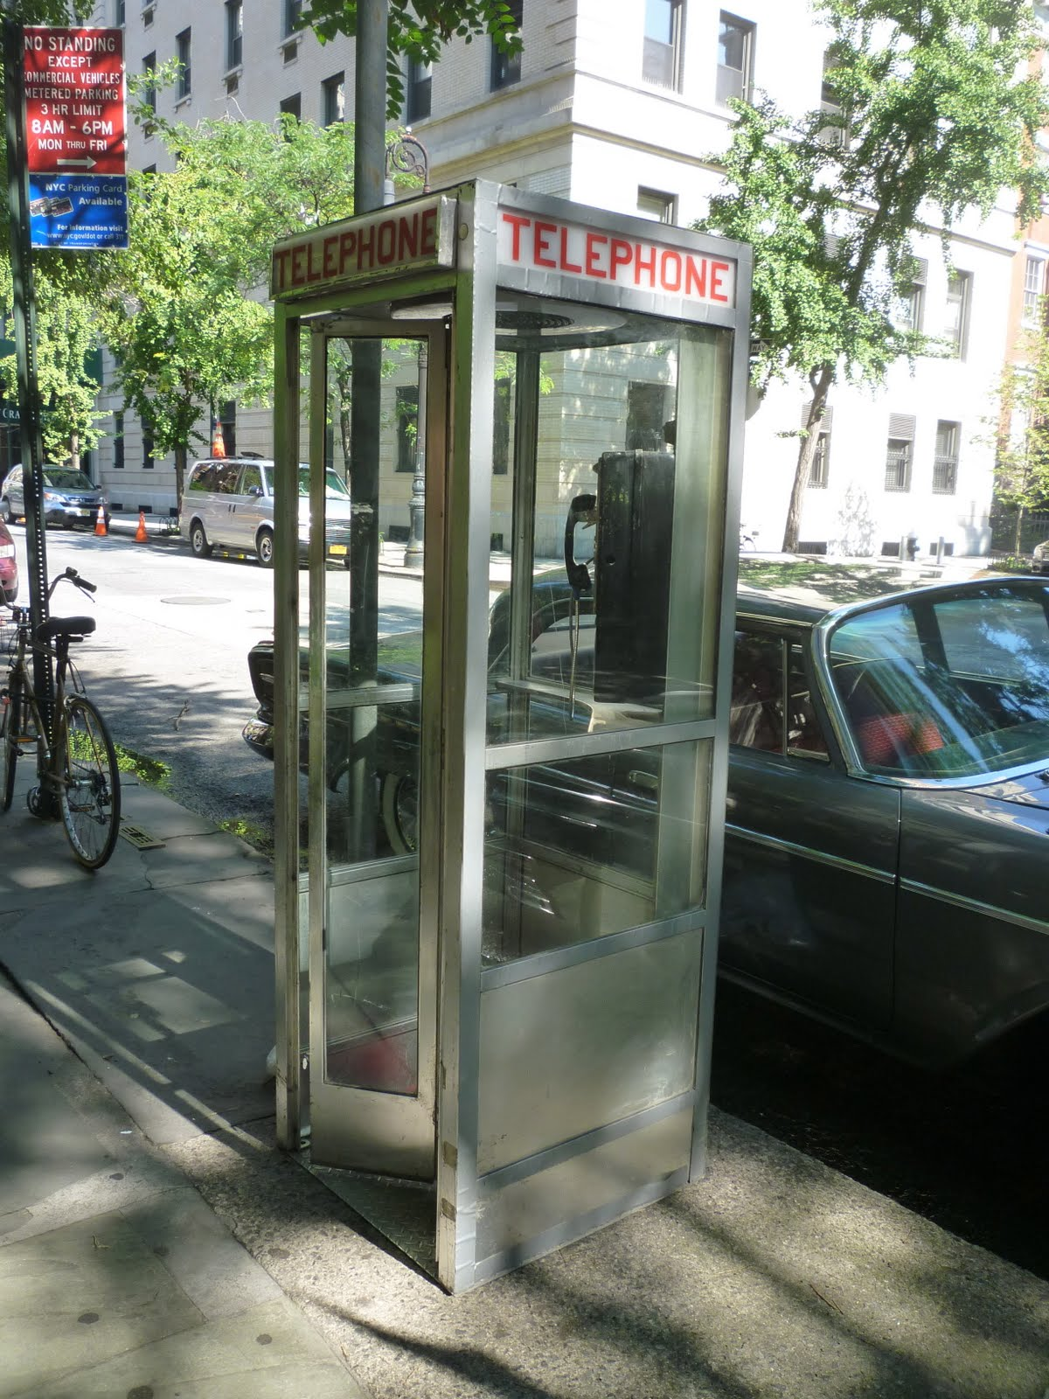
An opening example
Katz v. United States (1967)
Charles Katz used a public pay phone booth to transmit illegal gambling wagers from Los Angeles to Miami and Boston. Unbeknownst to Katz, the FBI was recording his conversations via an electronic eavesdropping device attached to the exterior of the phone booth. Katz was convicted based on these recordings. He challenged his conviction, arguing that the recordings were obtained in violation of his Fourth Amendment rights.
Notes:
From Wikipedia: The Fourth Amendment (Amendment IV) to the United States Constitution is the part of the Bill of Rights that prohibits unreasonable searches and seizures and requires any warrant to be judicially sanctioned and supported by probable cause.
Case: Charles Katz used a public pay phone booth to transmit illegal gambling wagers from Los Angeles to Miami and Boston. Unbeknownst to Katz, the FBI was recording his conversations via an electronic eavesdropping device attached to the exterior of the phone booth. Katz was convicted based on these recordings. He challenged his conviction, arguing that the recordings were obtained in violation of his Fourth Amendment rights. The Court of Appeals sided with the FBI because there was no physical intrusion into the phone booth itself.
Constitutional issues of the case
Does the right to privacy extend to telephone booths and other public places?
Is a physical intrusion necessary to constitute a search?
Ruling
"The Government's activities in electronically listening to and recording the petitioner's words violated the privacy upon which he justifiably relied while using the telephone booth and thus constituted a 'search and seizure' within the meaning of the Fourth Amendment." – Justice Stewart
Regardless of the location, a conversation is protected from unreasonable search and seizure under the Fourth Amendment if it is made with a “reasonable expectation of privacy”.
Wiretapping counts as a search (physical intrusion is not necessary).

Slide 8
An opening example
Katz v. United States (1967)
Refined the 4th Amendment section defining “unreasonable search and seizure” to provide a legal definition to “search”; also extended 4th Amendment rights to include “reasonable expectation of privacy.”
But who defines what is reasonable?
Notes:
From Wikipedia: The Fourth Amendment (Amendment IV) to the United States Constitution is the part of the Bill of Rights that prohibits unreasonable searches and seizures and requires any warrant to be judicially sanctioned and supported by probable cause.
Case: Charles Katz used a public pay phone booth to transmit illegal gambling wagers from Los Angeles to Miami and Boston. Unbeknownst to Katz, the FBI was recording his conversations via an electronic eavesdropping device attached to the exterior of the phone booth. Katz was convicted based on these recordings. He challenged his conviction, arguing that the recordings were obtained in violation of his Fourth Amendment rights. The Court of Appeals sided with the FBI because there was no physical intrusion into the phone booth itself.
Constitutional issues of the case
Does the right to privacy extend to telephone booths and other public places?
Is a physical intrusion necessary to constitute a search?
Ruling
"The Government's activities in electronically listening to and recording the petitioner's words violated the privacy upon which he justifiably relied while using the telephone booth and thus constituted a 'search and seizure' within the meaning of the Fourth Amendment." – Justice Stewart
Regardless of the location, a conversation is protected from unreasonable search and seizure under the Fourth Amendment if it is made with a “reasonable expectation of privacy”.
Wiretapping counts as a search (physical intrusion is not necessary).

Slide 9
Defining privacy
Four main frameworks for understanding privacy:
Privacy as a right (general): the “right to be left alone” (1890)
Privacy as a state (general): “limited access to a person” or “being apart from others”
Privacy as control: Altman’s “selective control of access to the self”; boundary regulation
Privacy as a commodity: we exchange some of our privacy for perceived benefits.
Common thread: control who has access to ”me”

Slide 10
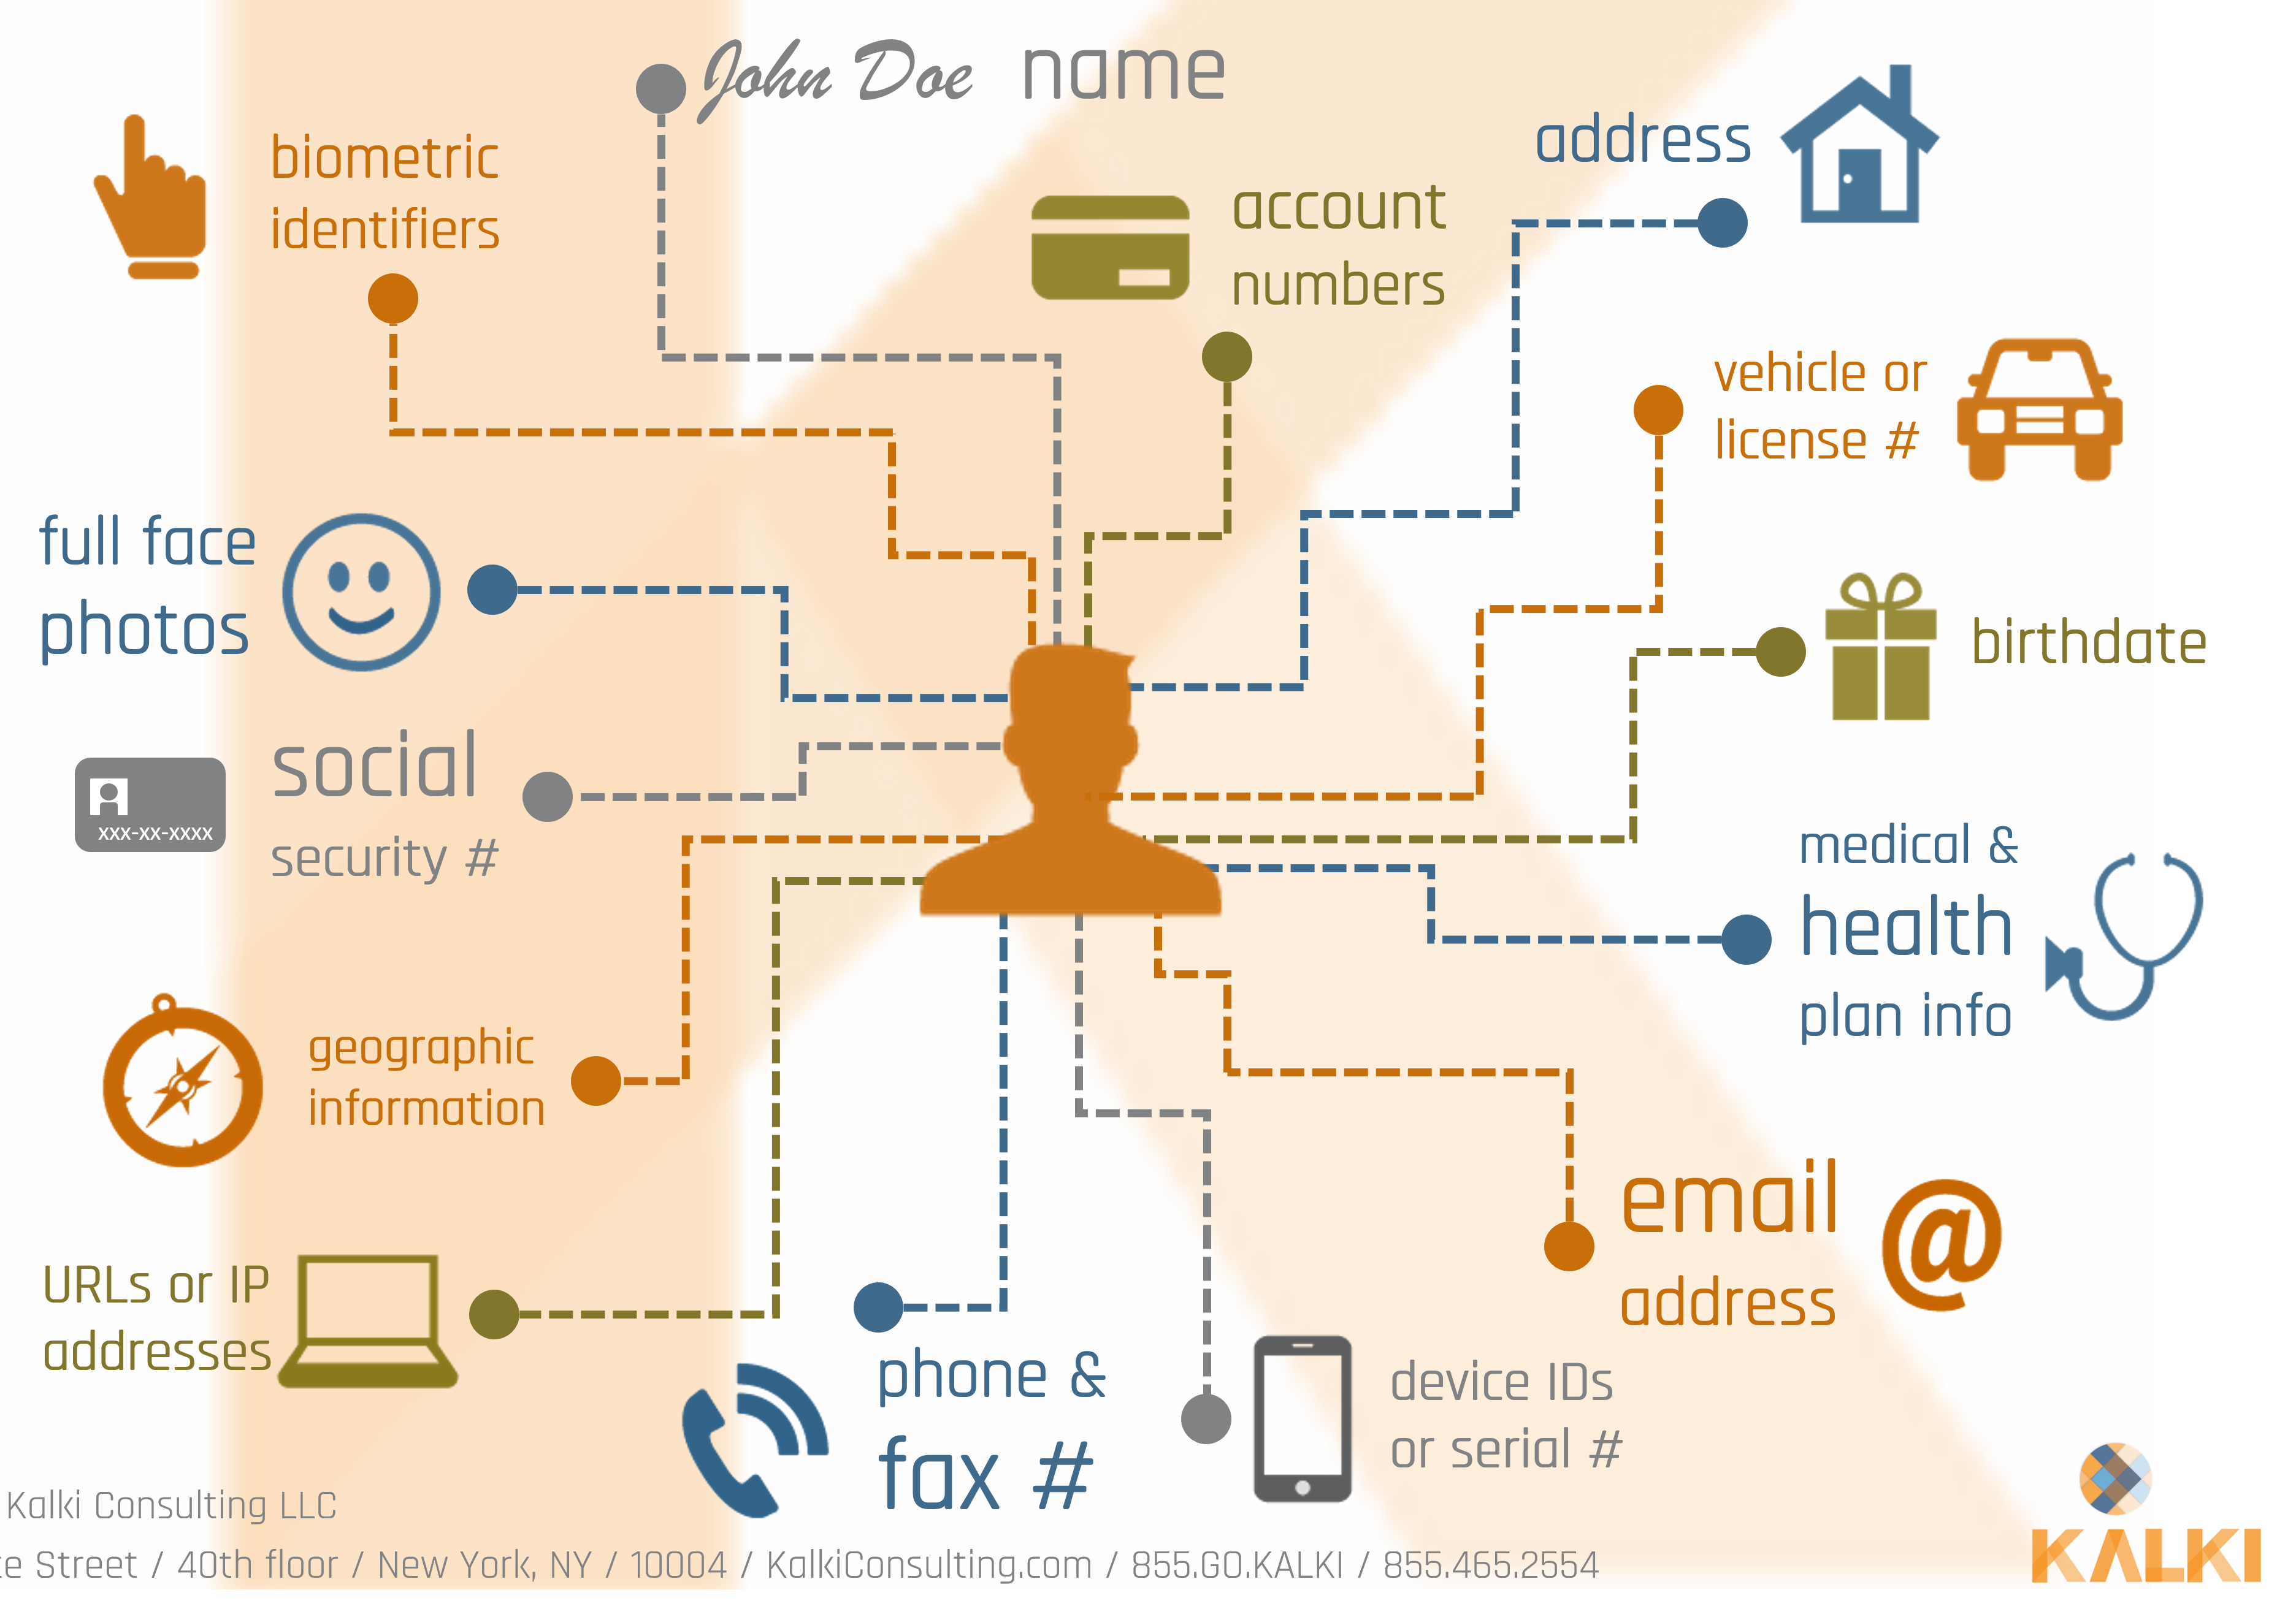
What is “me”?
Personally Identifiable Information (PII): generally thought to include name, date of birth, SSN, address, etc. More broadly, PII includes “any information that can be used to distinguish one person from another and can be used for de-anonymizing anonymous data.”

Slide 11
What Privacy Is Not: Related Concepts
Anonymity: ability to conceal one’s identity fully.
Related: pseudonymity, or use of ID/pseudonym/handle instead of person’s real name.
Confidentiality: externalization of restricted but accurate information to a specific entity; controlled release of information (e.g., to a doctor).
Secrecy: intentional concealment of information (think “secret” and “top secret” government documents).
Security: focus on protecting information across three areas: integrity, authentication, access (more on Friday)

Slide 12
What Privacy Is Not: Related Concepts
PRIVACY
SECURITY
right to be left alone
limited access to a person
selective control of access to the self
commodity
secrecy
confidentiality
anonymity

Slide 13
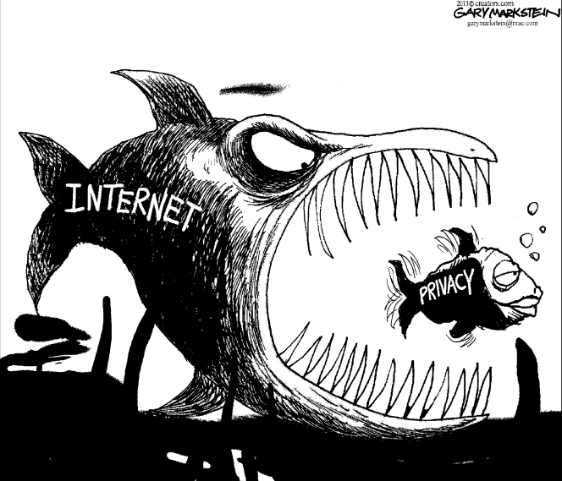
What makes privacy hard (in digital spaces)?

Slide 14
Public vs. (reasonably) private?
In most public spaces, we know we might be observed.
Notes:
Invisible audiences: not all audiences are visible when a person is contributing online, nor are they necessarily co-present.
Collapsed contexts: the lack of spatial, social, and temporal boundaries makes it difficult to maintain distinct social contexts.
The blurring of public and private: without control over context, public and private become meaningless binaries, are scaled in new ways, and are difficult to maintain as distinct.

Slide 15
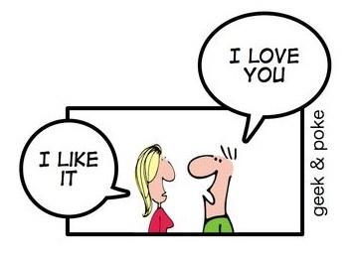
Public vs. (reasonably) private?
Digital spaces are increasingly networked publics
New technologies connect us more than ever…
...but they blur boundaries between public and private spaces.
This raises innumerable opportunities for communication misunderstandings, breakdowns, and norm violations.

Slide 16
Public vs. (reasonably) private?
Digital spaces are increasingly networked publics
Here, there are three main factors that make it harder to tell when you’re operating in a public space, a private space, or somewhere in between.
Invisible audiences
Context collapse due to the lack of spatial, social, and temporal boundaries
Blurring of public and private boundaries due to lack of control over context
Notes:
Invisible audiences: not all audiences are visible when a person is contributing online, nor are they necessarily co-present.
Collapsed contexts: the lack of spatial, social, and temporal boundaries makes it difficult to maintain distinct social contexts.
The blurring of public and private: without control over context, public and private become meaningless binaries, are scaled in new ways, and are difficult to maintain as distinct.

Slide 17
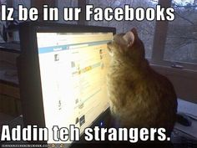
Invisible audiences
Imagined audience: “a person’s mental conceptualization of the people with whom he or she is communicating” (Litt, 2012).
Influenced by:
Environmental factors (e.g., social norms)
Individual factors (e.g., motivation/purpose for using site)
Notes:
Often difficult to perceive one’s full audience.
Imagined audience guides online performances.
So, for example, if I am using Twitter specifically to create my academic “brand,” I will likely have a different audience in mind when I tweet than if I was using the site primarily to follow my favorite celebrities and TV shows.

Slide 18
Who is my “audience”?
Notes:
https://support.mozilla.org/en-US/questions/975325?page=2

Slide 19
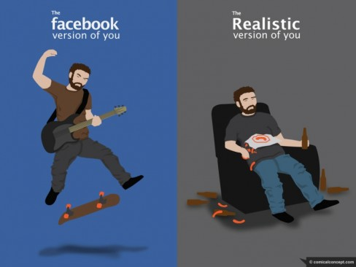
Selective self-presentation We highlight certain aspects of our identities and minimize others; this varies based on audience (remember the editability affordance?).

Slide 20
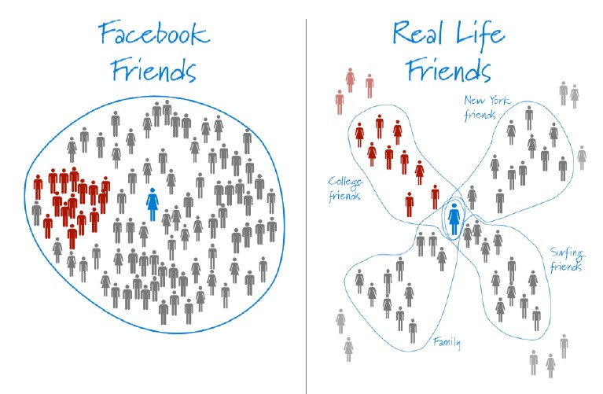
Why is this important? Context Collapse & Privacy Concerns
Paul Adams (2010)

Slide 21
Networked Public Problems: Context collapse can help or hurt your relationships
Strength of weak ties (Granovetter, 1973): users distribute content to entire network to increase likelihood that someone will see it and respond.
Privacy settings: users employ increasingly granular privacy settings to segment network into different audiences.
Lowest common denominator (Hogan, 2010): users only distribute content appropriate for all “friends.”

Slide 22
How do I know who is my audience?
What about:
Likes
Comments
Friends of friends
Tags
Photos
Etc.

Slide 23
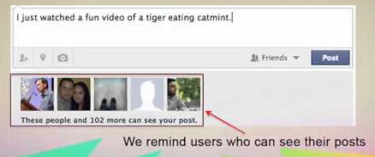
How do I know who is my audience?
Notes:
https://www.youtube.com/watch?v=4jPn2s9VLXU

Slide 24
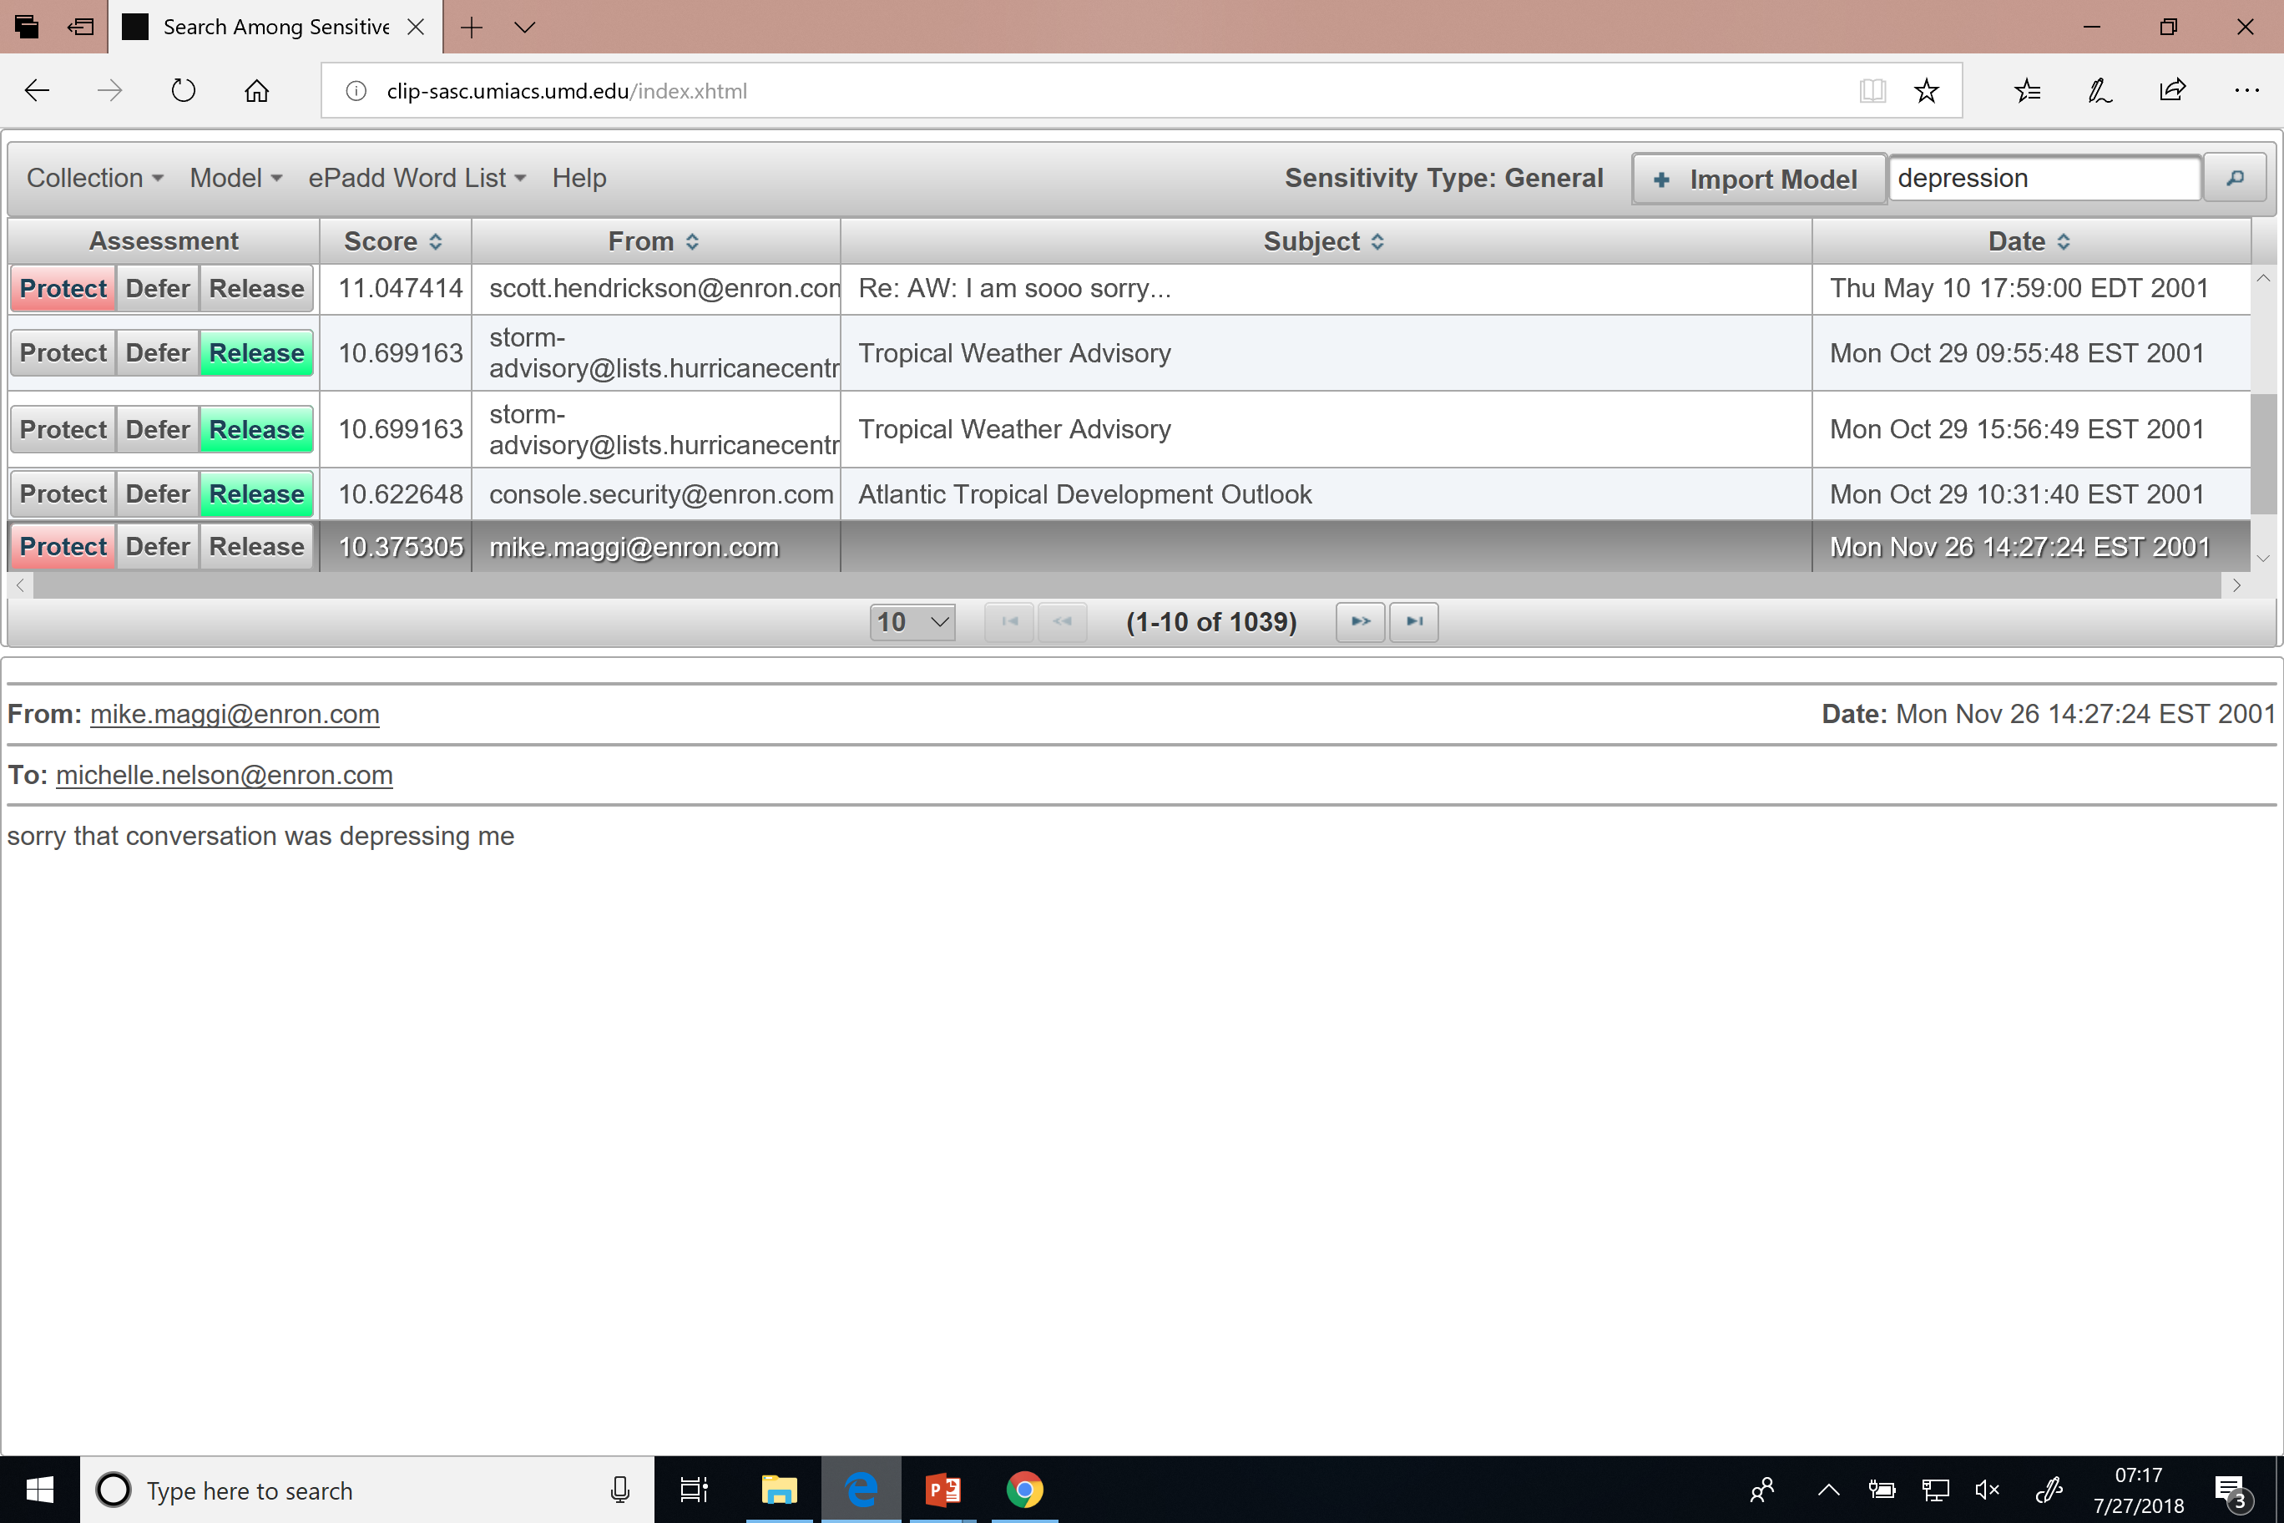
http://clip-sasc.umiacs.umd.edu/

Slide 25
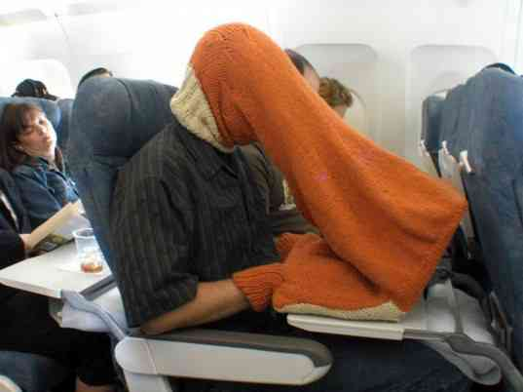
The public-private fallacy
Establishing privacy in public?
Technically possible, practically useless.

Slide 26
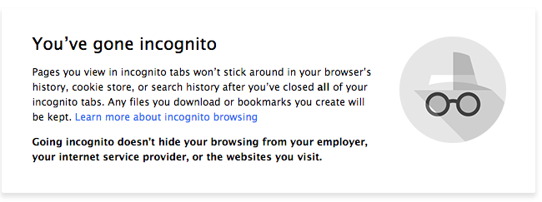
The public-private fallacy
Hiding online is even harder.
Think you’re anonymous online? You’re not.

Slide 27
So how can we manage our digital privacy (individually, as a society)?

Slide 28
Pass laws
Katz v. United States (1967)
Extend 4th Amendment to include “reasonable expectation of privacy.”
Notes:
From Wikipedia: The Fourth Amendment (Amendment IV) to the United States Constitution is the part of the Bill of Rights that prohibits unreasonable searches and seizures and requires any warrant to be judicially sanctioned and supported by probable cause.
Case: Charles Katz used a public pay phone booth to transmit illegal gambling wagers from Los Angeles to Miami and Boston. Unbeknownst to Katz, the FBI was recording his conversations via an electronic eavesdropping device attached to the exterior of the phone booth. Katz was convicted based on these recordings. He challenged his conviction, arguing that the recordings were obtained in violation of his Fourth Amendment rights. The Court of Appeals sided with the FBI because there was no physical intrusion into the phone booth itself.
Constitutional issues of the case
Does the right to privacy extend to telephone booths and other public places?
Is a physical intrusion necessary to constitute a search?
Ruling
"The Government's activities in electronically listening to and recording the petitioner's words violated the privacy upon which he justifiably relied while using the telephone booth and thus constituted a 'search and seizure' within the meaning of the Fourth Amendment." – Justice Stewart
Regardless of the location, a conversation is protected from unreasonable search and seizure under the Fourth Amendment if it is made with a “reasonable expectation of privacy”.
Wiretapping counts as a search (physical intrusion is not necessary).

Slide 29
Pass laws
Other really important privacy laws:
HIPAA (Health Insurance Portability and Accountability Act of 1996) provides data privacy and security provisions for safeguarding medical information. Requires electronic health records are properly secured.
FERPA (Family Educational Rights and Privacy Act protects the privacy of student education records. This requires written consent before student PII is released.
COPPA (Children's Online Privacy Protection Act of 1998) protects the privacy of children under 13 through additional requirements of websites that cater to young users. This is why most websites require users to be 13.

Slide 30
Pass laws
Strengths/weaknesses:
Can provide quite strong deterrence (especially under criminal law)
(good) laws are specific (to prevent abuse, enable judicious application), but privacy is heavily contextual
hard to exhaustively enumerate in advance where/when/with-what you have a reasonable expectation of privacy

Slide 31
Be obscure
What is obscurity?
The state of being hard to understand or interpret; unclear; murky
Woody Hartzog argues: when data are obscure, they are “safer.”
People may engage in data obfuscation.
For example, lying about your age when registering for a website.
Notes:
MAYBE SPLIT LECTURE HERE?
Harder to be obscure with new features, which make “stalking” easier.

Slide 32
Think about Where’s Waldo as a good example of obscurity.

Slide 33
Be obscure
So what is obscurity?
The state of being hard to understand or interpret; unclear; murky
How do I make my data more secure?
Hide it from search engines
Use privacy settings & pseudonyms
Engage in social steganography/“vaguebooking”
“Many contemporary privacy disputes are probably better classified as concern over losing obscurity.” → Think Spokeo!
Notes:
MAYBE SPLIT LECTURE HERE?
Harder to be obscure with new features, which make “stalking” easier.

Slide 34
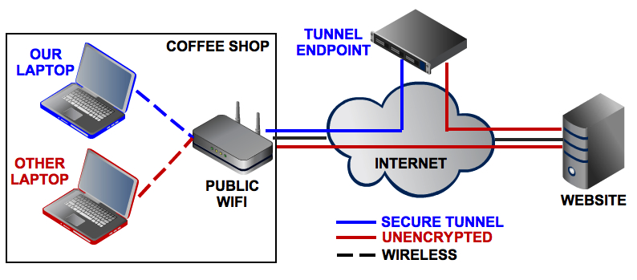
Be obscure with VPNs
VPN = virtual private network
VPNs allow you to extend a private network (e.g., your home network) to public spaces and allows greater protection and anonymity of your data.
VPNs can allow access to otherwise blocked content (e.g., censored websites in China)
Notes:
Wikipedia: A virtual private network (VPN) extends a private network across a public network, and enables users to send and receive data across shared or public networks as if their computing devices were directly connected to the private network. Applications running across the VPN may therefore benefit from the functionality, security, and management of the private network.

Slide 35
Why use VPNs?
Increased interest in fallout of new legislation allowing ISPs to sell your browsing data to third parties (see this article).
Lots of news coverage encouraging people to use VPNs since they “hide” your traffic from your ISP.
HOWEVER: VPNs are useful, but the aren’t going to “solve” the problem. They have limitations. For example:
Netflix blocks most VPNs
Your VPN could be selling your data.
VPNs Won’t Save You from Congress’ Internet Privacy Giveaway [WIRED]
Read more:
The impossible task of creating a “Best VPNs” list today [Ars Technica]
Online privacy? Forget it, even with VPN [USA TODAY]

Slide 36
Be obscure with Tor
Tor is an “anonymity network.”
From Wikipedia: “Tor directs Internet traffic through a free, worldwide, volunteer network consisting of more than seven thousand relays to conceal a user's location and usage from anyone conducting network surveillance or traffic analysis.”

Slide 37
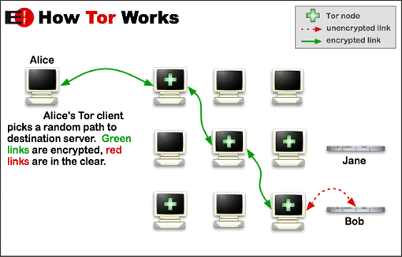
Goal: Conceal identity of users from surveillance.
Process: Multilayer encryption (hence onion metaphor), then send content through a random network of relays.
Notes:
Other computers are nodes/relays (meaning they pass Tor traffic)
Each node only has enough information to send it to another location
Every node changes information to obfuscate your identity

Slide 38
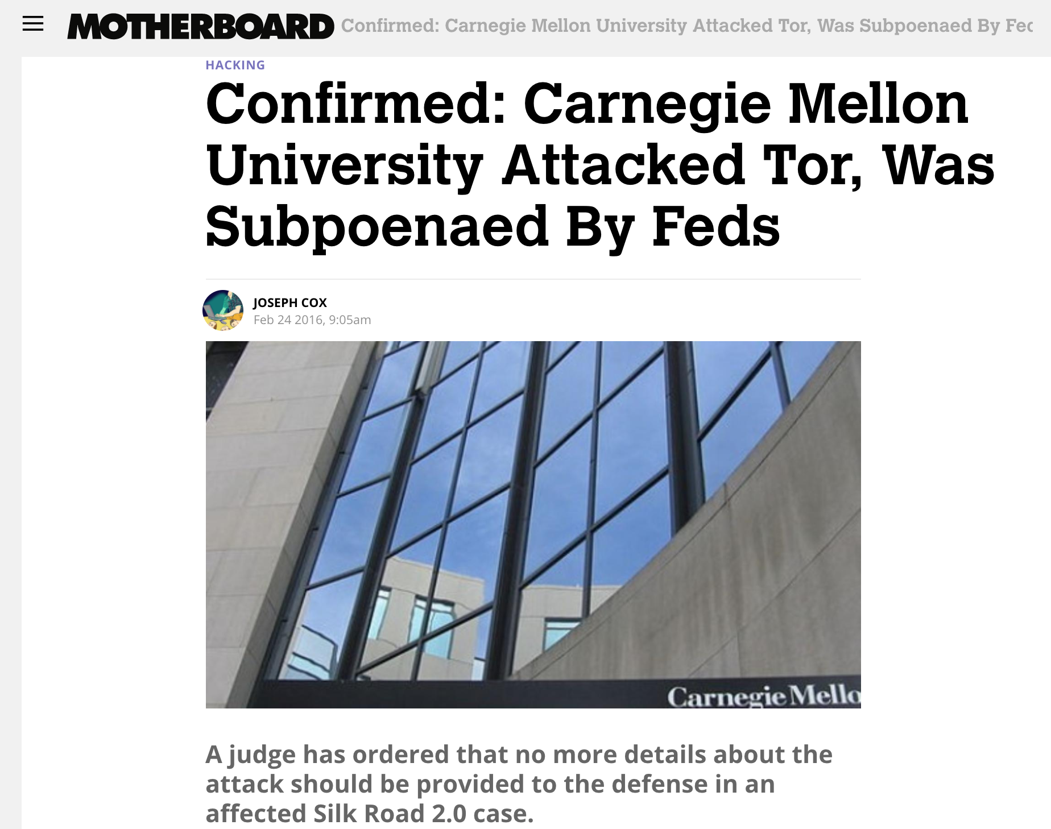
Even Tor isn’t a failsafe!

Slide 39
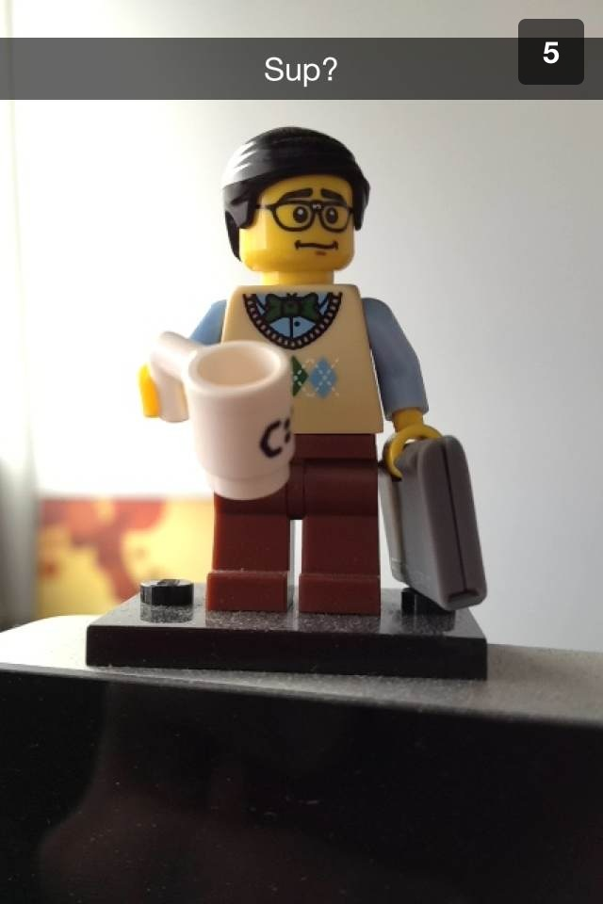
Be ephemeral
Apps highlighting ephemeral communication are becoming increasingly popular.
But are these a good substitute for other forms of communication?
See Bruce Schneier’s post on this topic.
Flickr: jessycat_techie
Notes:
Snapchat hides posts, doesn’t delete them: http://www.theguardian.com/media-network/partner-zone-infosecurity/snapchat-photos-not-deleted-hidden
How Whisper tracks “anonymous” users: http://www.theguardian.com/world/2014/oct/16/-sp-revealed-whisper-app-tracking-users

Slide 40
Be judicious… but how?
The public-private fallacy
People will sacrifice privacy & security for usability.
Companies structure their services to encourage sharing information with a wide audience.
Don’t believe me? Watch this.

Slide 41
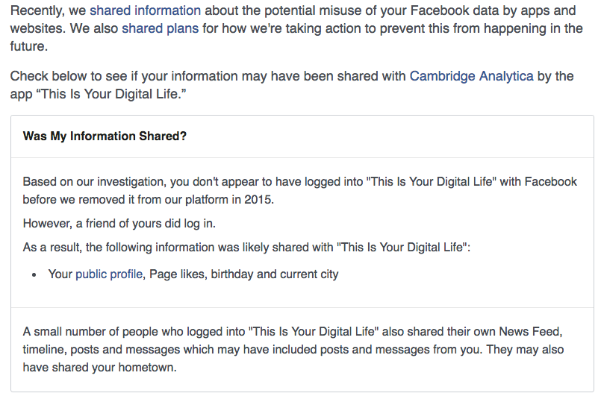

Slide 42
Be judicious… but how?
Notes:
http://bgr.com/2018/03/19/facebook-cambridge-analytica-scandal/
https://www.theguardian.com/technology/2018/mar/17/facebook-cambridge-analytica-kogan-data-algorithm

Slide 43
So how do we protect our data?
We’ll talk about that on Friday:
What counts as “me”?
Sociotechnical solutions for securing “me”

