Slide 1

Metadata
February 24, 2015
LBSC 770
Bibliographic Control

Slide 2
Two Ways of Searching
Controlled
Vocabulary
Searcher
Free-Text
Searcher
Author
Indexer
Construct query from
terms that may
appear in documents
Write the document
using terms to
convey meaning
Choose appropriate
concept descriptors
Construct query from
available concept
descriptors
Content-Based
Query-Document
Matching
Metadata-Based
Query-Document
Matching
Query Terms
Document Terms
Document Descriptors
Query Descriptors
Retrieval Status Value

Slide 3
Supporting the Search Process
Source
Selection
IR System
Query
Formulation
Query
Search
Ranked List
Selection
Indexing
Document
Index
Examination
Document
Acquisition
Collection
Delivery

Slide 4
Online Public Access Catalog (OPAC)
Known-item search
  Author, Title
Topic search
  Title, subject headings
Result display
  Sort by publication date, “relevance,” …
Navigation
  Broader/narrower headings, other editions, …
Delivery
  Call number or (digital content) direct delivery

Slide 5
Some Types of “Metadata”
Descriptive
  Content, creation process, relationships
Technical
  Format, system requirements
Administrative
  Acquisition, authentication, access rights
Preservation
  Media migration
Usage
  Display, derivative works
Adapted from
Introduction to Metadata,
Getty Information Institute (2000)

Slide 6
Metadata Sources
Automated
  Capture
  Extraction
  Classification
Manual
  Professional
  Community
  Personal

Slide 7




Aspects of Metadata
Framework
  Functional Requirements for Bibliographic Records (FRBR)
Schema (“Data Fields and Structure”)
  Dublin Core
Guidelines (“Data Content and Values”)
  Resource Description and Access (RDA)
  Library of Congress Subject Headings (LCSH)
Representation (abstract “Data Format”)
  Resource Description Framework (RDF)
Serialization (“Data Format”)
  RDF in eXtensible Markup Language (RDF/XML)
Adapted from Elings and Waibel, First Monday, (12)3, 2007

Slide 8
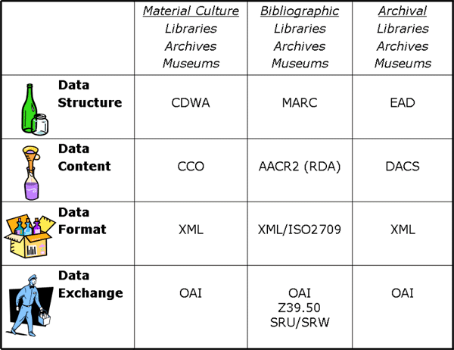
Different Description Contexts
Adapted from Elings and Waibel, First Monday, (12)3, 2007

Slide 9
Fostering Consistency
Content Standards
  Resource Description and Access (RDA)
  Describing Archives: a Content Standard (DACS)
Authority Control
  Subject Authority
  Name authority

Slide 10
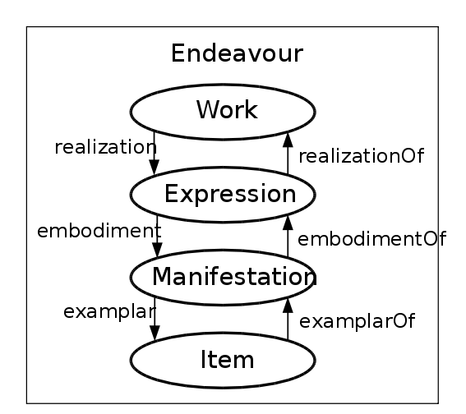
Functional Requirements for Bibliographic Records (FRBR)
Midsummer Night’s
Dream
2005 Free for All
August 23
Performance
Seat 23G

Slide 11
Aspects of Metadata
What kinds of objects can we describe?
  MARC, Dublin Core, FRBR, …
How can we convey it?
  MODS, RDF, OAI-PMH, METS
What can we say?
  LCSH, MeSH, PREMIS, …
What can we do with it?
  Discovery, description, reasoning

Slide 12
FRBR Bibliographic User Tasks
Find it
  Search (“to find”)
  Recognize (“to identify”)
  Choose (“to select”)
Serve it
  Location (“to obtain”)

Slide 13
Broader View of Metadata Uses
Have it
  Preservation (e.g., PREMIS)
  Validation
  Disposition
Find it
  Search/Recognize/Choose
  Browse (“Navigation”)
Serve it
  Persistent location
  Structure
  Surrogates
Use it
  Context
  Rights management
  User behavior capture
  Reasoning (“Semantic Web”)

Slide 14
Metadata Sources
Automated
  Capture
  Extraction
  Classification
Manual
  Professional
  Community
  Personal

Slide 15
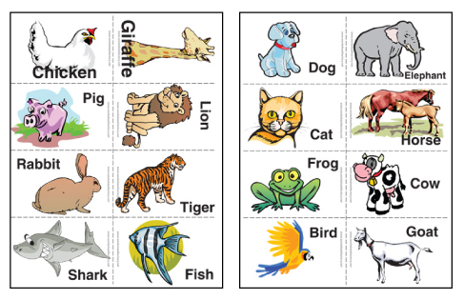
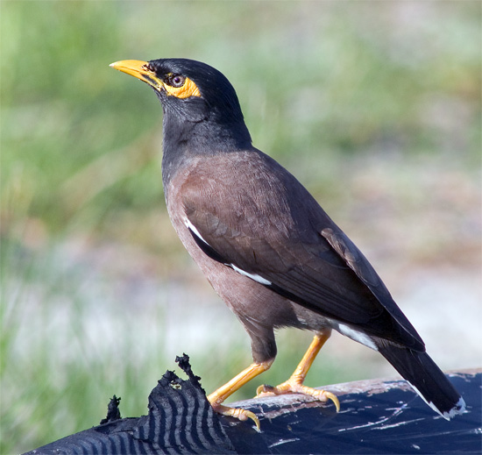

Slide 16
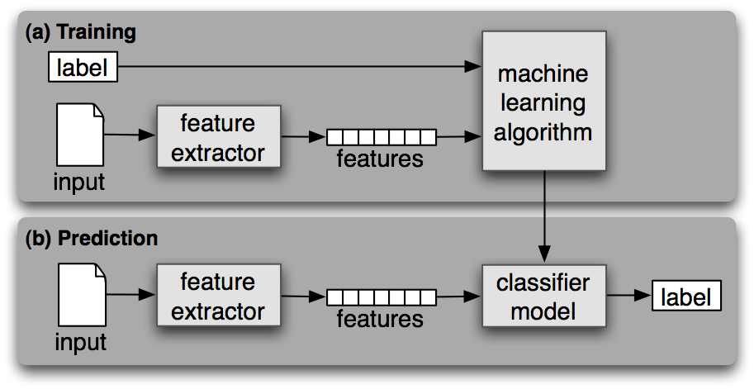
A Digital Mynah Bird
Steven Bird et al., Natural Language Processing, 2006

Slide 17
Cute Mynah Bird Tricks
Make scanned documents into e-text
Make speech into e-text
Make English e-text into Hindi e-text
Make long e-text into short e-text
Make e-text into hypertext
Make e-text into metadata
Make email into org charts
Make pictures into captions
…

Slide 18
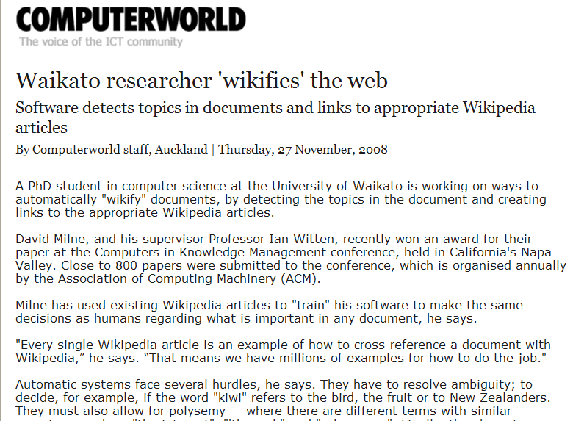

Slide 19
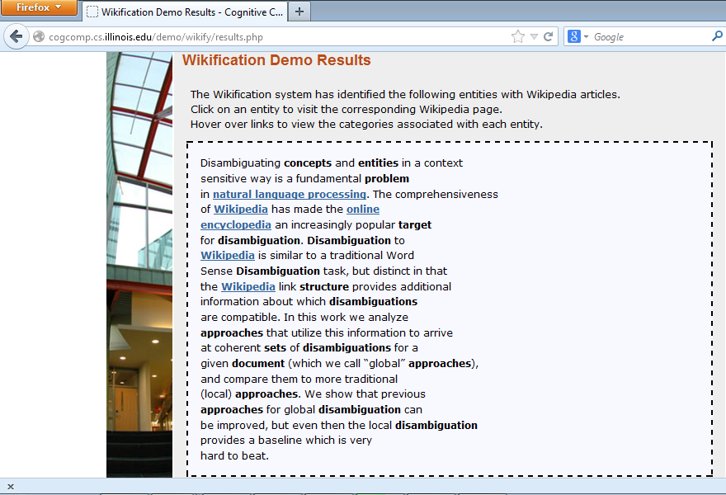
http://cogcomp.cs.illinois.edu/demo/wikify/?id=25

Slide 20
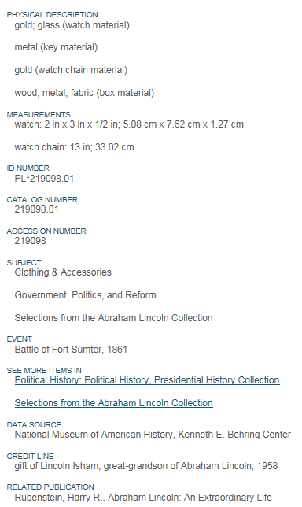
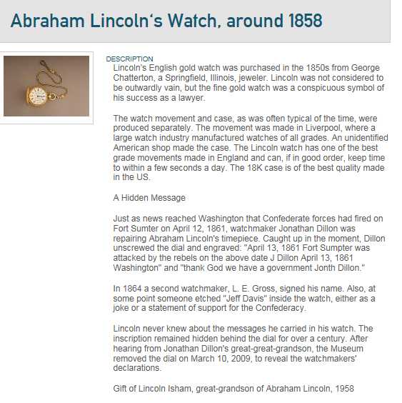
http://americanhistory.si.edu/collections/search/object/nmah_516567

Slide 21
Lincoln’s English gold watch was purchased in the 1850s from George Chatterton, a Springfield, Illinois, jeweler. Lincoln was not considered to be outwardly vain, but the fine gold watch was a conspicuous symbol of his success as a lawyer.
The watch movement and case, as was often typical of the time, were produced separately. The movement was made in Liverpool, where a large watch industry manufactured watches of all grades. An unidentified American shop made the case. The Lincoln watch has one of the best grade movements made in England and can, if in good order, keep time to within a few seconds a day. The 18K case is of the best quality made in the US.
A Hidden Message
Just as news reached Washington that Confederate forces had fired on Fort Sumter on April 12, 1861, watchmaker Jonathan Dillon was repairing Abraham Lincoln's timepiece. Caught up in …

Slide 22

NEIL A. ARMSTRONG
INTERVIEWED BY DR. STEPHEN E. AMBROSE AND DR. DOUGLAS BRINKLEY
HOUSTON, TEXAS – 19 SEPTEMBER 2001
ARMSTRONG: I'd always said to colleagues and friends that one day I'd go back to the university. I've done a little teaching before. There were a lot of opportunities, but the University of Cincinnati invited me to go there as a faculty member and pretty much gave me carte blanche to do what I wanted to do. I spent nearly a decade there teaching engineering. I really enjoyed it. I love to teach. I love the kids, only they were smarter than I was, which made it a challenge. But I found the governance unexpectedly difficult, and I was poorly prepared and trained to handle some of the aspects, not the teaching, but just the—universities operate differently than the world I came from, and after doing it—and actually, I stayed in that job longer than any job I'd ever had up to that point, but I decided it was time for me to go on and try some other things.
AMBROSE: Well, dealing with administrators and then dealing with your colleagues, I know—but Dwight Eisenhower was convinced to take the presidency of Columbia [University, New York, New York] by Tom Watson when he retired as chief of staff in 1948, and he once told me, he said, "You know, I thought there was a lot of red tape in the army, then I became a college president." He said, "I thought we used to have awful arguments in there about who to put into what position." Have you ever been with a bunch of deans when they're talking about—
ARMSTRONG: Yes. And, you know, there's a lot of constituencies, all with different perspectives, and it's quite a challenge.
http://wikipedia-miner.cms.waikato.ac.nz/demos/annotate/

Slide 23
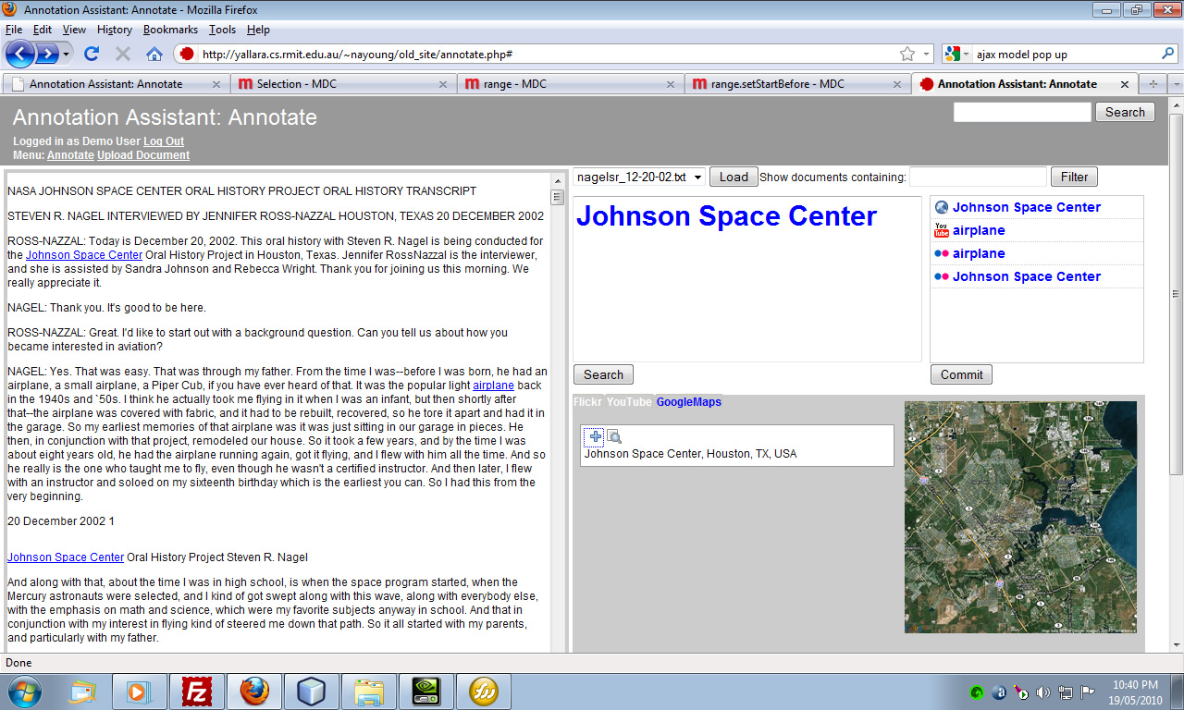
Oral History Annotation Assistant

Slide 24






After two years in the academic quagmire of Springfield Elementary, Lisa finally has a teacher that she connects with. But she soon learns that the problem with being middle-class is that
When Lisa's mother Marge Simpson went to a weekend getaway at Rancho Relaxo, …
Springfield
Bottomless Pete, Nature’s
Cruelest Mistake
per:cities_of_residence
per:alternate_names
Marge Simpson
Homer Simpson
Springfield Elementary
per:children
per:children
per:spouse
per:schools_attended
Lisa Simpson
Bart Simpson

Slide 25
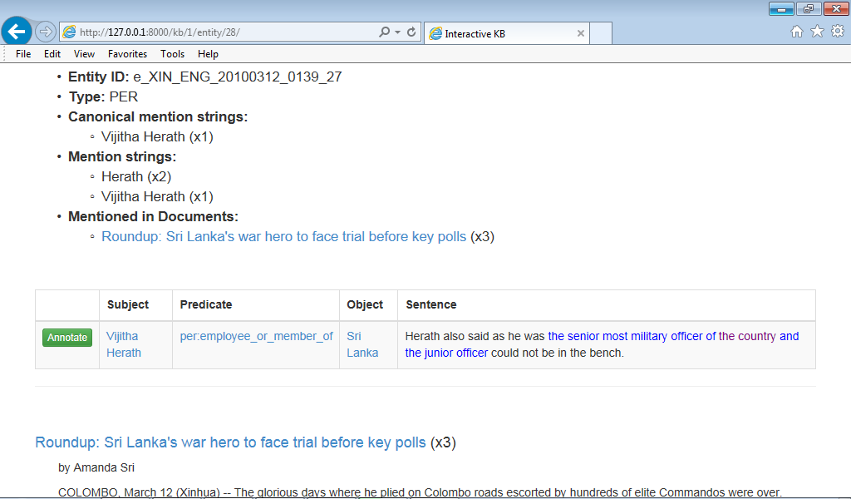
Knowledge-Base Population

Slide 26
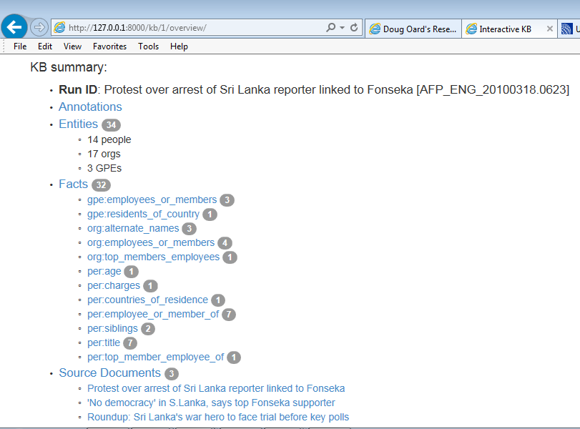

Slide 27
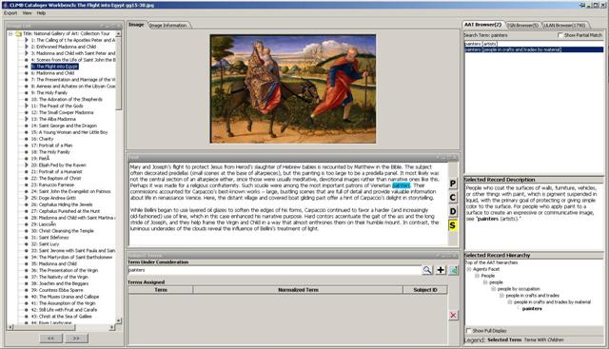
CLiMB: Metadata from Description

Slide 28
Metadata Capture:
Exchangeable Image Format (EXIF)
Time
Location
Camera manufacturer and model
Camera orientation
Exposure information (shutter speed, f stop)
Thumbnail versions
  Altering the image may not change the thumbnail!

Slide 29
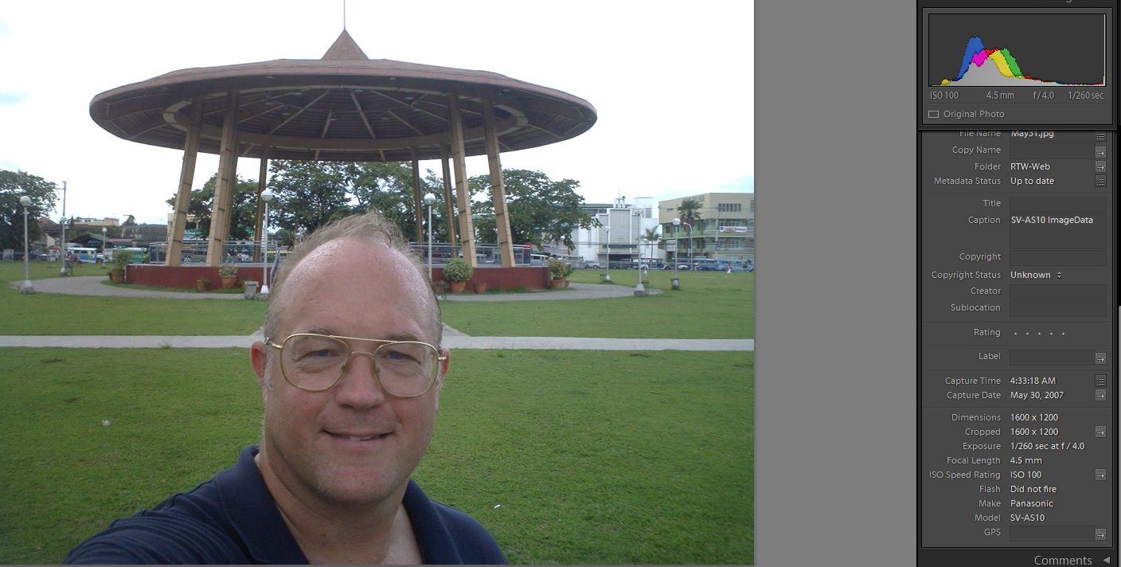
Inconsistent Metadata
http://www.umiacs.umd.edu/~oard/rtw/

Slide 30
Metadata Capture: Email
Message metadata
  Times
    Sent
    Resent
    Received
  Route
  In-reply-to
  Attachment file type
System metadata
  Folder

Slide 31
Metadata Capture:
Windows File System (NTFS)
Time file created (or copied)
  Most recent one; optionally “journaled”
Time file content changed (or made changeable)
  Most recent one; optionally “journaled”
Time file renamed (or moved)
  Most recent one
Time file metadata created or changed
  Most recent one
Time file accessed (content or metadata)
  Most recent one; optionally disabled

Slide 32
Metadata Capture:
Microsoft Word
Author
Title
Dates (may not agree with file system)
  Created
  Modified
  Accessed
  Printed
  Each tracked change

Slide 33
Metadata Capture: User Behavior
Minimum Scope
Segment
Object
Class
Examine
View
Select
Listen
Retain
Print
Bookmark
Save
Purchase
Subscribe
Delete
Behavior Category
Reference
Copy / paste
Forward
Quote
Reply
Link
Cite
Annotate
Mark up
Tag
Organize
Publish
Create
Type
Edit

Slide 34
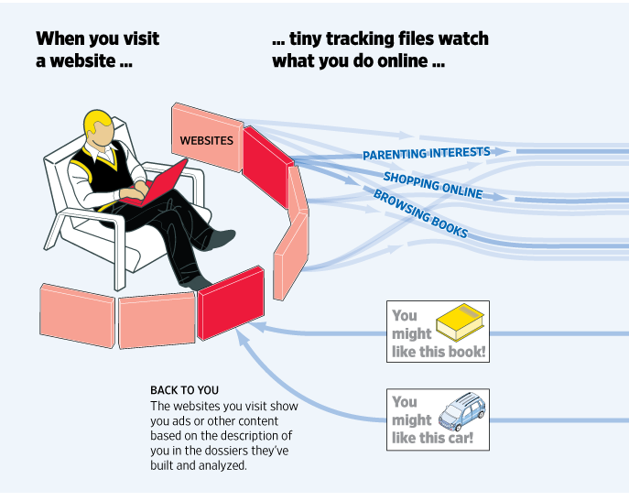
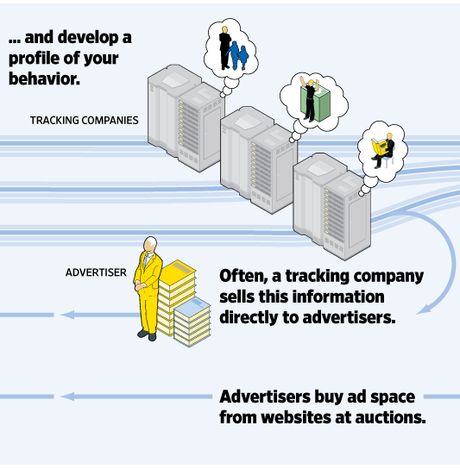
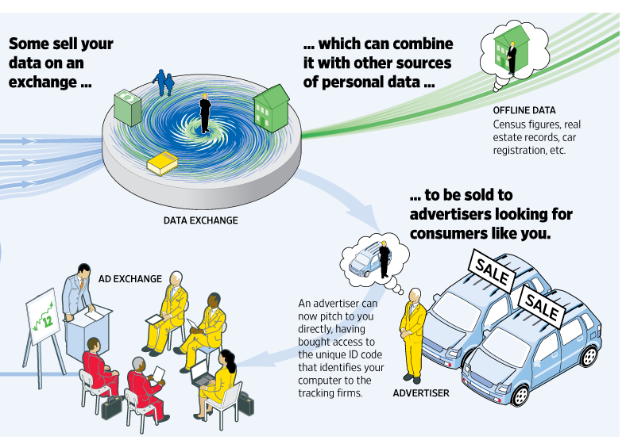
Exploiting Behavioral Metadata
http://wsj.com/wtk

Slide 35
Metadata Extraction:
Named Entity “Tagging”
Machine learning techniques can find:
  Location
  Extent
  Type
Two types of features are useful
  Orthography
    e.g., Paired or non-initial capitalization
  Trigger words
    e.g., Mr., Professor, said, …

Slide 36
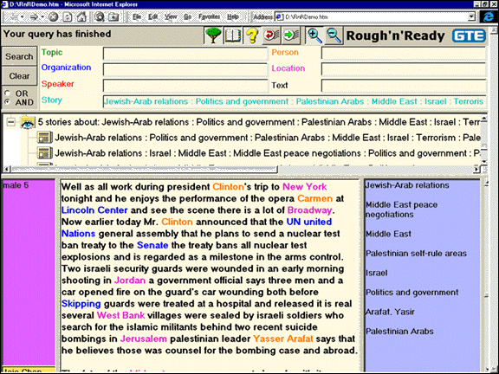

Slide 37
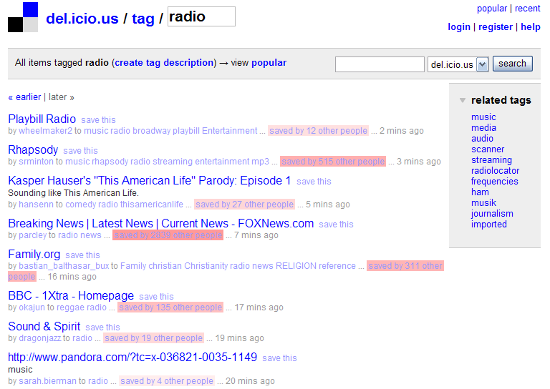
Community Metadata:
“Folksonomies”

Slide 38
Community Metadata:
Games With a Purpose
van Ahn and Dabbish, CHI 2004

Slide 39
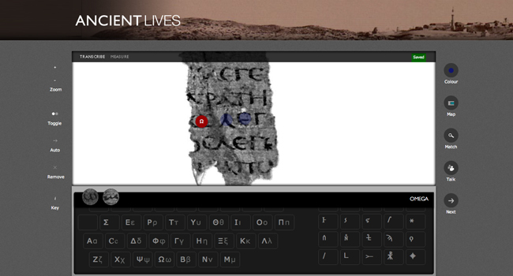
Community Metadata:
Crowdsourcing

Slide 40
Sources of File Type Metadata
Capture:
  MyDocument.xls
  Attachment MIME type
Extraction
  “Magic bytes”
Classification
  Machine learning on byte sequences
Manual
  Mechanical Turk

Slide 41
Metadata Challenges
Balancing cost and benefit
Accommodating dynamic factors
  Content
  Location
Reuse for unanticipated purposes
Remaining interpretable in the far future

Slide 42
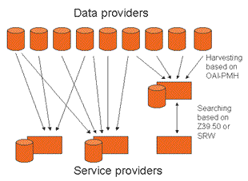
Open Archives Initiative-
Protocol for Metadata Harvesting
(OAI-PMH)

Slide 43
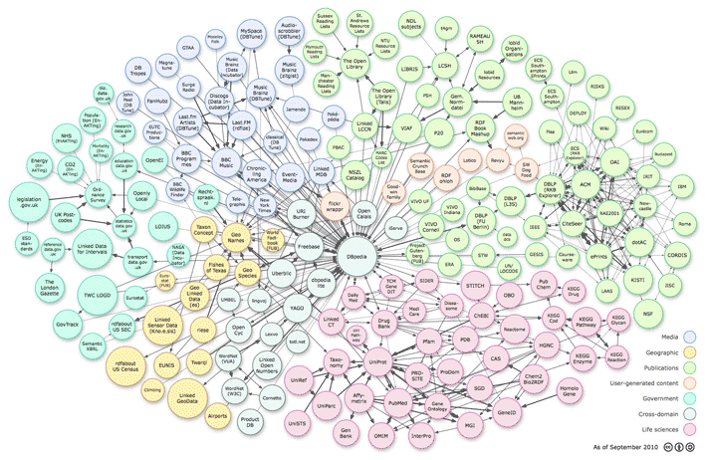
Linked Open Data

Slide 44
Web Ontology Language (OWL)
<owl:Class rdf:about="http://dbpedia.org/ontology/Astronaut">
<rdfs:label xml:lang="en">astronaut</rdfs:label>
<rdfs:label xml:lang="de">Astronaut</rdfs:label>
<rdfs:label xml:lang="fr">astronaute</rdfs:label>
<rdfs:subClassOf
rdf:resource="http://dbpedia.org/ontology/Person">
</rdfs:subClassOf>
</owl:Class>

Slide 45

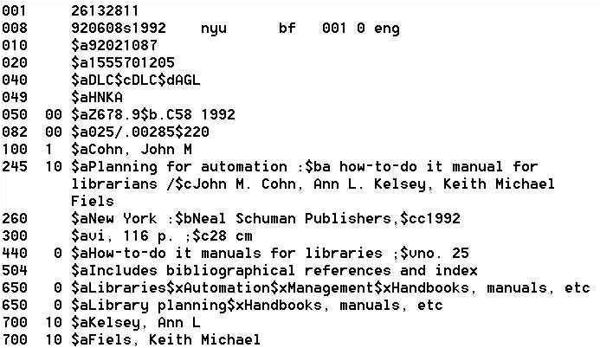



Deconstructing MARC
Sally McCallum, September, 2012

Slide 46
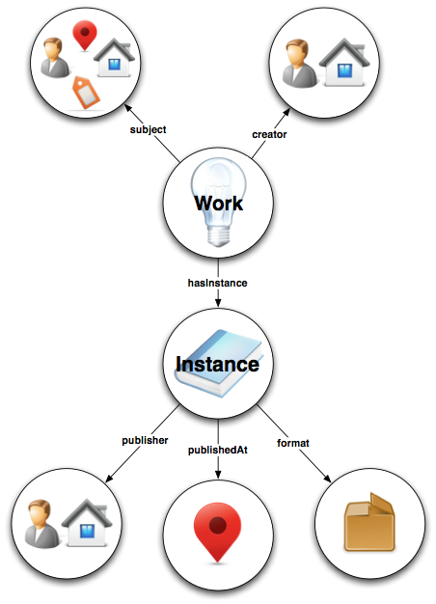
Bibliographic Framework Initiative
(BIBFRAME)
http://bibframe.org

Slide 47
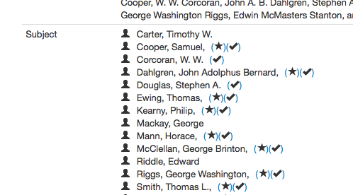
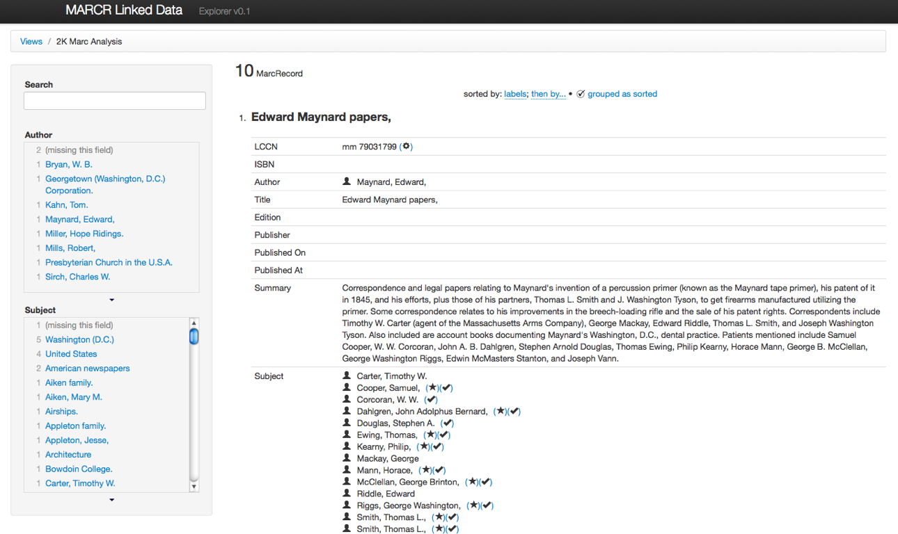

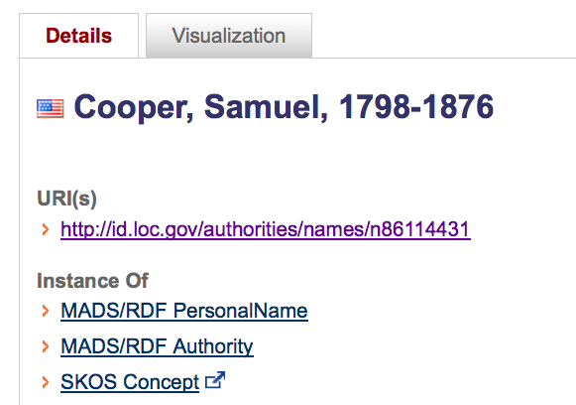
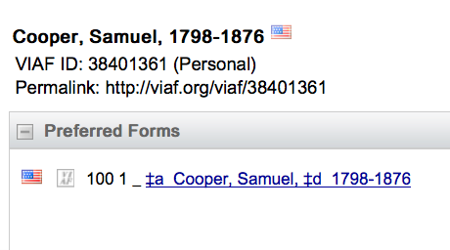

Slide 48
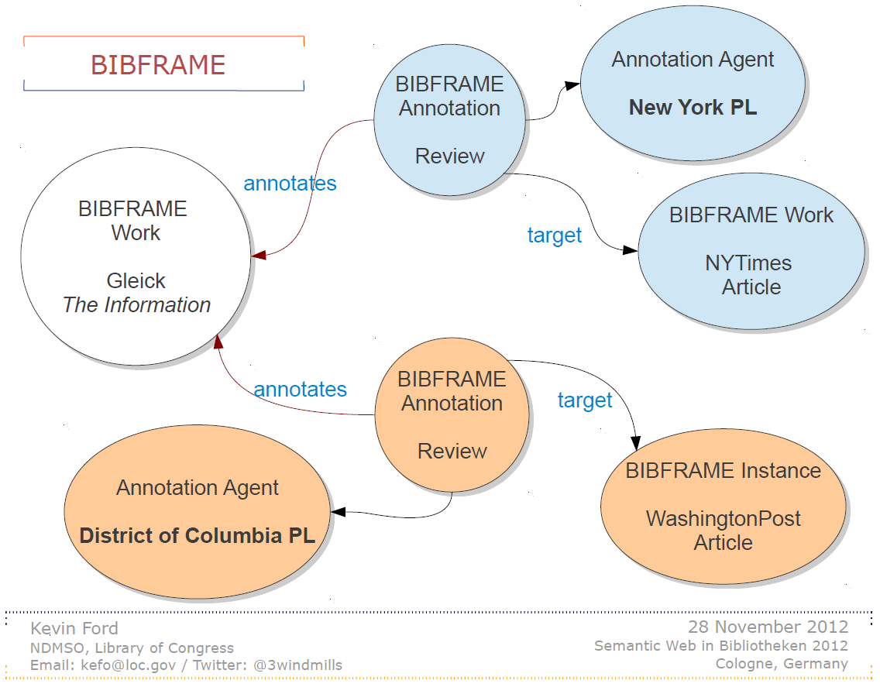

Slide 49
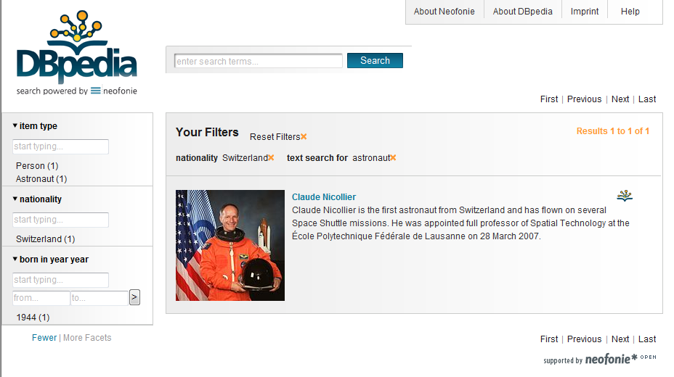
“Semantic Web” Search

Slide 50
FRBR Bibliographic User Tasks
Find it
  Search (“to find”)
  Recognize (“to identify”)
  Choose (“to select”)
Serve it
  Location (“to obtain”)

Slide 51
FRBR Entity Types
Subject-Only Entities
  (abstract) Concepts
  (tangible) Objects
  (any kind of) Places
  Events
Subject or Responsibility Entities
  Persons
  “Corporate” Bodies (~any kind of organization)
  Families (technically, only in FRAD)
Product Entities
  Works, Expressions, Manifestations, Items

Slide 52
Work
Expression
Manifestation
Item
is owned by
Person
is produced by
Family
is realized by
is created by
Corporate Body
many
Notes:
52
52
Let’s now move on to relationships for the Group 2 entities: person, family, and corporate body.
You see the relationships with the Group 1 entities in this picture:
work is created by a person, family, or corporate body
expression is realized by a person, family, or corporate body
manifestation is produced by a person, family, or corporate body
item is owned by a person, family, or corporate body.
The names of these Group 2 entities are controlled when they are used as access points in bibliographic records.
In the future we expect to see the names linked to descriptions of the resources and the links would indicate the specific type of relationship.

Slide 53
Work
The idea or impression in the mind of its creator
  Completely abstract, no physical form
What all forms, presentations, publications, or performances of a work have in common
  Romeo & Juliet
  Homer’s Odyssey
  Debussy’s Syrinx

Slide 54
Expression (Realization)
A work formulated into an ordered presentation
When a work takes a form
  Can be notational, aural, kinetic, etc.
Excludes aspects of form not integral to the work
  Font, layout, etc. (with some exceptions)
Attributes: Form, Language

Slide 55
Manifestation
Physical embodiment of an expression
  The level usually described via cataloging
Set of physical objects that bear the same:
  intellectual content (expression), and
  physical form (item)
May have one or many items
  Mona Lisa, Gone with the Wind, …
Attributes
  Format, Physical medium, Manufacturer

Slide 56
Item
Instance of a manifestation
  A thing!
Attributes:
  Owned by, Location, Condition

Slide 57
Family of Works
Equivalent
Derivative
Descriptive
Free
Translation
Review
Microform
Reproduction
Edition
Summary
Casebook
Simultaneous
“Publication”
Abridged
Edition
Abstract
Dramatization
Digest
Novelization
Criticism
Screenplay
Copy
Libretto
Revision
Illustrated
Edition
Evaluation
Change of Genre
Exact
Reproduction
Parody
Translation
Expurgated
Edition
Annotated
Edition
Imitation
Variations or Versions
Same Style or
Thematic Content
Facsimile
Arrangement
Commentary
Reprint
Slight
Modification
Adaptation
Original Work - Same Expression
Same Work –
New Expression
New Work
Cataloging Rules Cut-Off Point
RDA for Georgia, 2011
Notes:
57
This picture shows a continuum of the relationships within a family of works as represented in manifestations <click> moving from left to right following this red arrow On the left <click> are those that are equivalent content, that are from the same expression of the same work. Once we introduce a change to the content, like a translation, <click> we have a new expression of the same work - and as we make further changes to the content we move further to the right, farther away from the original work. These are derivative expressions of the same work. Once that derivation crosses the <click> “magic line” of becoming more of the work of another person or corporate body, we consider it a new work, but it is part of the family of related works, even when the content moves on to be only describing <click> a work in the family at the right end of this continuum. Works in a descriptive relationship can also be said to be in a subject relationships, because the subject of those works is another work – as with a commentary on a work.
The ability to inform the user of these related works ties back to the ** collocating and finding functions of a catalog. We need to show users the pathways to related materials. The FRBR model reminds us of these important relationships that we should reflect in our catalogs and resource discovery systems for our users.

Slide 58
Dublin Core
Goals:
  Easily understood, implemented and used
  Broadly applicable to many applications
Approach:
  Intersect several standards (e.g., MARC)
  Suggest only “best practices” for element content
Implementation:
  Initially 15 optional and repeatable “elements”
    Refined using a growing set of “qualifiers”
  Now extended to 22 elements

Slide 59
Dublin Core Elements (version 1.1)
Content
Title
Subject [LCSH, MeSH, …]
Description
Type
Coverage [spatial, temporal, …]
Related resource
Rights
Instantiation
Date [Created, Modified, Copyright, …]
Format
Language
Identifier [URI, Citation, …]
Responsibility
Creator
Contributor
Source
Publisher

Slide 60
Resource Description Framework
XML schema for describing resources
Can integrate multiple metadata standards
  Dublin Core, P3P, PICS, vCARD, …
Dublin Core provides a XML “namespace”
  DC Elements are XML “properties
    DC Refinements are RDF “subproperties”
  Values are XML “content”

Slide 61
Dublin Core in RDF XML
<rdf:RDF
xmlns:rdf="http://www.w3.org/1999/02/22-rdf-syntax-ns#"
xmlns:dc="http://purl.org/dc/elements/1.1/">
<rdf:Description
rdf:about="http://media.example.com/audio/guide.ra">
<dc:creator>Rose Bush</dc:creator>
<dc:title>A Guide to Growing Roses</dc:title>
<dc:description>Describes process for planting and nurturing
different kinds of rose bushes.</dc:description>
<dc:date>2001-01-20</dc:date>
</rdf:Description>
</rdf:RDF>

Slide 62
FRBR Bibliographic User Tasks
Find it
  Search (“to find”)
  Recognize (“to identify”)
  Choose (“to select”)
Serve it
  Location (“to obtain”)

Slide 63
Resource Description & Access (RDA)
RDA metadata describes entities associated with a resource to help users perform the following tasks:
  Find information on that entity and on resources associated with the entity
  Identify: confirm that the entity described corresponds to the entity sought, or to distinguish between two or more entities with similar names, etc.
  Clarify the relationship between two or more such entities, or to clarify the relationship between the entity described and a name by which that entity is known
  Understand why a particular name or title, or form of name or title, has been chosen as the preferred name or title for the entity

Slide 64
Authority Control
Unify references to the same entity (synonyms)
  Samuel Clemens, Mark Twain
Distinguish references to different entities (homonyms)
  Michael Jordan (basketball), Michael Jordan (computers)
Establish “access points”
  Canonical and variant forms, to better support “find it” tasks

Slide 65
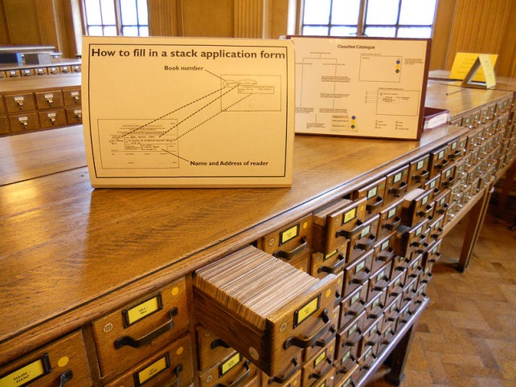
Access Points
Originally designed for card catalogs
  One card for every “authorized” access point
Four types “dictionary” catalog access points
  Title (uniform titles)
  Author (name authority)
  Subject (controlled vocabulary)
  Series
Other things can serve a similar purpose
  Call number (shelf order)
  “Keywords” (full-text search)

Slide 66
Classification
Classification
  A system for organizing knowledge
Notation
  Expressing the classification in a systematic way

Slide 67
Library of Congress Subject Headings
Controlled vocabulary for subject access points
  Most commonly applied to books and serials
Used when a subject describes ≥20% of the work
Choose the most specific appropriate headings
  But if more than 3 subtopics, choose a broader heading

Slide 68
LCSH Subdivisions
Topical
  Archaeology – Methodology
Form
    Archaeology – Fiction
Chronological
    Archaeology – History – 18th century
Geographic
    Archaeology – Egypt

Slide 69
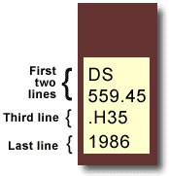
Library of Congress Classification
Book title: Uncensored War: The Media and Vietnam
Author: Daniel C. Hallin
Call Number: DS559.46 .H35 1986
The first two lines describe the subject of the book.
DS559.45 = Vietnamese Conflict
The third line often represents the author's last name.
H = Hallin
The last line represents the date of publication.
D History
DS1-937 History of Asia
DS520-560.72 Southeast Asia
DS556-559.93 Vietnam. Annam
DS557-559.9 Vietnamese Conflict
After other initial consonants for the second letter: use number: |  | a 3 | e 4 | i 5 | o 6 | r 7 | u 8 | y 9
For expansion for the letter: use number: |  | a-d 3 | e-h 4 | i-l 5 | m-o 6 | p-s 7 | t-v 8 | w-z 9
http://www.usg.edu/galileo/skills/unit03/libraries03_04.phtml

Slide 70
The World Is Flat (in LCC)
    HM846 .F74 2005
H Social sciences
HM Sociology
HM831 Social change – Causes
HM846 Technological Innovations. Technology.
.F74 Cutter number for Friedman, Thomas

Slide 71
The World Is Flat (in Dewey)
303.4833
300 Social science
300 Social sciences, sociology, & anthropology
303 Social processes
303.4 Social change
303.48 Causes of change
303.483 Development of science and technology
303.4833 Communication (Information technology)

Slide 72
Functional Requirements for Authority Data (FRAD)
Name
  Canonical form for display to users
Identifier
  Canonical form for use by systems
Controlled access points
  Forms that can be used as a basis for access
Rules
  For creating access points
Agency
  Organization responsible for creating access points

Slide 73
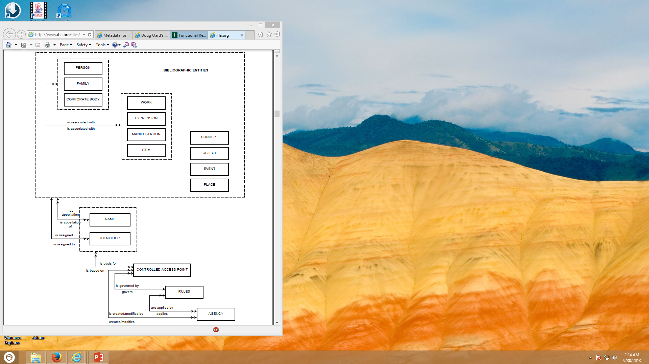
Functional Requirements for Authority Data
IFLA, 2013

Slide 74
FRBR Bibliographic User Tasks
Find it
  Search (“to find”)
  Recognize (“to identify”)
  Choose (“to select”)
Serve it
  Location (“to obtain”)

Slide 75
FRAD Authority Control User Tasks
Searcher tasks
  Find
  Identify
Authority control tasks
  Contextualize
  Justify

Slide 76
Metadata Encoding and Transmission Standard (METS)
Descriptive metadata (e.g., subject, author)
Administrative metadata (e.g., rights, provenance)
Technical metadata (e.g., resolution, color space)
Behavior (which program can render this?)
Structural map (e.g., page order)
  Structural links (e.g., Web site navigation links)
Files (the raw data)
Root (meta-metadata)

Slide 77
The character ‘A’
ASCII encoding: 7 bits used per character
  0 1 0 0 0 0 0 1 = 65 (decimal)
  0 1 0 0 0 0 0 1 = 41 (hexadecimal)
  0 1 0 0 0 0 0 1 = 101 (octal)
Number of representable character codes:
  2⁷ = 128
Some codes are used as “control characters”
  e.g. 7 (decimal) rings a “bell” (these days, a beep) (“^G”)

Slide 78
ASCII
| 0 NUL | 32 SPACE | 64 @ | 96 ` |
| 1 SOH | 33 ! | 65 A | 97 a |
| 2 STX | 34 " | 66 B | 98 b |
| 3 ETX | 35 # | 67 C | 99 c |
| 4 EOT | 36 $ | 68 D | 100 d |
| 5 ENQ | 37 % | 69 E | 101 e |
| 6 ACK | 38 & | 70 F | 102 f |
| 7 BEL | 39 ' | 71 G | 103 g |
| 8 BS | 40 ( | 72 H | 104 h |
| 9 HT | 41 ) | 73 I | 105 i |
| 10 LF | 42 * | 74 J | 106 j |
| 11 VT | 43 + | 75 K | 107 k |
| 12 FF | 44 , | 76 L | 108 l |
| 13 CR | 45 - | 77 M | 109 m |
| 14 SO | 46 . | 78 N | 110 n |
| 15 SI | 47 / | 79 O | 111 o |
Widely used in the U.S.
  American Standard Code for Information Interchange
  ANSI X3.4-1968
| 16 DLE | 48 0 | 80 P | 112 p |
| 17 DC1 | 49 1 | 81 Q | 113 q |
| 18 DC2 | 50 2 | 82 R | 114 r |
| 19 DC3 | 51 3 | 83 S | 115 s |
| 20 DC4 | 52 4 | 84 T | 116 t |
| 21 NAK | 53 5 | 85 U | 117 u |
| 22 SYN | 54 6 | 86 V | 118 v |
| 23 ETB | 55 7 | 87 W | 119 w |
| 24 CAN | 56 8 | 88 X | 120 x |
| 25 EM | 57 9 | 89 Y | 121 y |
| 26 SUB | 58 : | 90 Z | 122 z |
| 27 ESC | 59 ; | 91 [ | 123 { |
| 28 FS | 60 < | 92 \ | 124 | |
| 29 GS | 61 = | 93 ] | 125 } |
| 30 RS | 62 > | 94 ^ | 126 ~ |
| 31 US | 64 ? | 95 _ | 127 DEL |
Notes:
7

Slide 79
The Latin-1 Character Set
ISO 8859-1 8-bit characters for Western Europe
  French, Spanish, Catalan, Galician, Basque, Portuguese, Italian, Albanian, Afrikaans, Dutch, German, Danish, Swedish, Norwegian, Finnish, Faroese, Icelandic, Irish, Scottish, and English
Printable Characters, 7-bit ASCII
Additional Defined Characters, ISO 8859-1
Notes:
8

Slide 80
Other ISO-8859 Character Sets
-2
-6
-3
-7
-4
-8
-5
-9
Notes:
9

Slide 81
East Asian Character Sets
More than 256 characters are needed
  Two-byte encoding schemes (e.g., EUC) are used
Several countries have unique character sets
  GB in Peoples Republic of China, BIG5 in Taiwan, JIS in Japan, KS in Korea, TCVN in Vietnam
Many characters appear in several languages
  Research Libraries Group developed EACC
    Unified “CJK” character set for USMARC records
Notes:
10

Slide 82
Unicode
Single code for all the world’s characters
  ISO Standard 10646
Separates “code space” from “encoding”
  Code space extends Latin-1
    The first 256 positions are identical
  UTF-7 encoding will pass through email
    Uses only the 64 printable ASCII characters
  UTF-8 encoding is designed for disk file systems
Notes:
11

Slide 83
Limitations of Unicode
Produces larger files than Latin-1
Fonts may be hard to obtain for some characters
Some characters have multiple representations
  e.g., accents can be part of a character or separate
Some characters look identical when printed
  But they come from unrelated languages
Encoding does not define the “sort order”
Notes:
12

Slide 84
Machine-Readable Catalog (MARC)

Slide 85
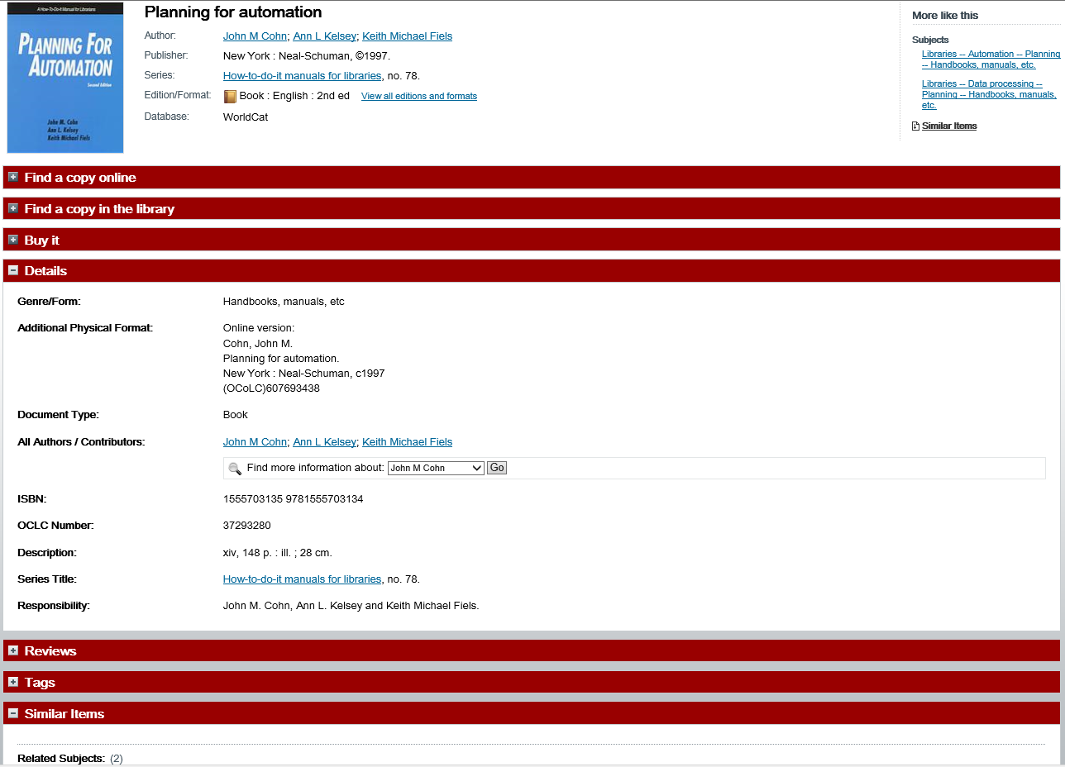

Slide 86
History of Structured Documents
Early standards were “typesetting languages”
  NROFF, TeX, LaTeX, SGML
HTML was developed for the Web
  Too specialized for other uses
Specialized standards met other needs
  Change tracking in Word, annotating manuscripts, …
XML seeks to unify these threads
  One standard format for printing, viewing, processing

Slide 87
eXtensible Markup Language (XML)
SGML was too complex
HTML was too simple
Goals for XML
  Easily adapted to specific tasks
    Rendering Web pages
    Encoding metadata
    “Semantic Web”
  Easily created
  Easily processed
  Easily read
  Concise

Slide 88
Some XML Applications
Text Encoding Initiative
  For adding annotation to historical manuscripts
  http://www.tei-c.org/
Encoded Archival Description
  To enhance automated processing of finding aids
  http://www.loc.gov/ead/
Metadata Encoding and Transmission Standard
  Bundles many types of metadata
  http://www.loc.gov/standards/mets/

Slide 89
Even More Uses of XML …
MARCXML – MARC in XML
MODS – Metadata Object Description Schema
CML – Chemical Markup Language
CellML – biological models
BSML – bioinformatic sequences
MAGE-ML – MicroArray Gene Expression
XSTAR – for archaeological research
AML – astronomy markup language
SportsML – for sharing sports data

Slide 90

Really Simple Syndication (RSS)
<?xml version="1.0"?>
<rss version="2.0">
<channel>
<title>Lift Off News</title>
<link>http://liftoff.msfc.nasa.gov/</link>
<description>Liftoff to Space Exploration.</description>
<language>en-us</language>
<pubDate>Tue, 10 Jun 2003 04:00:00 GMT</pubDate>
<lastBuildDate>Tue, 10 Jun 2003 09:41:01 GMT</lastBuildDate>
<docs>http://blogs.law.harvard.edu/tech/rss</docs>
<generator>Weblog Editor 2.0</generator>
<managingEditor>editor@example.com</managingEditor>
<webMaster>webmaster@example.com</webMaster>
<ttl>5</ttl>
<item>
<title>Star City</title>
<link>http://liftoff.msfc.nasa.gov/news/2003/news-starcity.asp</link>
<description>How do Americans get ready to work with Russians aboard the International Space Station? They take
a crash course in culture, language and protocol at Russia's Star City.</description>
<pubDate>Tue, 03 Jun 2003 09:39:21 GMT</pubDate>
<guid>http://liftoff.msfc.nasa.gov/2003/06/03.html#item573</guid>
</item>
</channel>
</rss>
See example at http://www.nytimes.com/services/xml/rss/

Slide 91
XML: A Family of Standards
Definition: DTD or Schema
  Known types of entities with “labels”
  Defines part-whole and is-a relationships
Markup: XML
  “Tags” regions of text with labels
Presentation: XSLT
  Specifies transformations
  Commonly used to create a HTML display

Slide 92
Resource Description Framework
XML schema for describing resources
Can integrate multiple metadata standards
  Dublin Core, P3P, PICS, vCARD, …
Dublin Core provides a XML “namespace”
  DC Elements are XML “properties
    DC Refinements are RDF “subproperties”
  Values are XML “content”

Slide 93
XML Namespaces
<?xml version="1.0"?>
<rdf:RDF
xmlns:rdf="http://www.w3.org/1999/02/22-rdf-syntax-ns#"
xmlns:rss="http://purl.org/rss/1.0/"
xmlns:dc="http://purl.org/dc/elements/1.1/">
<rss:channel rdf:about="http://www.xml.com/xml/news.rss">
<rss:title>XML.com</rss:title>
<rss:link>http://xml.com/pub</rss:link>
<dc:description>
XML.com features a rich mix of
information and services for the XML community.
</dc:description>
<dc:subject>XML, RDF, metadata, information
syndication services</dc:subject>
<dc:identifier>http://www.xml.com</dc:identifier>
<dc:publisher>O'Reilly & Associates, Inc.</dc:publisher>
<dc:rights>Copyright 2000, O'Reilly &
Associates, Inc.</dc:rights>
</rss:channel>
</rdf:RDF>
Example from http://www.xml.com/pub/a/2000/10/25/dublincore/

Slide 94
Dublin Core in RDF XML
<rdf:RDF
xmlns:rdf="http://www.w3.org/1999/02/22-rdf-syntax-ns#"
xmlns:dc="http://purl.org/dc/elements/1.1/">
<rdf:Description
rdf:about="http://media.example.com/audio/guide.ra">
<dc:creator>Rose Bush</dc:creator>
<dc:title>A Guide to Growing Roses</dc:title>
<dc:description>Describes process for planting and nurturing
different kinds of rose bushes.</dc:description>
<dc:date>2001-01-20</dc:date>
</rdf:Description>
</rdf:RDF>

Slide 95
<?xml version="1.0" encoding="UTF-8"?>
<mods:mods version="3.2"
ID="MODS" xsi:schemaLocation="http://www.loc.gov/mods/v3 http://www.loc.gov/standards/mods/v3/mods-3-2.xsd"
xmlns:xsi="http://www.w3.org/2001/XMLSchema-instance" xmlns="http://www.loc.gov/mods/v3"
xmlns:xlink="http://www.w3.org/1999/xlink" xmlns:mods="http://www.loc.gov/mods/v3">
<!-- DLC-MODS Workbook version 1.2 released 6 November 2007 by University Of Tennessee Libraries Digital Library Center:
<!-- CONTENT CONTRIBUTOR: Doug Oard -->
<!-- INSTITUTION: University of Maryland -->
<!-- RECORD CREATION DATE: Fri Feb 28 2014 21:54:45 GMT-0500 (Eastern Standard Time) -->
<!-- FILENAME: iconf14-oard.xml -->
<mods:titleInfo><mods:title>It's About Time</mods:title>
<mods:subTitle>Projecting Temporal Metadata for Historically Significant Recordings</mods:subTitle></mods:titleInfo>
<mods:name authority="LCNAF" type="personal"><mods:namePart type="family">Oard</mods:namePart>
<mods:namePart type="given">Douglas W.</mods:namePart></mods:name>
<mods:name authority="LCNAF" type="personal"><mods:namePart type="family">Kraus</mods:namePart>
<mods:namePart type="given">Kari</mods:namePart><mods:namePart type="termsOfAddress">Kari Michele</mods:namePart>
<mods:namePart type="date">1968-</mods:namePart></mods:name>
<mods:name type="personal"><mods:namePart type="family">Wu</mods:namePart>
<mods:namePart type="given">Min</mods:namePart></mods:name><mods:typeOfResource>text</mods:typeOfResource>
<mods:originInfo><mods:dateCreated encoding="w3cdtf" keyDate="yes">2014-03-05</mods:dateCreated>
<mods:dateIssued encoding="w3cdtf">2014</mods:dateIssued><mods:place>
<mods:placeTerm authority="iso1366" type="code">US</mods:placeTerm>
</mods:place><mods:publisher>iConference 2014, Berlin, Germany</mods:publisher>
</mods:originInfo><mods:language><mods:languageTerm authority="iso639-2b" type="code">eng</mods:languageTerm>
<mods:languageTerm type="text">English</mods:languageTerm></mods:language>
<mods:physicalDescription><mods:internetMediaType>application/pdf</mods:internetMediaType>
<mods:digitalOrigin>born digital</mods:digitalOrigin></mods:physicalDescription>
<mods:abstract>Twentieth century audio recordings and motion pictures are important sources, both for scholarly analysis and for
public history. In some cases, important metadata has not reached the collecting institutions along with the materials, which are
now in need of richer description. This paper describes a novel technique for determining the date and time on which a recording
was made based on analysis of incidentally captured traces of small variations in the electric power supply at the time the
recording was made.</mods:abstract>
<mods:subject authority="lcsh"><mods:topic>Metadata</mods:topic></mods:subject>
<mods:identifier type="uri">http://terpconnect.umd.edu/~oard/pdf/iconference14.pdf</mods:identifier>
<mods:location><mods:url usage="primary display">http://terpconnect.umd.edu/~oard/pdf/iconference14.pdf</mods:url></mods:location>
<mods:recordInfo><mods:languageOfCataloging><mods:languageTerm authority="iso639-2b" type="code">eng</mods:languageTerm>
<mods:languageTerm type="text">English</mods:languageTerm></mods:languageOfCataloging></mods:recordInfo></mods:mods>

